Slide 1
PER rescue Data

Slide 2
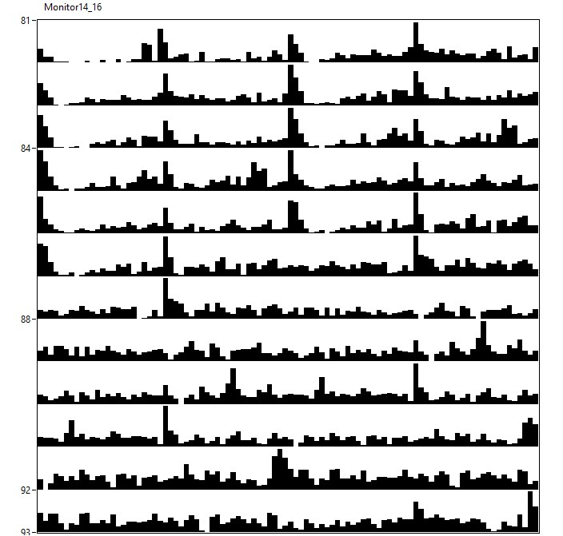
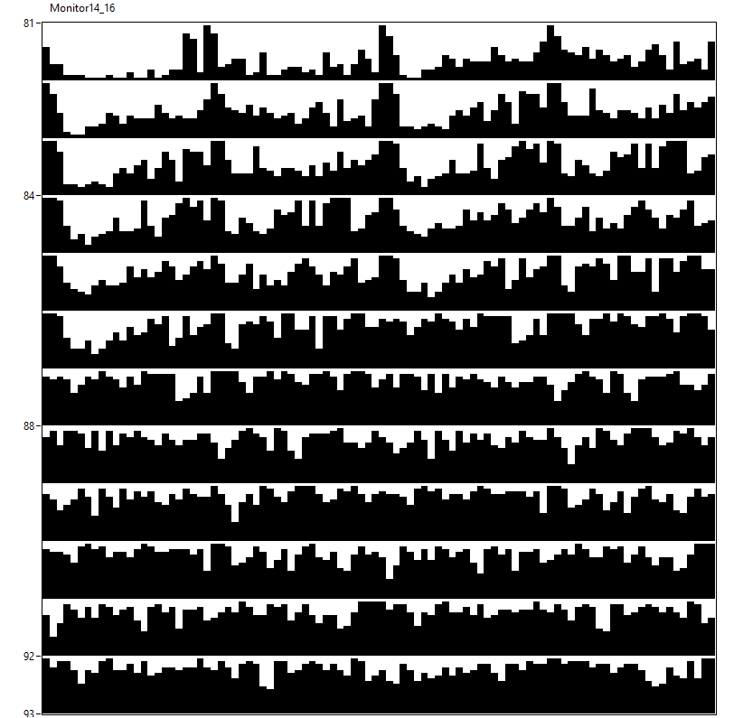
15♂ per[01]w[*];;UASper[16]/+ [12hL:12hD]₅>[DD]₇ 23°C
M14

Slide 3
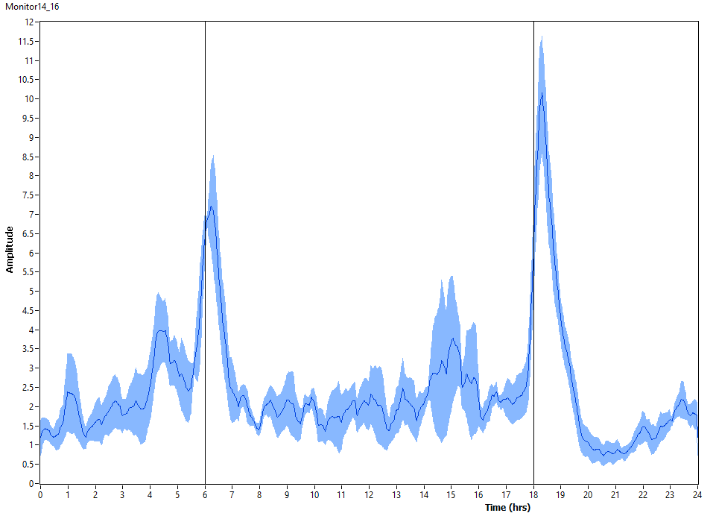
15♂ per[01]w[*];;UASper[16]/+ [12hL:12hD]₅ 23°C
M14

Slide 4
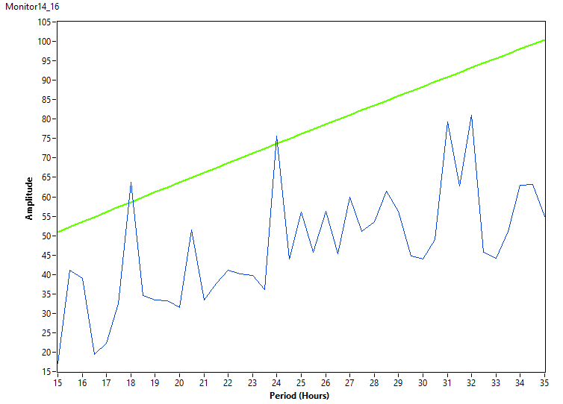
15♂ per[01]w[*];;UASper[16]/+ [DD]₇ 23°C
M14

Slide 5
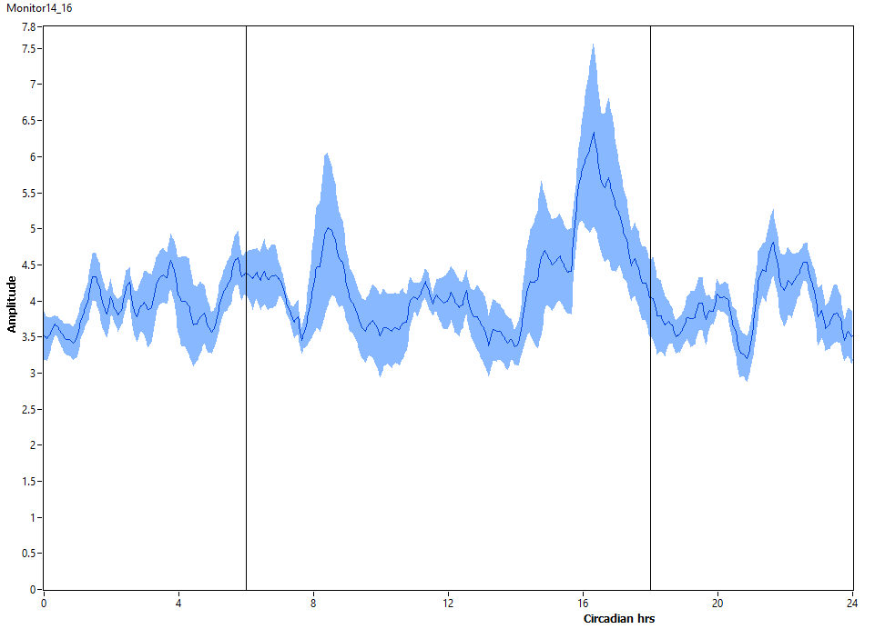
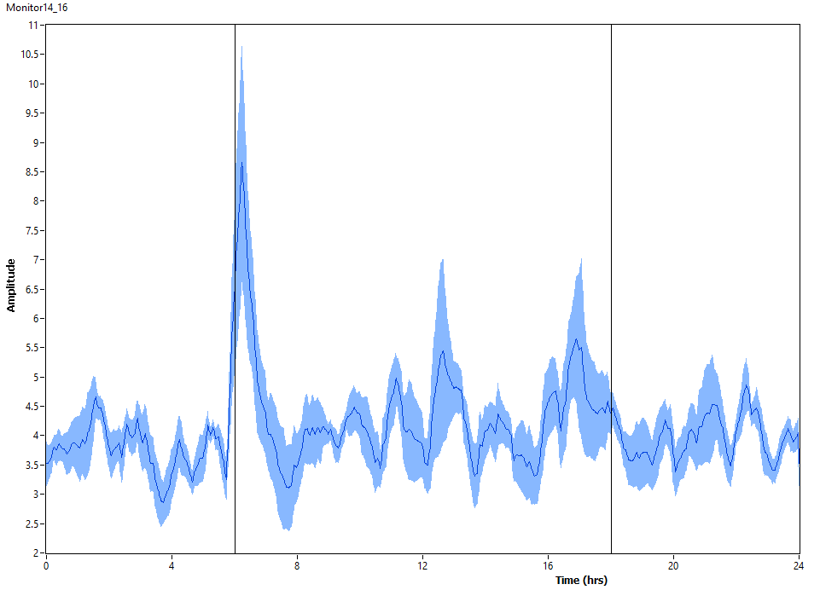
15♂ per[01]w[*];;UASper[16]/+ [DD]₇ 23°C
M14

Slide 6
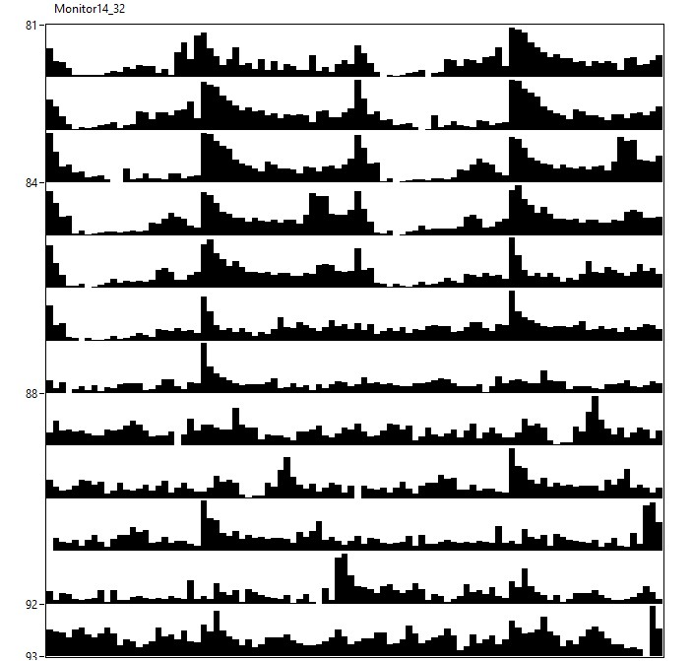
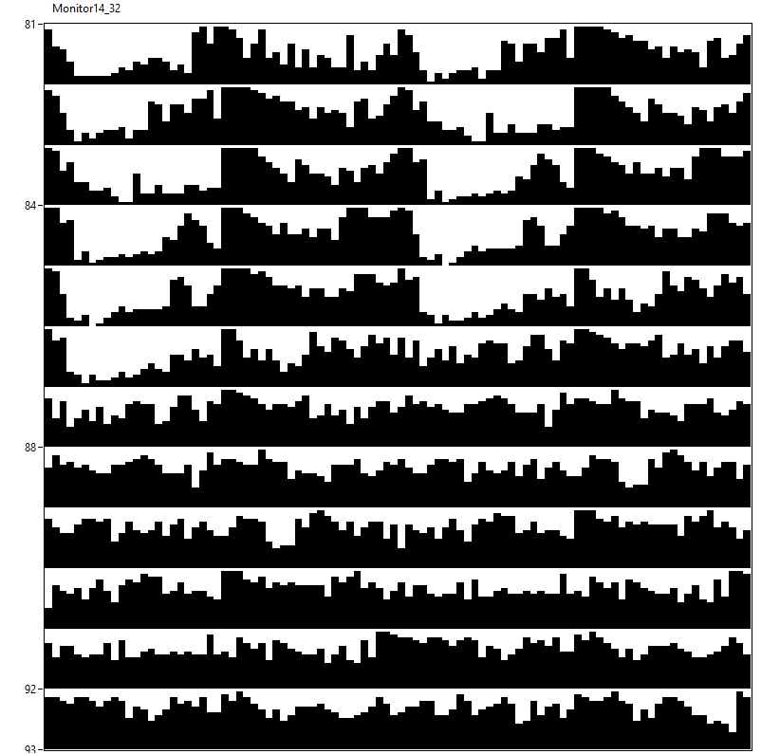
16♀ per[01]w[*];;UASper[16]/+ [12hL:12hD]₅>[DD]₇ 23°C
M14

Slide 7
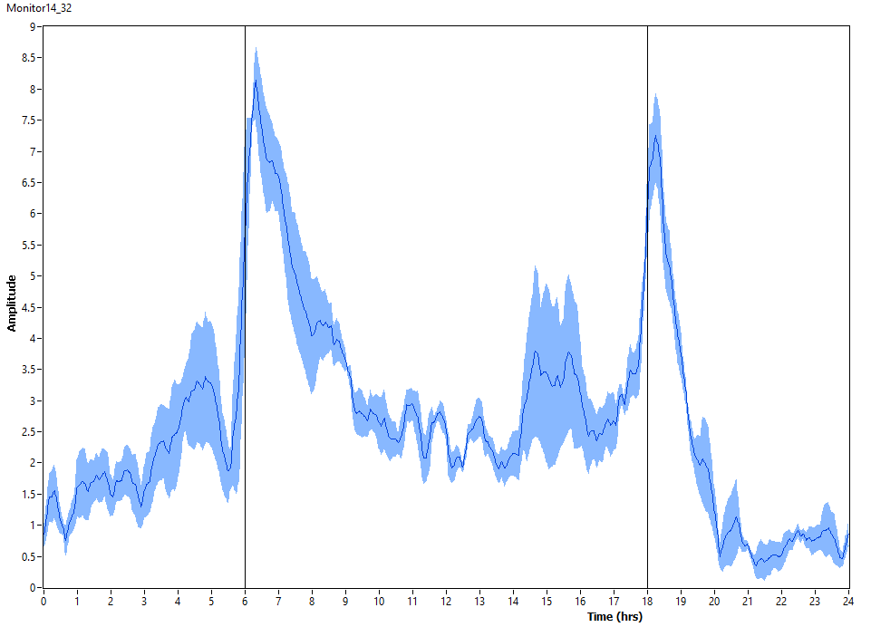
16♀ per[01]w[*];;UASper[16]/+ [12hL:12hD]₅ 23°C
M14

Slide 8
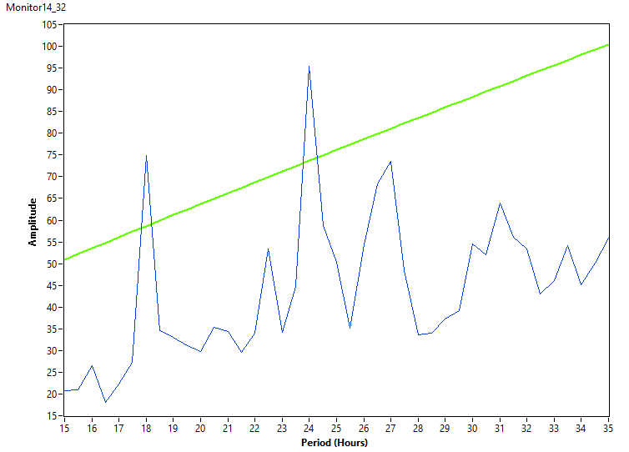
16♀ per[01]w[*];;UASper[16]/+ [DD]₇ 23°C
M14

Slide 9
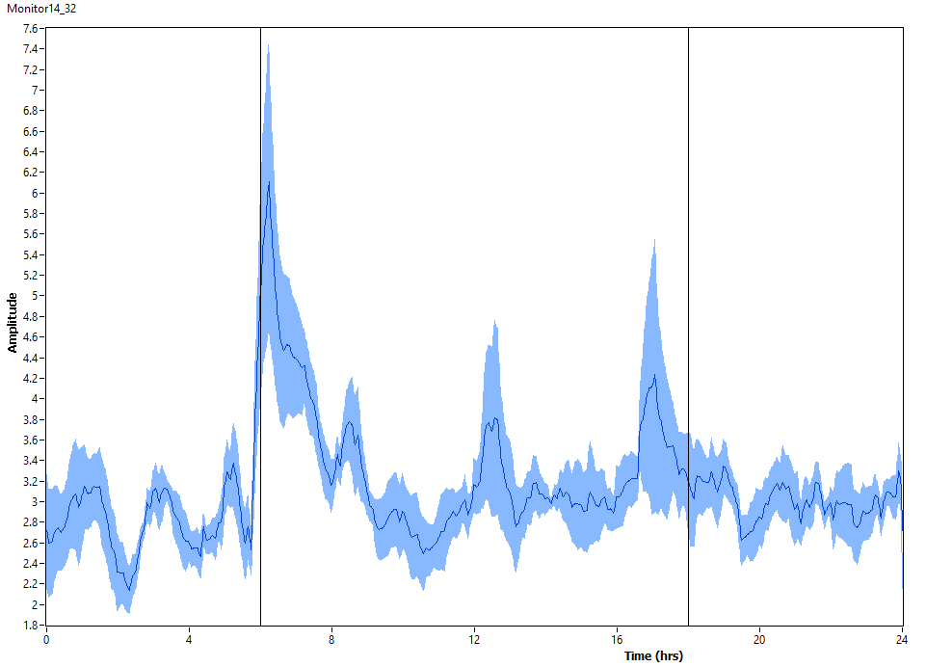
16♀ per[01]w[*];;UASper[16]/+ [DD]₇ 23°C
M14

Slide 10
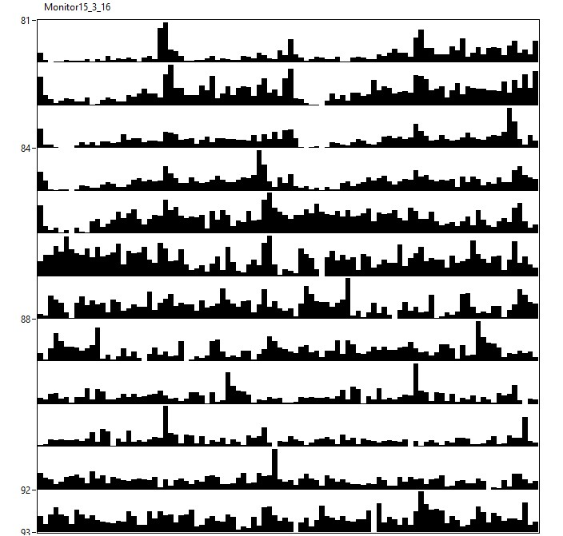
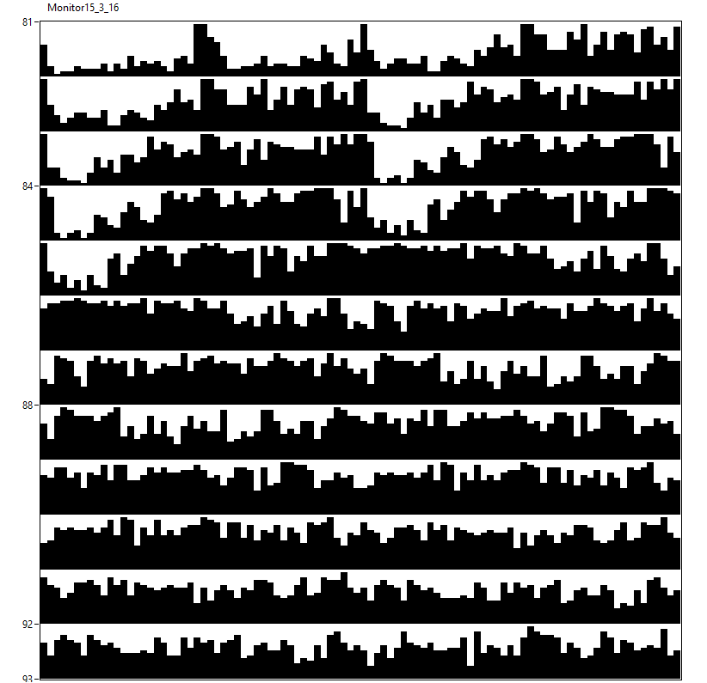
15♂ per[01]w[*];;UASper[16]/+ [12hR:12hD]₅>[RR]₇ 23°C
M15

Slide 11
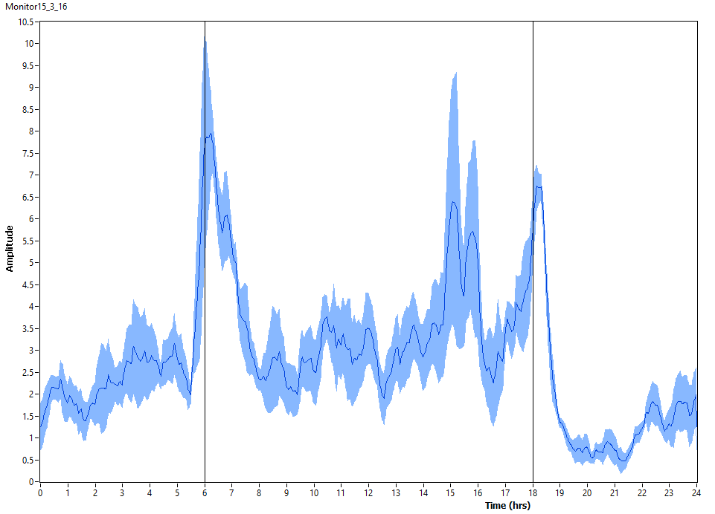
15♂ per[01]w[*];;UASper[16]/+ [12hR:12hD]₅ 23°C
M15

Slide 12
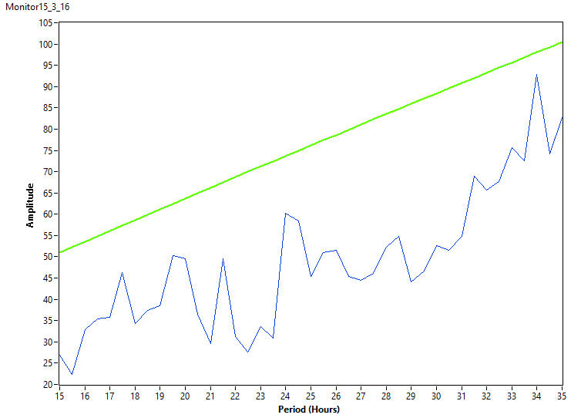
15♂ per[01]w[*];;UASper[16]/+ [RR]₇ 23°C
M15

Slide 13
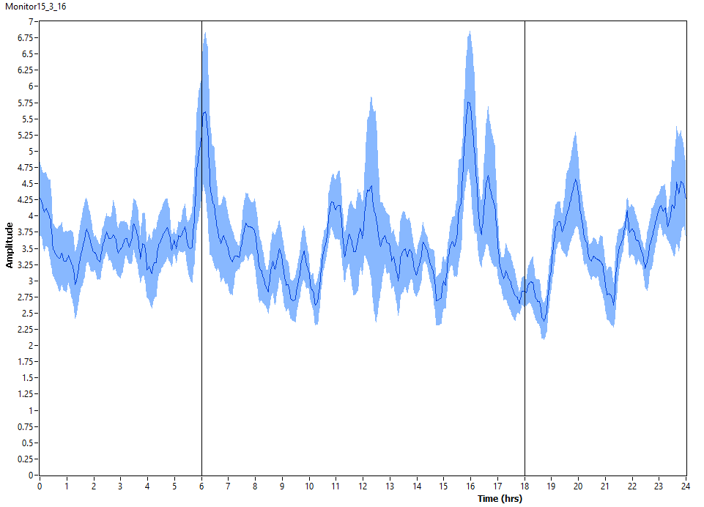
15♂ per[01]w[*];;UASper[16]/+ [RR]₇ 23°C
M15

Slide 14
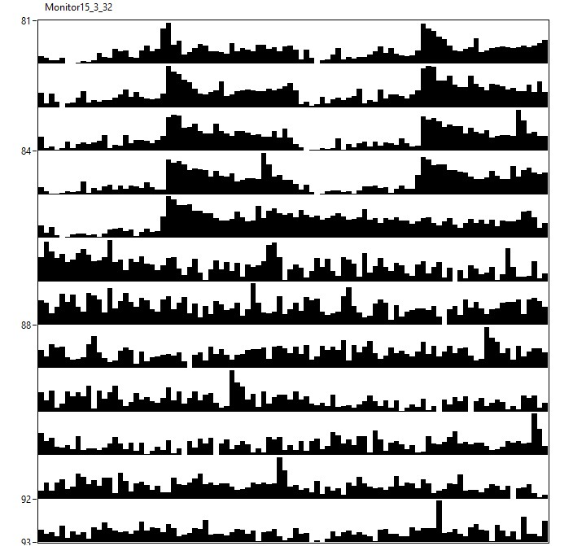
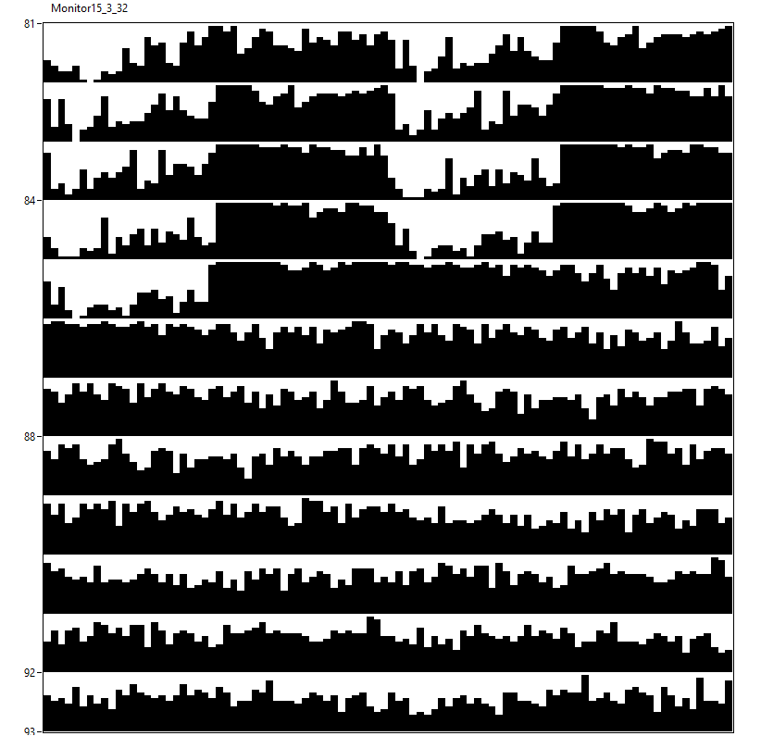
15♀ per[01]w[*];;UASper[16]/+ [12hR:12hD]₅>[RR]₇ 23°C
M15

Slide 15
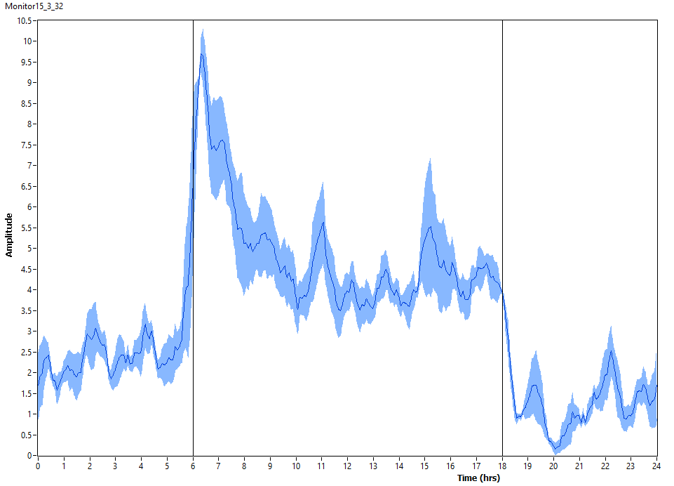
15♀ per[01]w[*];;UASper[16]/+ [12hR:12hD]₅ 23°C
M15

Slide 16
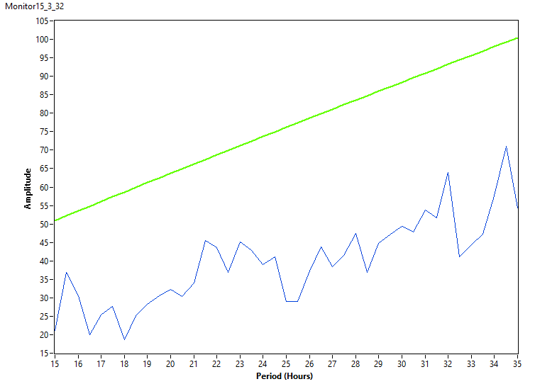
15♀ per[01]w[*];;UASper[16]/+ [RR]₇ 23°C
M15

Slide 17
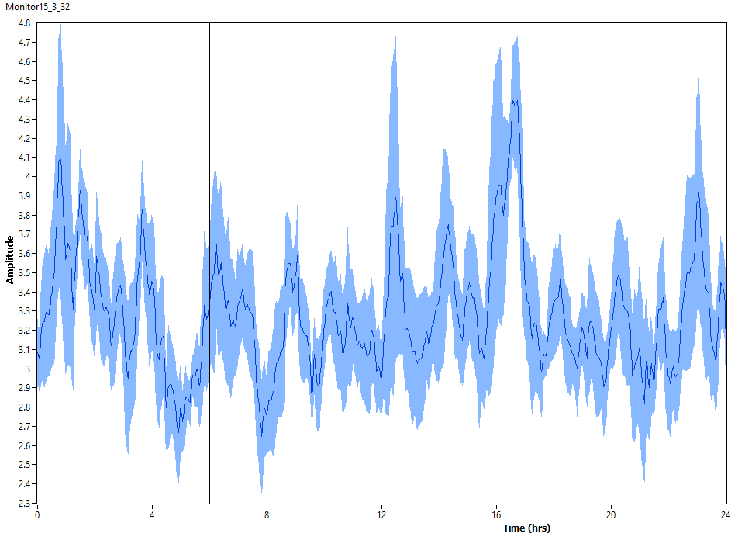
15♀ per[01]w[*];;UASper[16]/+ [RR]₇ 23°C
M15

Slide 18
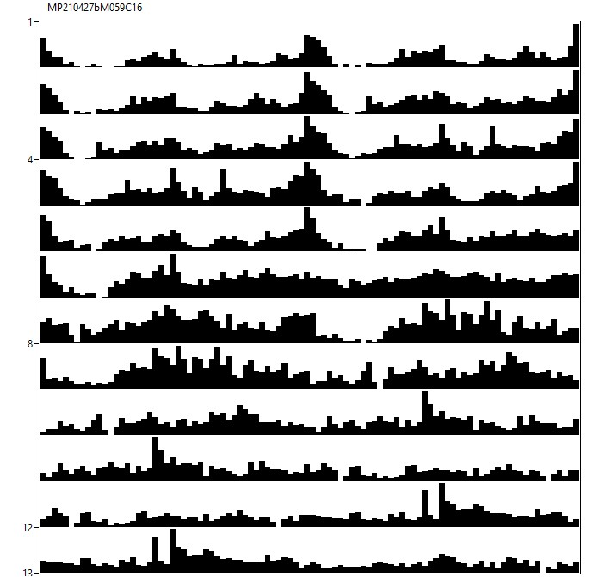
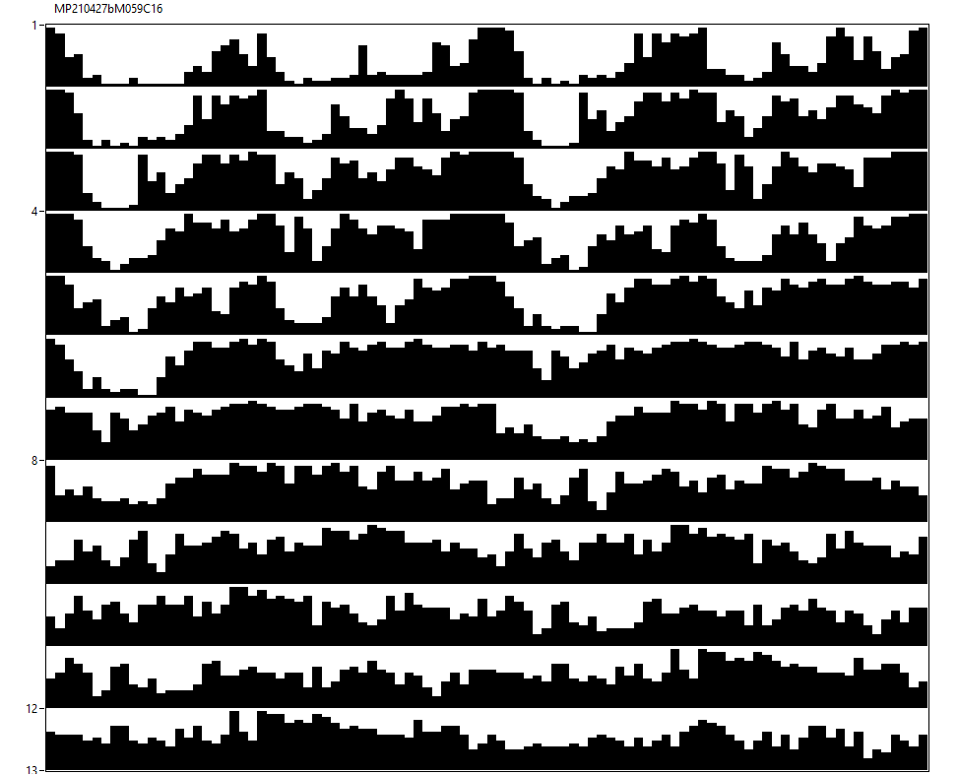
23♂ per[01]w[*]/Y;MB122B-Gal4/+;UASper[16]/+ [12hL:12hD]₅>[DD]₇ 23°C
M56+59

Slide 19
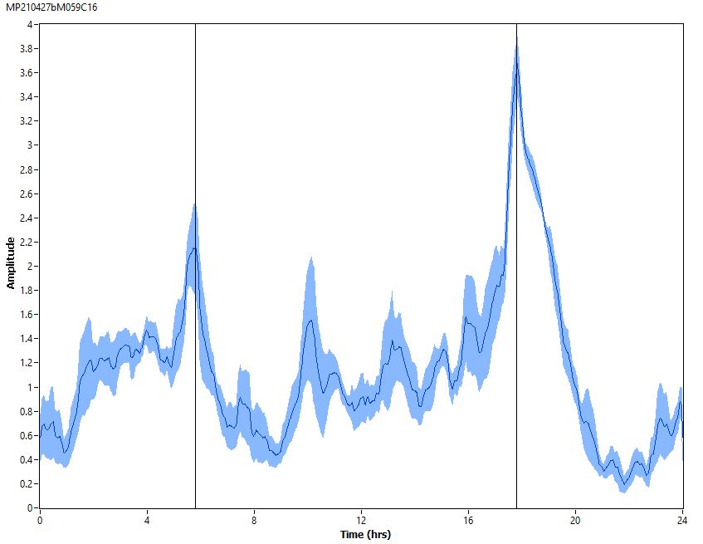
23♂ per[01]w[*]/Y;MB122B-Gal4/+;UASper[16]/+ [12hL:12hD]₅ 23°C
M56+59

Slide 20
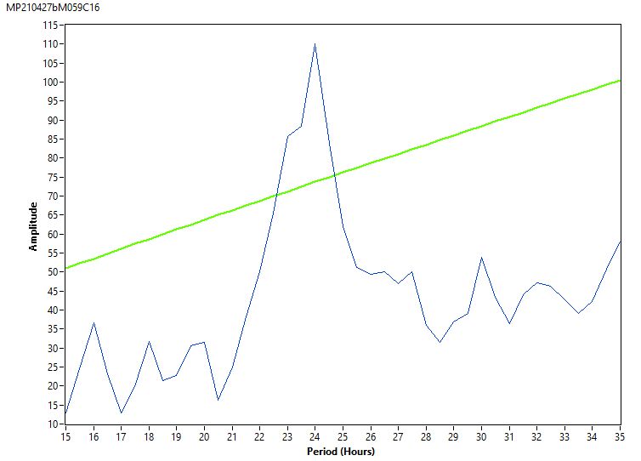
23♂ per[01]w[*]/Y;MB122B-Gal4/+;UASper[16]/+ [DD]₇ 23°C
M56+59

Slide 21
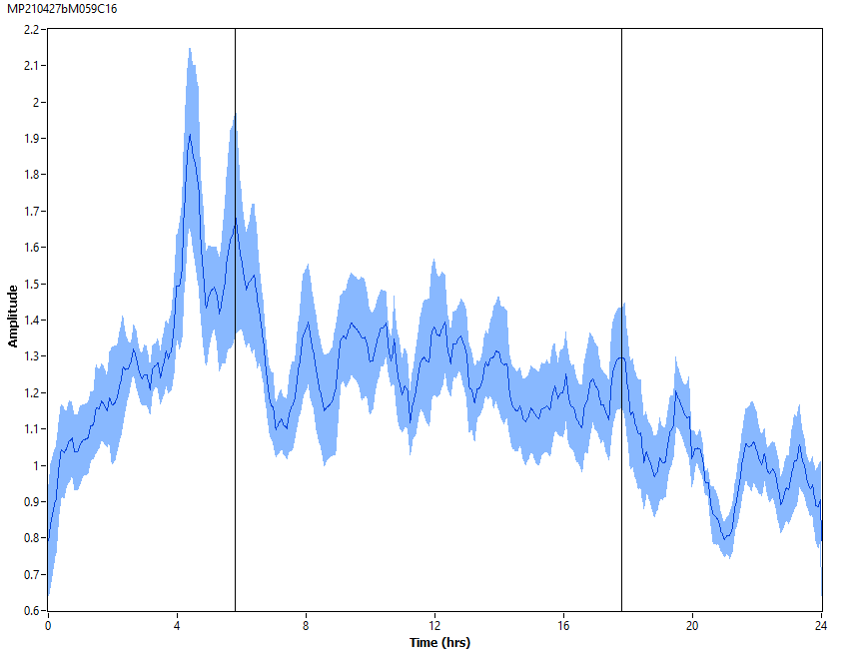
23♂ per[01]w[*]/Y;MB122B-Gal4/+;UASper[16]/+ [DD]₇ 23°C
M56+59

Slide 22
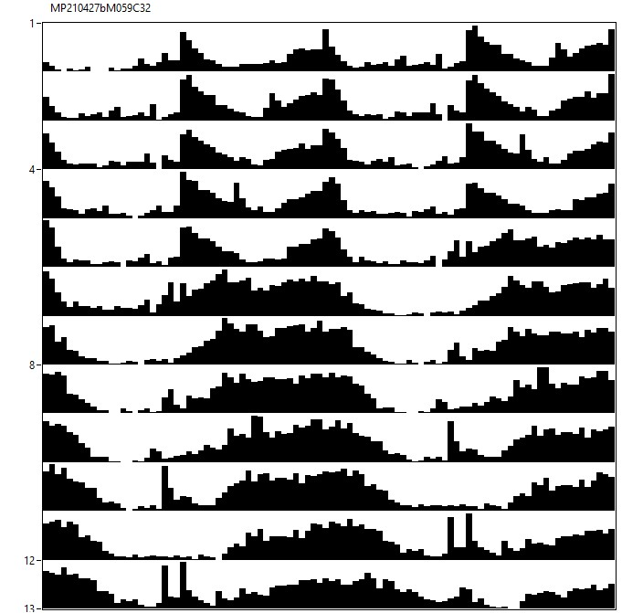
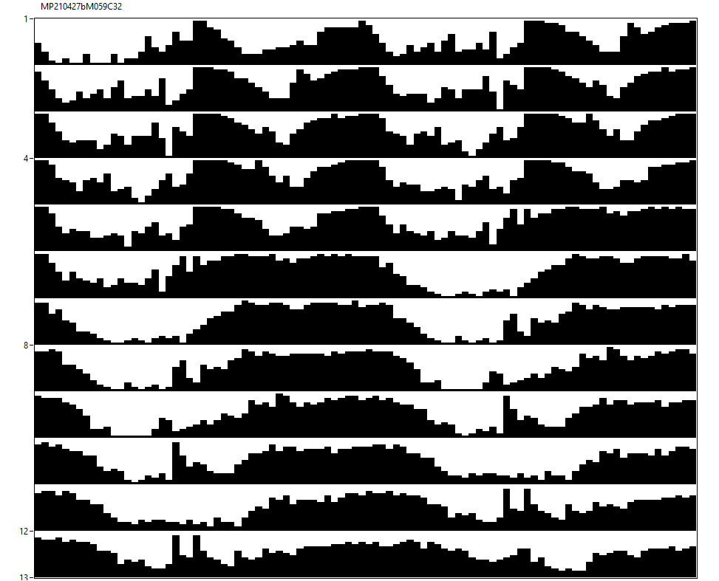
28♀ per[01]w[*]/w[*];MB122B-Gal4/+;UASper[16]/+ [12hL:12hD]₅>[DD]₇ 23°C
M56+59

Slide 23
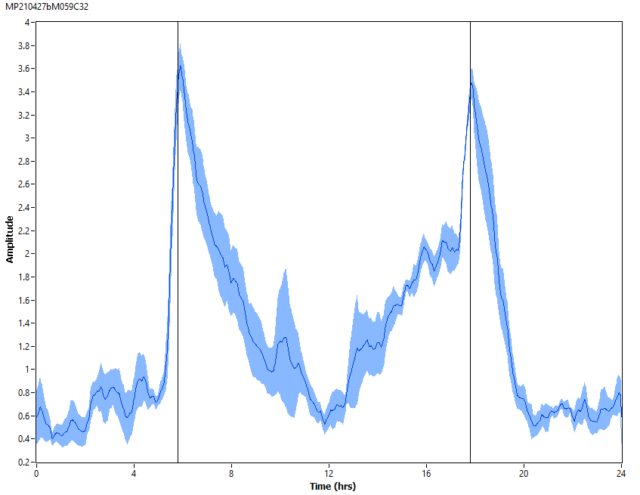
28♀ per[01]w[*]/w[*];MB122B-Gal4/+;UASper[16]/+ [12hL:12hD]₅ 23°C
M56+59

Slide 24
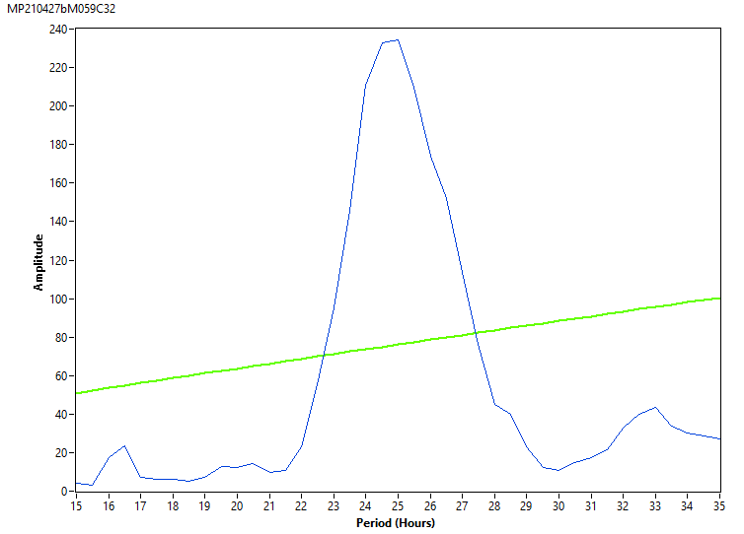
28♀ per[01]w[*]/w[*];MB122B-Gal4/+;UASper[16]/+ [DD]₇ 23°C
M56+59

Slide 25
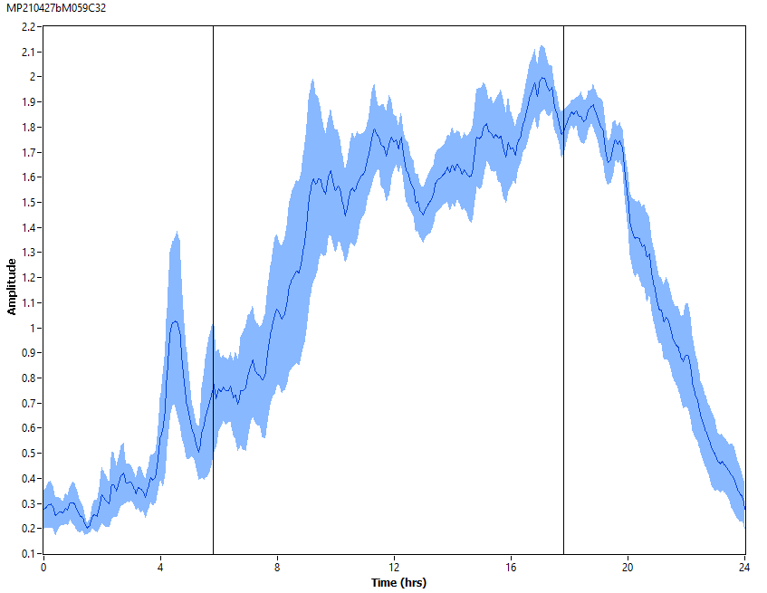
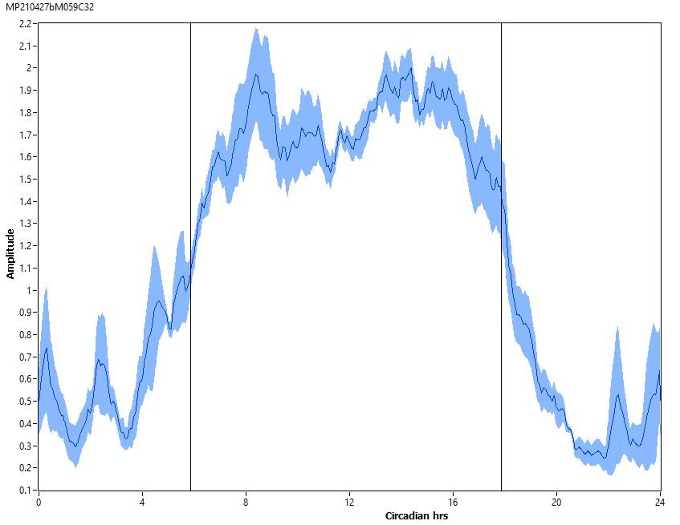
28♀ per[01]w[*]/w[*];MB122B-Gal4/+;UASper[16]/+ [DD]₇ 23°C
M56+59

Slide 26
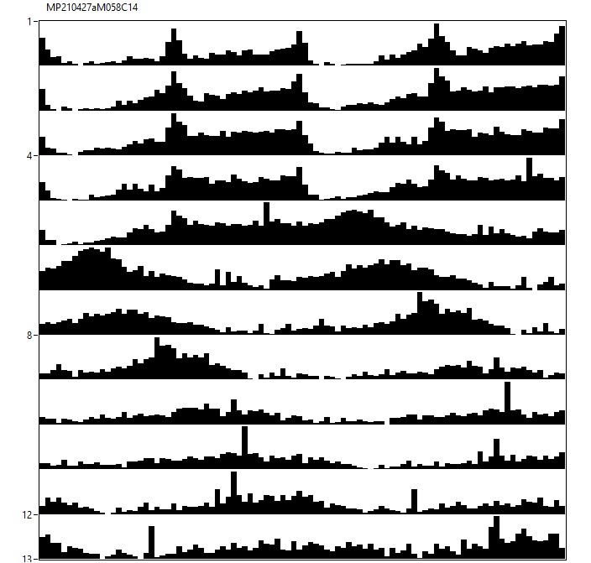
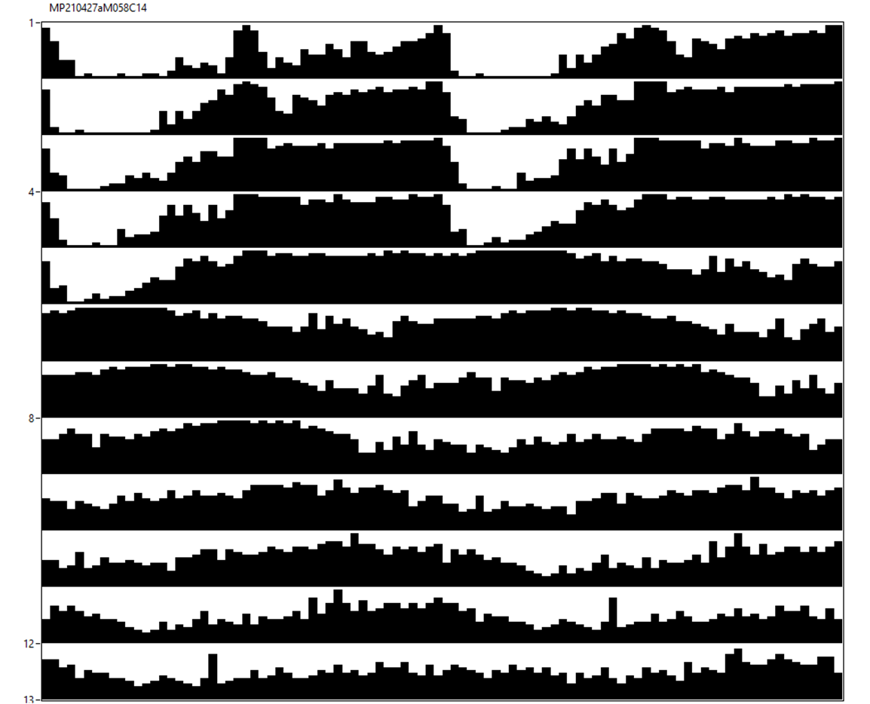
20♂ per[01]w[*]/Y;MB122B-Gal4/+;UASper[16]/+ [12hR:12hD]₅>[RR]₇ 23°C
M57+58

Slide 27
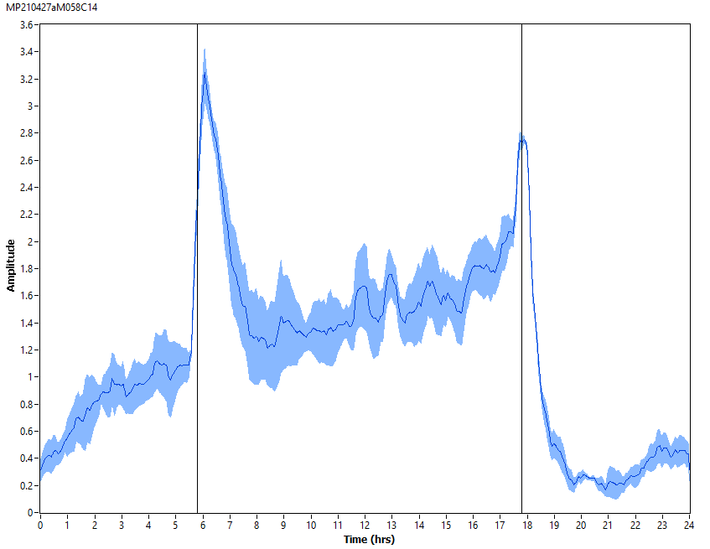
20♂ per[01]w[*]/Y;MB122B-Gal4/+;UASper[16]/+ [12hR:12hD]₅ 23°C
M57+58

Slide 28
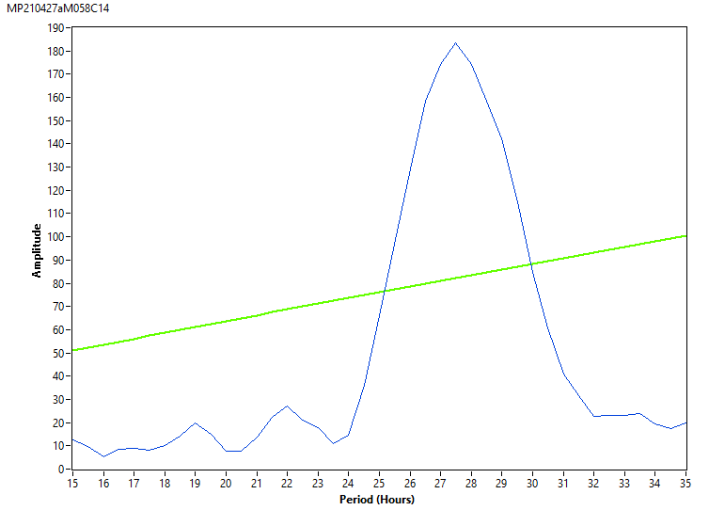
20♂ per[01]w[*]/Y;MB122B-Gal4/+;UASper[16]/+ [RR]₇ 23°C
M57+58

Slide 29
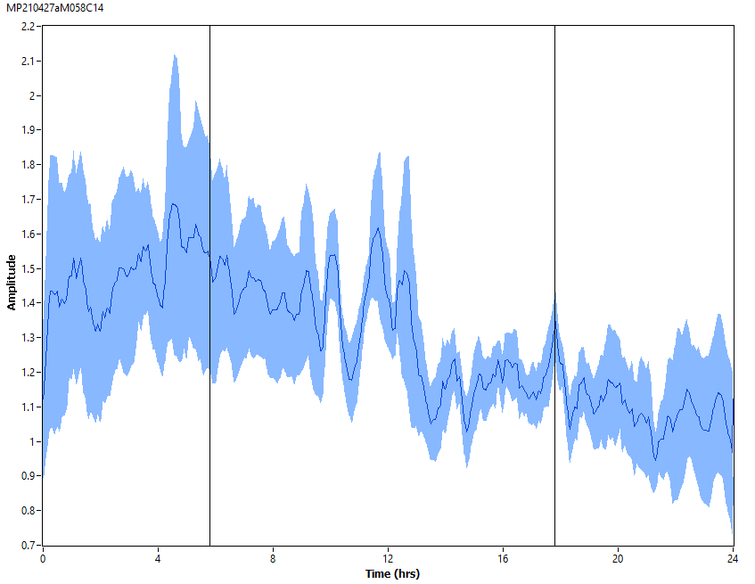
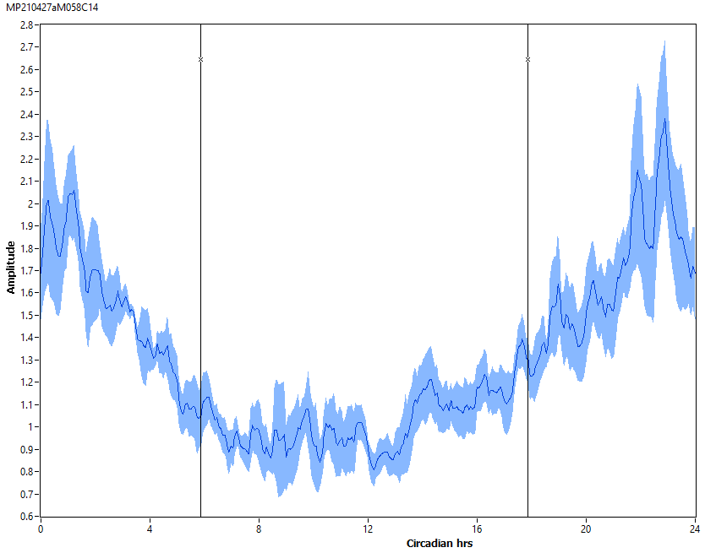
20♂ per[01]w[*]/Y;MB122B-Gal4/+;UASper[16]/+ [RR]₇ 23°C
M57+58

Slide 30
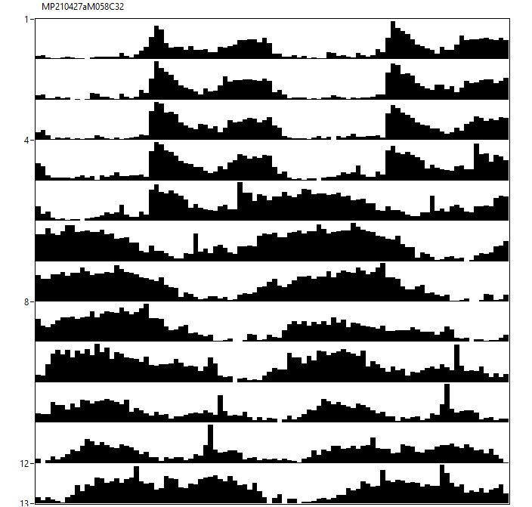
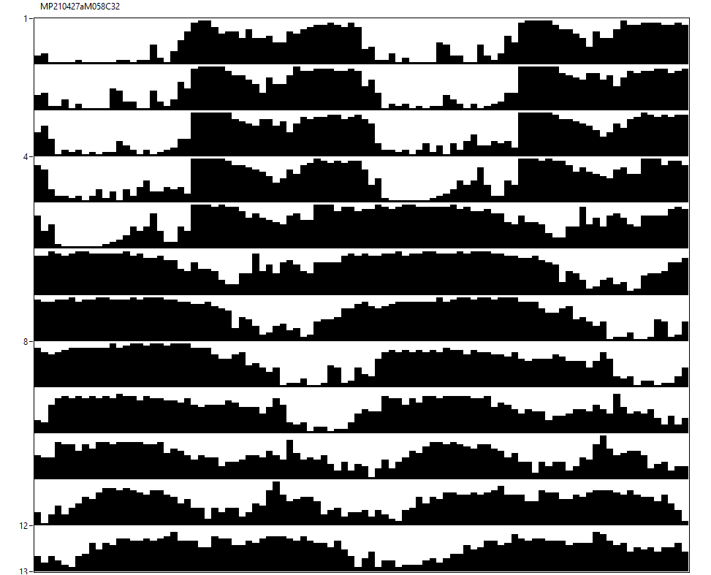
21♀ per[01]w[*]/w[*];MB122B-Gal4/+;UASper[16]/+ [12hR:12hD]₅>[RR]₇ 23°C
M57+58

Slide 31
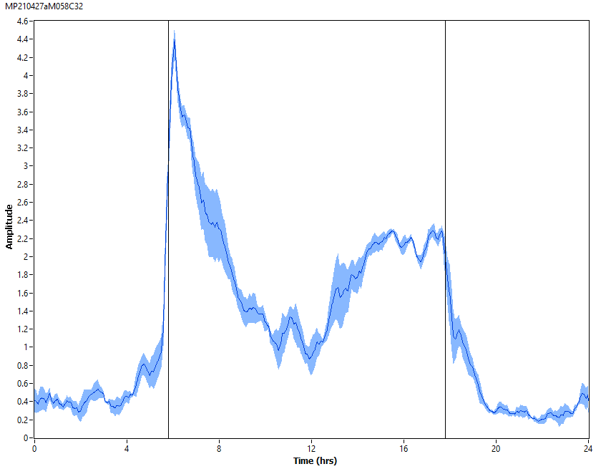
21♀ per[01]w[*]/w[*];MB122B-Gal4/+;UASper[16]/+ [12hR:12hD]₅ 23°C
M57+58

Slide 32
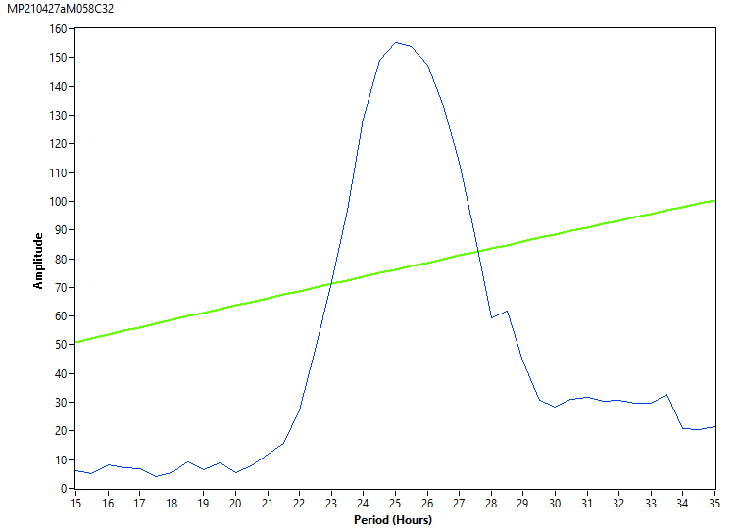
21♀ per[01]w[*]/w[*];MB122B-Gal4/+;UASper[16]/+ [RR]₇ 23°C
M57+58

Slide 33
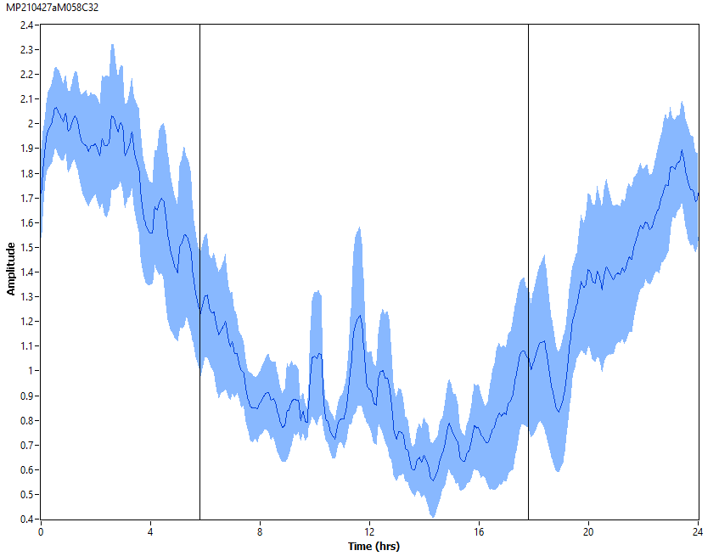
21♀ per[01]w[*]/w[*];MB122B-Gal4/+;UASper[16]/+ [RR]₇ 23°C
M57+58

Slide 34
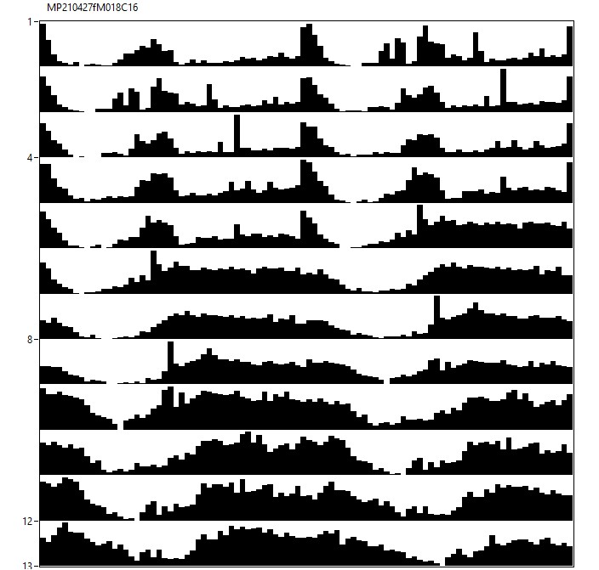
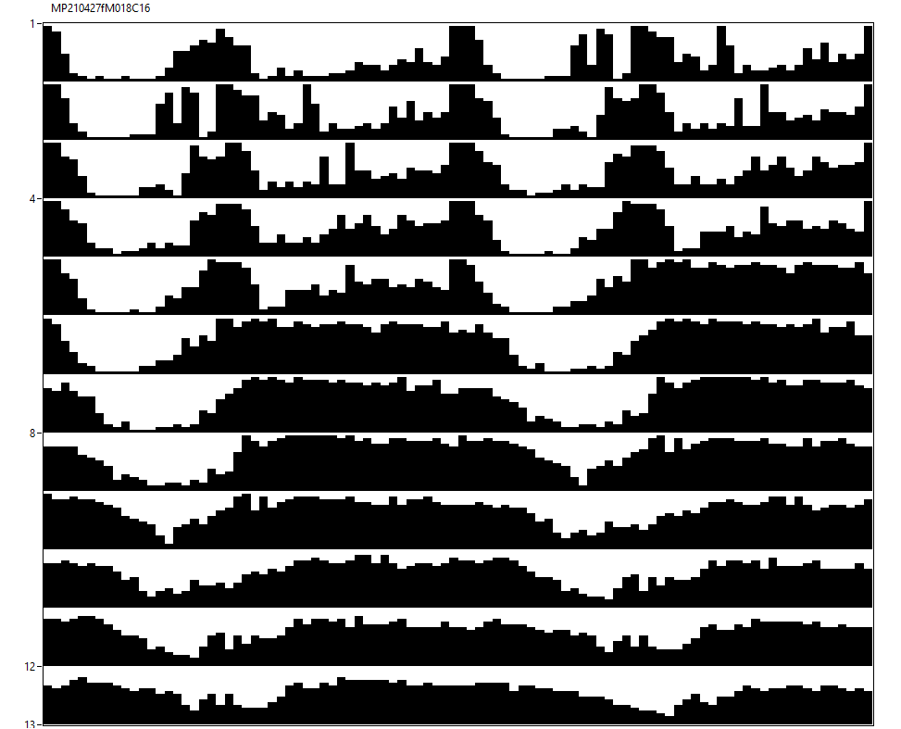
28♂ per[01]w[*]/Y;ss00681-Gal4/+;UASper[16]/+ [12hL:12hD]₅>[DD]₇ 23°C
M16+18

Slide 35
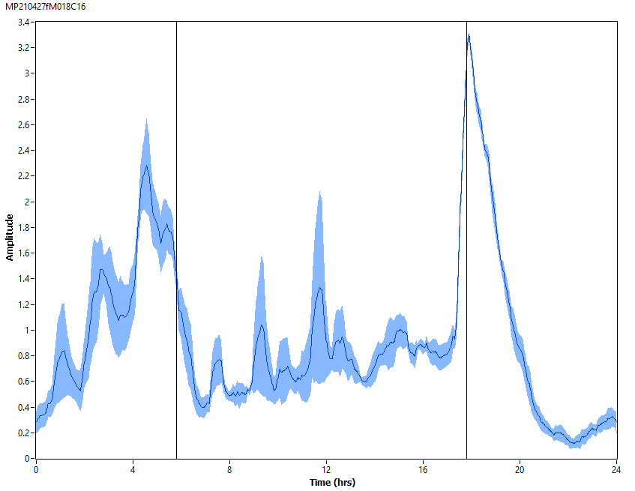
28♂ per[01]w[*]/Y;ss00681-Gal4/+;UASper[16]/+ [12hL:12hD]₅ 23°C
M16+18

Slide 36
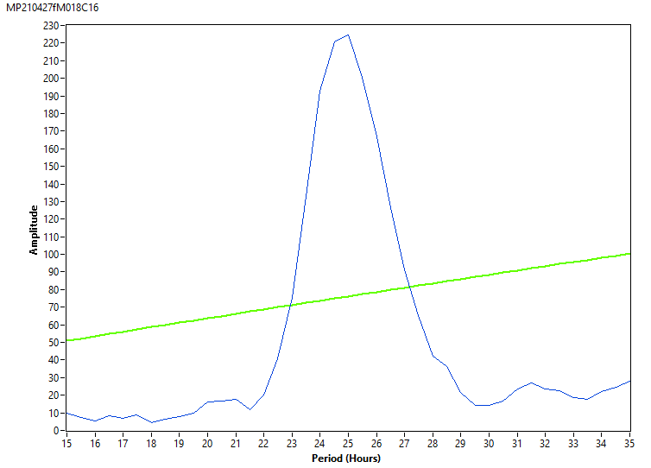
28♂ per[01]w[*]/Y;ss00681-Gal4/+;UASper[16]/+ [DD]₇ 23°C
M16+18

Slide 37
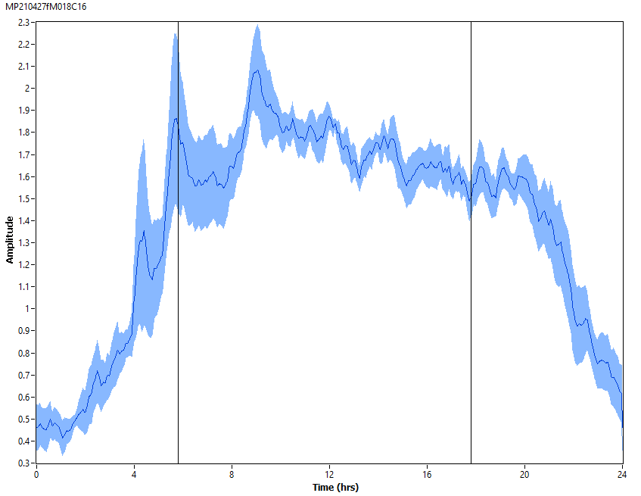
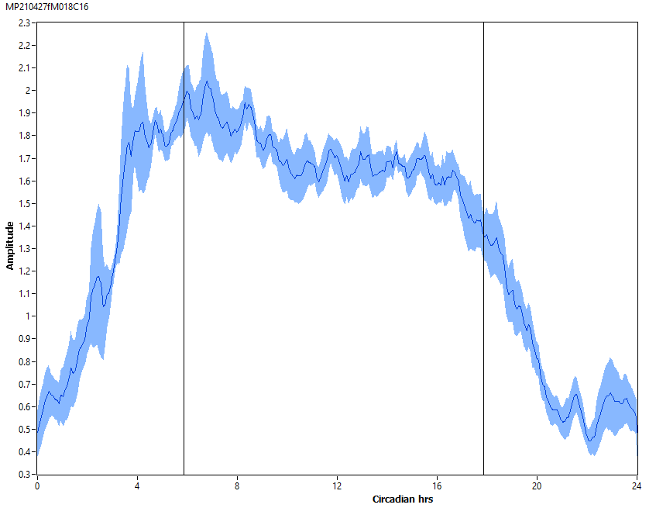
28♂ per[01]w[*]/Y;ss00681-Gal4/+;UASper[16]/+ [DD]₇ 23°C
M16+18

Slide 38
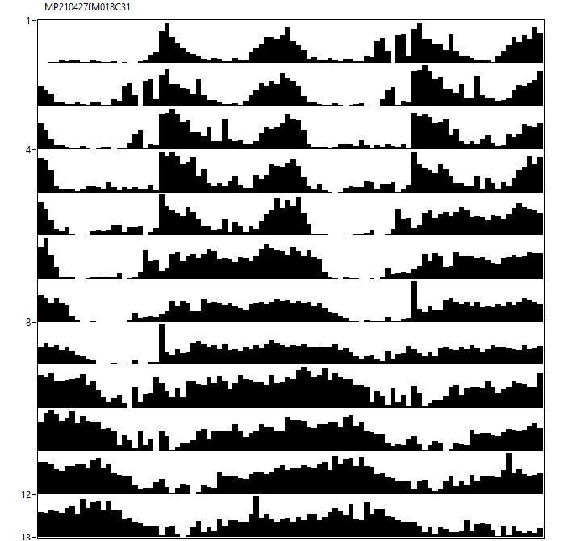

12♀ per[01]w[*]/w[*];ss00681-Gal4/+;UASper[16]/+ [12hL:12hD]₅>[DD]₇ 23°C
M16+18

Slide 39

12♀ per[01]w[*]/w[*];ss00681-Gal4/+;UASper[16]/+ [12hL:12hD]₅ 23°C
M16+18

Slide 40

12♀ per[01]w[*]/w[*];ss00681-Gal4/+;UASper[16]/+ [DD]₇ 23°C
M16+18

Slide 41


12♀ per[01]w[*]/w[*];ss00681-Gal4/+;UASper[16]/+ [DD]₇ 23°C
M16+18

Slide 42


24♂ per[01]w[*]/Y;ss00681-Gal4/+;UASper[16]/+ [12hR:12hD]₅>[RR]₇ 23°C
M5+8

Slide 43

24♂ per[01]w[*]/Y;ss00681-Gal4/+;UASper[16]/+ [12hR:12hD]₅ 23°C
M5+8

Slide 44

24♂ per[01]w[*]/Y;ss00681-Gal4/+;UASper[16]/+ [RR]₇ 23°C
M5+8

Slide 45


24♂ per[01]w[*]/Y;ss00681-Gal4/+;UASper[16]/+ [RR]₇ 23°C
M5+8

Slide 46


25♀ per[01]w[*]/w[*];ss00681-Gal4/+;UASper[16]/+ [12hR:12hD]₅>[RR]₇ 23°C
M5+8

Slide 47

25♀ per[01]w[*]/w[*];ss00681-Gal4/+;UASper[16]/+ [12hR:12hD]₅ 23°C
M5+8

Slide 48

25♀ per[01]w[*]/w[*];ss00681-Gal4/+;UASper[16]/+ [RR]₇ 23°C
M5+8

Slide 49


25♀ per[01]w[*]/w[*];ss00681-Gal4/+;UASper[16]/+ [RR]₇ 23°C
M5+8

Slide 50


25♂ per[01]w[*]/Y;Clk[856]-Gal4/+;UASper[16]/+ [12hL:12hD]₅>[DD]₇ 23°C
M48+5

Slide 51

25♂ per[01]w[*]/Y;Clk[856]-Gal4/+;UASper[16]/+ [12hL:12hD]₅ 23°C
M48+5

Slide 52

25♂ per[01]w[*]/Y;Clk[856]-Gal4/+;UASper[16]/+ [DD]₇ 23°C
M48+5

Slide 53

25♂ per[01]w[*]/Y;Clk[856]-Gal4/+;UASper[16]/+ [DD]₇ 23°C
M48+5

Slide 54


27♀ per[01]w[*]/w[*];Clk[856]-Gal4/+;UASper[16]/+ [12hL:12hD]₅>[DD]₇ 23°C
M48+5

Slide 55

27♀ per[01]w[*]/w[*];Clk[856]-Gal4/+;UASper[16]/+ [12hL:12hD]₅ 23°C
M48+5

Slide 56

27♀ per[01]w[*]/w[*];Clk[856]-Gal4/+;UASper[16]/+ [DD]₇ 23°C
M48+5

Slide 57


27♀ per[01]w[*]/w[*];Clk[856]-Gal4/+;UASper[16]/+ [DD]₇ 23°C
M48+5

Slide 58


27♂ per[01]w[*]/Y;Clk[856]-Gal4/+;UASper[16]/+ [12hR:12hD]₅>[RR]₇ 23°C
M49+8

Slide 59

27♂ per[01]w[*]/Y;Clk[856]-Gal4/+;UASper[16]/+ [12hR:12hD]₅ 23°C
M49+8

Slide 60

27♂ per[01]w[*]/Y;Clk[856]-Gal4/+;UASper[16]/+ [RR]₇ 23°C
M49+8

Slide 61


27♂ per[01]w[*]/Y;Clk[856]-Gal4/+;UASper[16]/+ [RR]₇ 23°C
M49+8

Slide 62


28♀ per[01]w[*]/w[*];Clk[856]-Gal4/+;UASper[16]/+ [12hR:12hD]₅>[RR]₇ 23°C
M49+8

Slide 63

28♀ per[01]w[*]/w[*];Clk[856]-Gal4/+;UASper[16]/+ [12hR:12hD]₅ 23°C
M49+8

Slide 64

28♀ per[01]w[*]/w[*];Clk[856]-Gal4/+;UASper[16]/+ [RR]₇ 23°C
M49+8

Slide 65


28♀ per[01]w[*]/w[*];Clk[856]-Gal4/+;UASper[16]/+ [RR]₇ 23°C
M49+8

Slide 66


21♂ per[01]w[*]/Y;;UASper[16]/ChAT2A-Gal4 [12hL:12hD]₅>[DD]₇ 23°C
M18+43

Slide 67

21♂ per[01]w[*]/Y;;UASper[16]/ChAT2A-Gal4 [12hL:12hD]₅ 23°C
M18+43

Slide 68

21♂ per[01]w[*]/Y;;UASper[16]/ChAT2A-Gal4 [DD]₇ 23°C
M18+43

Slide 69

21♂ per[01]w[*]/Y;;UASper[16]/ChAT2A-Gal4 [DD]₇ 23°C
M18+43

Slide 70


22♀ per[01]w[*]/Y;;UASper[16]/ChAT2A-Gal4 [12hL:12hD]₅>[DD]₇ 23°C
M18+43

Slide 71

22♀ per[01]w[*]/Y;;UASper[16]/ChAT2A-Gal4 [12hL:12hD]₅ 23°C
M18+43

Slide 72

22♀ per[01]w[*]/Y;;UASper[16]/ChAT2A-Gal4 [DD]₇ 23°C
M18+43

Slide 73

22♀ per[01]w[*]/Y;;UASper[16]/ChAT2A-Gal4 [DD]₇ 23°C
M18+43

Slide 74


21♂ per[01]w[*]/Y;;UASper[16]/ChAT2A-Gal4 [12hR:12hD]₅>[RR]₇ 23°C
M19+44

Slide 75

21♂ per[01]w[*]/Y;;UASper[16]/ChAT2A-Gal4 [12hR:12hD]₅ 23°C
M19+44

Slide 76

21♂ per[01]w[*]/Y;;UASper[16]/ChAT2A-Gal4 [RR]₇ 23°C
M19+44

Slide 77


21♂ per[01]w[*]/Y;;UASper[16]/ChAT2A-Gal4 [RR]₇ 23°C
M19+44

Slide 78


26♀ per[01]w[*]/Y;;UASper[16]/ChAT2A-Gal4 [12hR:12hD]₅>[RR]₇ 23°C
M19+44

Slide 79

26♀ per[01]w[*]/Y;;UASper[16]/ChAT2A-Gal4 [12hR:12hD]₅ 23°C
M19+44

Slide 80

26♀ per[01]w[*]/Y;;UASper[16]/ChAT2A-Gal4 [RR]₇ 23°C
M19+44

Slide 81


26♀ per[01]w[*]/Y;;UASper[16]/ChAT2A-Gal4 [RR]₇ 23°C
M19+44

Slide 82


16♂ per[01]w[*]/Y;ChAT-Gal4.7.4/+;UASper[16]/+ [12hL:12hD]₅>[DD]₇ 23°C
M8

Slide 83

16♂ per[01]w[*]/Y;ChAT-Gal4.7.4/+;UASper[16]/+ [12hL:12hD]₅ 23°C
M8

Slide 84

16♂ per[01]w[*]/Y;ChAT-Gal4.7.4/+;UASper[16]/+ [DD]₇ 23°C
M8

Slide 85

16♂ per[01]w[*]/Y;ChAT-Gal4.7.4/+;UASper[16]/+ [DD]₇ 23°C
M8

Slide 86


13♀ per[01]w[*]/Y;ChAT-Gal4.7.4/+;UASper[16]/+ [12hL:12hD]₅>[DD]₇ 23°C
M8

Slide 87

13♀ per[01]w[*]/Y;ChAT-Gal4.7.4/+;UASper[16]/+ [12hL:12hD]₅ 23°C
M8

Slide 88

13♀ per[01]w[*]/Y;ChAT-Gal4.7.4/+;UASper[16]/+ [DD]₇ 23°C
M8

Slide 89

13♀ per[01]w[*]/Y;ChAT-Gal4.7.4/+;UASper[16]/+ [DD]₇ 23°C
M8

Slide 90


15♂ per[01]w[*]/Y;ChAT-Gal4.7.4/+;UASper[16]/+ [12hL:12hD]₅>[DD]₇ 23°C
M26

Slide 91

15♂ per[01]w[*]/Y;ChAT-Gal4.7.4/+;UASper[16]/+ [12hL:12hD]₅ 23°C
M26

Slide 92

15♂ per[01]w[*]/Y;ChAT-Gal4.7.4/+;UASper[16]/+ [DD]₇ 23°C
M26

Slide 93

15♂ per[01]w[*]/Y;ChAT-Gal4.7.4/+;UASper[16]/+ [DD]₇ 23°C
M26

Slide 94

14♀ per[01]w[*]/Y;ChAT-Gal4.7.4/+;UASper[16]/+ [12hL:12hD]₅>[DD]₇ 23°C
M26

Slide 95

14♀ per[01]w[*]/Y;ChAT-Gal4.7.4/+;UASper[16]/+ [12hL:12hD]₅ 23°C
M26

Slide 96

14♀ per[01]w[*]/Y;ChAT-Gal4.7.4/+;UASper[16]/+ [DD]₇ 23°C
M26

Slide 97


14♀ per[01]w[*]/Y;ChAT-Gal4.7.4/+;UASper[16]/+ [DD]₇ 23°C
M26

Slide 98


28♂ per[01]w[*]/Y;ChAT-Gal4.7.4/+;UASper[16]/+ [12hR:12hD]₅>[RR]₇ 23°C
M19+65

Slide 99

28♂ per[01]w[*]/Y;ChAT-Gal4.7.4/+;UASper[16]/+ [12hR:12hD]₅ 23°C
M19+65

Slide 100

28♂ per[01]w[*]/Y;ChAT-Gal4.7.4/+;UASper[16]/+ [RR]₇ 23°C
M19+65

Slide 101


28♂ per[01]w[*]/Y;ChAT-Gal4.7.4/+;UASper[16]/+ [RR]₇ 23°C
M19+65

Slide 102


27♀ per[01]w[*]/Y;ChAT-Gal4.7.4/+;UASper[16]/+ [12hR:12hD]₅>[RR]₇ 23°C
M19+65

Slide 103

27♀ per[01]w[*]/Y;ChAT-Gal4.7.4/+;UASper[16]/+ [12hR:12hD]₅ 23°C
M19+65

Slide 104

27♀ per[01]w[*]/Y;ChAT-Gal4.7.4/+;UASper[16]/+ [RR]₇ 23°C
M19+65

Slide 105


27♀ per[01]w[*]/Y;ChAT-Gal4.7.4/+;UASper[16]/+ [RR]₇ 23°C
M19+65

Slide 106


12♂ per[01]w[*]/Y;ChAT-Gal4.7.4/+;UASper[16]/cry-Gal80 [12hL:12hD]₅>[DD]₇ 23°C
M56

Slide 107

12♂ per[01]w[*]/Y;ChAT-Gal4.7.4/+;UASper[16]/cry-Gal80 [12hL:12hD]₅ 23°C
M56

Slide 108

12♂ per[01]w[*]/Y;ChAT-Gal4.7.4/+;UASper[16]/cry-Gal80 [DD]₇ 23°C
M56

Slide 109

12♂ per[01]w[*]/Y;ChAT-Gal4.7.4/+;UASper[16]/cry-Gal80 [DD]₇ 23°C
M56

Slide 110


9♀ per[01]w[*]/Y;ChAT-Gal4.7.4/+;UASper[16]/cry-Gal80 [12hL:12hD]₅>[DD]₇ 23°C
M56

Slide 111

9♀ per[01]w[*]/Y;ChAT-Gal4.7.4/+;UASper[16]/cry-Gal80 [12hL:12hD]₅ 23°C
M56

Slide 112

9♀ per[01]w[*]/Y;ChAT-Gal4.7.4/+;UASper[16]/cry-Gal80 [DD]₇ 23°C
M56

Slide 113


9♀ per[01]w[*]/Y;ChAT-Gal4.7.4/+;UASper[16]/cry-Gal80 [DD]₇ 23°C
M56

Slide 114


15♂ per[01]w[*]/Y;ChAT-Gal4.7.4/+;UASper[16]/cry-Gal80 [12hR:12hD]₅>[RR]₇ 23°C
M57
MARS

Slide 115

15♂ per[01]w[*]/Y;ChAT-Gal4.7.4/+;UASper[16]/cry-Gal80 [12hR:12hD]₅ 23°C
M57

Slide 116

15♂ per[01]w[*]/Y;ChAT-Gal4.7.4/+;UASper[16]/cry-Gal80 [RR]₇ 23°C
M57

Slide 117

15♂ per[01]w[*]/Y;ChAT-Gal4.7.4/+;UASper[16]/cry-Gal80 [RR]₇ 23°C
M57

Slide 118

14♀ per[01]w[*]/w[*];ChAT-Gal4.7.4/+;UASper[16]/cry-Gal80 [12hR:12hD]₅>[RR]₇ 23°C
M57

Slide 119

14♀ per[01]w[*]/w[*];ChAT-Gal4.7.4/+;UASper[16]/cry-Gal80 [12hR:12hD]₅ 23°C
M57

Slide 120

14♀ per[01]w[*]/w[*];ChAT-Gal4.7.4/+;UASper[16]/cry-Gal80 [RR]₇ 23°C
M57

Slide 121


14♀ per[01]w[*]/w[*];ChAT-Gal4.7.4/+;UASper[16]/cry-Gal80 [RR]₇ 23°C
M57

Slide 122


15♂ per[01]w[*]/Y;ChAT-Gal4.7.4/+;UASper[16]/cry-Gal80 [12hR:12hD]₅>[RR]₇ 23°C
M58
PURGATORIO

Slide 123

15♂ per[01]w[*]/Y;ChAT-Gal4.7.4/+;UASper[16]/cry-Gal80 [12hR:12hD]₅ 23°C
M58

Slide 124

15♂ per[01]w[*]/Y;ChAT-Gal4.7.4/+;UASper[16]/cry-Gal80 [RR]₇ 23°C
M58

Slide 125

15♂ per[01]w[*]/Y;ChAT-Gal4.7.4/+;UASper[16]/cry-Gal80 [RR]₇ 23°C
M58

Slide 126


14♀ per[01]w[*]/Y;ChAT-Gal4.7.4/+;UASper[16]/cry-Gal80 [12hR:12hD]₅>[RR]₇ 23°C
M58

Slide 127

14♀ per[01]w[*]/Y;ChAT-Gal4.7.4/+;UASper[16]/cry-Gal80 [12hR:12hD]₅ 23°C
M58

Slide 128

14♀ per[01]w[*]/Y;ChAT-Gal4.7.4/+;UASper[16]/cry-Gal80 [RR]₇ 23°C
M58

Slide 129


14♀ per[01]w[*]/Y;ChAT-Gal4.7.4/+;UASper[16]/cry-Gal80 [RR]₇ 23°C
M58

Slide 130


25♂ per[01]w[*]/Y;Clk856-Gal4/+;UASper[16]/ChAT-Gal80 [12hR:12hD]₅>[RR]₇ 23°C
M47+48

Slide 131

25♂ per[01]w[*]/Y;Clk856-Gal4/+;UASper[16]/ChAT-Gal80 [12hR:12hD]₅ 23°C
M47+48

Slide 132

25♂ per[01]w[*]/Y;Clk856-Gal4/+;UASper[16]/ChAT-Gal80 [RR]₇ 23°C
M47+48

Slide 133


25♂ per[01]w[*]/Y;Clk856-Gal4/+;UASper[16]/ChAT-Gal80 [RR]₇ 23°C
M47+48

Slide 134


26♀ per[01]w[*]/Y;Clk856-Gal4/+;UASper[16]/ChAT-Gal80 [12hR:12hD]₅>[RR]₇ 23°C
M47+48

Slide 135

26♀ per[01]w[*]/Y;Clk856-Gal4/+;UASper[16]/ChAT-Gal80 [12hR:12hD]₅ 23°C
M47+48

Slide 136

26♀ per[01]w[*]/Y;Clk856-Gal4/+;UASper[16]/ChAT-Gal80 [RR]₇ 23°C
M47+48

Slide 137


26♀ per[01]w[*]/Y;Clk856-Gal4/+;UASper[16]/ChAT-Gal80 [RR]₇ 23°C
M47+48

Slide 138


13♂ per[01]w[*]/Y;TUG/+;UASper[16]/ChAT-Gal80 [12hL:12hD]₅>[DD]₇ 23°C
M92

Slide 139

13♂ per[01]w[*]/Y;TUG/+;UASper[16]/ChAT-Gal80 [12hL:12hD]₅ 23°C
M92

Slide 140

13♂ per[01]w[*]/Y;TUG/+;UASper[16]/ChAT-Gal80 [DD]₇ 23°C
M92

Slide 141


13♂ per[01]w[*]/Y;TUG/+;UASper[16]/ChAT-Gal80 [DD]₇ 23°C
M92

Slide 142


15♀ per[01]w[*]/Y;TUG/+;UASper[16]/ChAT-Gal80 [12hL:12hD]₅>[DD]₇ 23°C
M92

Slide 143

15♀ per[01]w[*]/Y;TUG/+;UASper[16]/ChAT-Gal80 [12hL:12hD]₅ 23°C
M92

Slide 144

15♀ per[01]w[*]/Y;TUG/+;UASper[16]/ChAT-Gal80 [DD]₇ 23°C
M92

Slide 145


15♀ per[01]w[*]/Y;TUG/+;UASper[16]/ChAT-Gal80 [DD]₇ 23°C
M92

Slide 146


31♂ per[01]w[*]/Y;TUG/+;UASper[16]/ChAT-Gal80 [12hR:12hD]₅>[RR]₇ 23°C
M93+94

Slide 147

31♂ per[01]w[*]/Y;TUG/+;UASper[16]/ChAT-Gal80 [12hR:12hD]₅ 23°C
M93+94

Slide 148

31♂ per[01]w[*]/Y;TUG/+;UASper[16]/ChAT-Gal80 [RR]₇ 23°C
M93+94

Slide 149


31♂ per[01]w[*]/Y;TUG/+;UASper[16]/ChAT-Gal80 [RR]₇ 23°C
M93+94

Slide 150

28♀ per[01]w[*]/Y;TUG/+;UASper[16]/ChAT-Gal80 [12hR:12hD]₅>[RR]₇ 23°C
M93+94

Slide 151

28♀ per[01]w[*]/Y;TUG/+;UASper[16]/ChAT-Gal80 [12hR:12hD]₅ 23°C
M93+94

Slide 152

28♀ per[01]w[*]/Y;TUG/+;UASper[16]/ChAT-Gal80 [RR]₇ 23°C
M93+94

Slide 153


28♀ per[01]w[*]/Y;TUG/+;UASper[16]/ChAT-Gal80 [RR]₇ 23°C
M93+94

Slide 154


37♂ per[01]w[*]/Y;Pdf-Gal80/+;UASper[16]/cry-Gal4.13 [12hL:12hD]₅>[DD]₇ 23°C
M46+47

Slide 155

37♂ per[01]w[*]/Y;Pdf-Gal80/+;UASper[16]/cry-Gal4.13 [12hL:12hD]₅ 23°C
M46+47

Slide 156

37♂ per[01]w[*]/Y;Pdf-Gal80/+;UASper[16]/cry-Gal4.13 [DD]₇ 23°C
M46+47

Slide 157

37♂ per[01]w[*]/Y;Pdf-Gal80/+;UASper[16]/cry-Gal4.13 [DD]₇ 23°C
M46+47

Slide 158


26♀ per[01]w[*]/w[*];Pdf-Gal80/+;UASper[16]/cry-Gal4.13 [12hL:12hD]₅>[DD]₇ 23°C
M46+47

Slide 159

26♀ per[01]w[*]/w[*];Pdf-Gal80/+;UASper[16]/cry-Gal4.13 [12hL:12hD]₅ 23°C
M46+47

Slide 160

26♀ per[01]w[*]/w[*];Pdf-Gal80/+;UASper[16]/cry-Gal4.13 [DD]₇ 23°C
M46+47

Slide 161


26♀ per[01]w[*]/w[*];Pdf-Gal80/+;UASper[16]/cry-Gal4.13 [DD]₇ 23°C
M46+47

Slide 162


30♂ per[01]w[*]/Y;Pdf-Gal80/+;UASper[16]/cry-Gal4.13 [12hR:12hD]₅>[RR]₇ 23°C
M13+14

Slide 163

30♂ per[01]w[*]/Y;Pdf-Gal80/+;UASper[16]/cry-Gal4.13 [12hR:12hD]₅ 23°C
M13+14

Slide 164

30♂ per[01]w[*]/Y;Pdf-Gal80/+;UASper[16]/cry-Gal4.13 [RR]₇ 23°C
M13+14

Slide 165


30♂ per[01]w[*]/Y;Pdf-Gal80/+;UASper[16]/cry-Gal4.13 [RR]₇ 23°C
M13+14

Slide 166


29♀ per[01]w[*]/w[*];Pdf-Gal80/+;UASper[16]/cry-Gal4.13 [12hR:12hD]₅>[RR]₇ 23°C
M13+14

Slide 167

29♀ per[01]w[*]/w[*];Pdf-Gal80/+;UASper[16]/cry-Gal4.13 [12hR:12hD]₅ 23°C
M13+14

Slide 168

29♀ per[01]w[*]/w[*];Pdf-Gal80/+;UASper[16]/cry-Gal4.13 [RR]₇ 23°C
M13+14

Slide 169


29♀ per[01]w[*]/w[*];Pdf-Gal80/+;UASper[16]/cry-Gal4.13 [RR]₇ 23°C
M13+14

Slide 170

15♂ per[01]w[*]/Y;ChAT4.7.4/+;PdfGal4/UASper[16] [12hL:12hD]₅>[DD]₇ 23°C
M44

Slide 171

15♂ per[01]w[*]/Y;ChAT4.7.4/+;PdfGal4/UASper[16] [12hL:12hD]₅ 23°C
M44

Slide 172

15♂ per[01]w[*]/Y;ChAT4.7.4/+;PdfGal4/UASper[16] [DD]₇ 23°C
M44

Slide 173


15♂ per[01]w[*]/Y;ChAT4.7.4/+;PdfGal4/UASper[16] [DD]₇ 23°C
M44

Slide 174

15♀ per[01]w[*]/w[*];ChAT4.7.4/+;PdfGal4/UASper[16] [12hL:12hD]₅>[DD]₇ 23°C
M44

Slide 175

15♀ per[01]w[*]/w[*];ChAT4.7.4/+;PdfGal4/UASper[16] [12hL:12hD]₅ 23°C
M44

Slide 176

15♀ per[01]w[*]/w[*];ChAT4.7.4/+;PdfGal4/UASper[16] [DD]₇ 23°C
M44

Slide 177


15♀ per[01]w[*]/w[*];ChAT4.7.4/+;PdfGal4/UASper[16] [DD]₇ 23°C
M44

Slide 178

15♂ per[01]w[*]/Y;ChAT4.7.4/+;PdfGal4/UASper[16] [12hR:12hD]₅>[RR]₇ 23°C
M45

Slide 179

15♂ per[01]w[*]/Y;ChAT4.7.4/+;PdfGal4/UASper[16] [12hR:12hD]₅ 23°C
M45

Slide 180

15♂ per[01]w[*]/Y;ChAT4.7.4/+;PdfGal4/UASper[16] [RR]₇ 23°C
M45

Slide 181


15♂ per[01]w[*]/Y;ChAT4.7.4/+;PdfGal4/UASper[16] [RR]₇ 23°C
M45

Slide 182

15♀ per[01]w[*]/w[*];ChAT4.7.4/+;PdfGal4/UASper[16] [12hR:12hD]₅>[RR]₇ 23°C
M45

Slide 183

15♀ per[01]w[*]/w[*];ChAT4.7.4/+;PdfGal4/UASper[16] [12hR:12hD]₅ 23°C
M45

Slide 184

15♀ per[01]w[*]/w[*];ChAT4.7.4/+;PdfGal4/UASper[16] [RR]₇ 23°C
M45

Slide 185


15♀ per[01]w[*]/w[*];ChAT4.7.4/+;PdfGal4/UASper[16] [RR]₇ 23°C
M45

Slide 186

15♂ per[01]w[*]/Y;ChAT4.7.4/+;PdfGal4/UASper[16] [12hL:12hD]₅>[DD]₇ 23°C
M22

Slide 187

15♂ per[01]w[*]/Y;ChAT4.7.4/+;PdfGal4/UASper[16] [12hL:12hD]₅ 23°C
M22

Slide 188

15♂ per[01]w[*]/Y;ChAT4.7.4/+;PdfGal4/UASper[16] [DD]₇ 23°C
M22

Slide 189

15♂ per[01]w[*]/Y;ChAT4.7.4/+;PdfGal4/UASper[16] [DD]₇ 23°C
M22

Slide 190

15♀ per[01]w[*]/w[*];ChAT4.7.4/+;PdfGal4/UASper[16] [12hL:12hD]₅>[DD]₇ 23°C
M22

Slide 191

15♀ per[01]w[*]/w[*];ChAT4.7.4/+;PdfGal4/UASper[16] [12hL:12hD]₅ 23°C
M22

Slide 192

15♀ per[01]w[*]/w[*];ChAT4.7.4/+;PdfGal4/UASper[16] [DD]₇ 23°C
M22

Slide 193


15♀ per[01]w[*]/w[*];ChAT4.7.4/+;PdfGal4/UASper[16] [DD]₇ 23°C
M22

Slide 194

15♂ per[01]w[*]/Y;ChAT4.7.4/+;PdfGal4/UASper[16] [12hR:12hD]₅>[RR]₇ 23°C
M23

Slide 195

15♂ per[01]w[*]/Y;ChAT4.7.4/+;PdfGal4/UASper[16] [12hR:12hD]₅ 23°C
M23

Slide 196

15♂ per[01]w[*]/Y;ChAT4.7.4/+;PdfGal4/UASper[16] [RR]₇ 23°C
M23

Slide 197


15♂ per[01]w[*]/Y;ChAT4.7.4/+;PdfGal4/UASper[16] [RR]₇ 23°C
M23

Slide 198

15♀ per[01]w[*]/w[*];ChAT4.7.4/+;PdfGal4/UASper[16] [12hR:12hD]₅>[RR]₇ 23°C
M23

Slide 199

15♀ per[01]w[*]/w[*];ChAT4.7.4/+;PdfGal4/UASper[16] [12hR:12hD]₅ 23°C
M23

Slide 200

15♀ per[01]w[*]/w[*];ChAT4.7.4/+;PdfGal4/UASper[16] [RR]₇ 23°C
M23

Slide 201


15♀ per[01]w[*]/w[*];ChAT4.7.4/+;PdfGal4/UASper[16] [RR]₇ 23°C
M23

Slide 202

15♂ per[01]w[*]/Y;+/CyO;PdfGal4/UASper[16] [12hR:12hD]₅>[RR]₇ 23°C
M24

Slide 203

15♂ per[01]w[*]/Y;+/CyO;PdfGal4/UASper[16] [12hR:12hD]₅ 23°C
M24

Slide 204

15♂ per[01]w[*]/Y;+/CyO;PdfGal4/UASper[16] [RR]₇ 23°C
M24

Slide 205

15♂ per[01]w[*]/Y;+/CyO;PdfGal4/UASper[16] [RR]₇ 23°C
M24

Slide 206

14♀ per[01]w[*]/Y;+/CyO;PdfGal4/UASper[16] [12hR:12hD]₅>[RR]₇ 23°C
M24

Slide 207

14♀ per[01]w[*]/Y;+/CyO;PdfGal4/UASper[16] [12hR:12hD]₅ 23°C
M24

Slide 208

14♀ per[01]w[*]/Y;+/CyO;PdfGal4/UASper[16] [RR]₇ 23°C
M24

Slide 209


14♀ per[01]w[*]/Y;+/CyO;PdfGal4/UASper[16] [RR]₇ 23°C
M24

