Slide 1
Data Fusion for Improved Prediction Interval Performance of Ratiometric Binary Liposome Measurement
Dr Waseem Ahmed, Dr Aneesh Vincent Veluthandath, Prof Senthil Murugan Ganapathy
PIERS 2025
8th May 2025

Slide 2
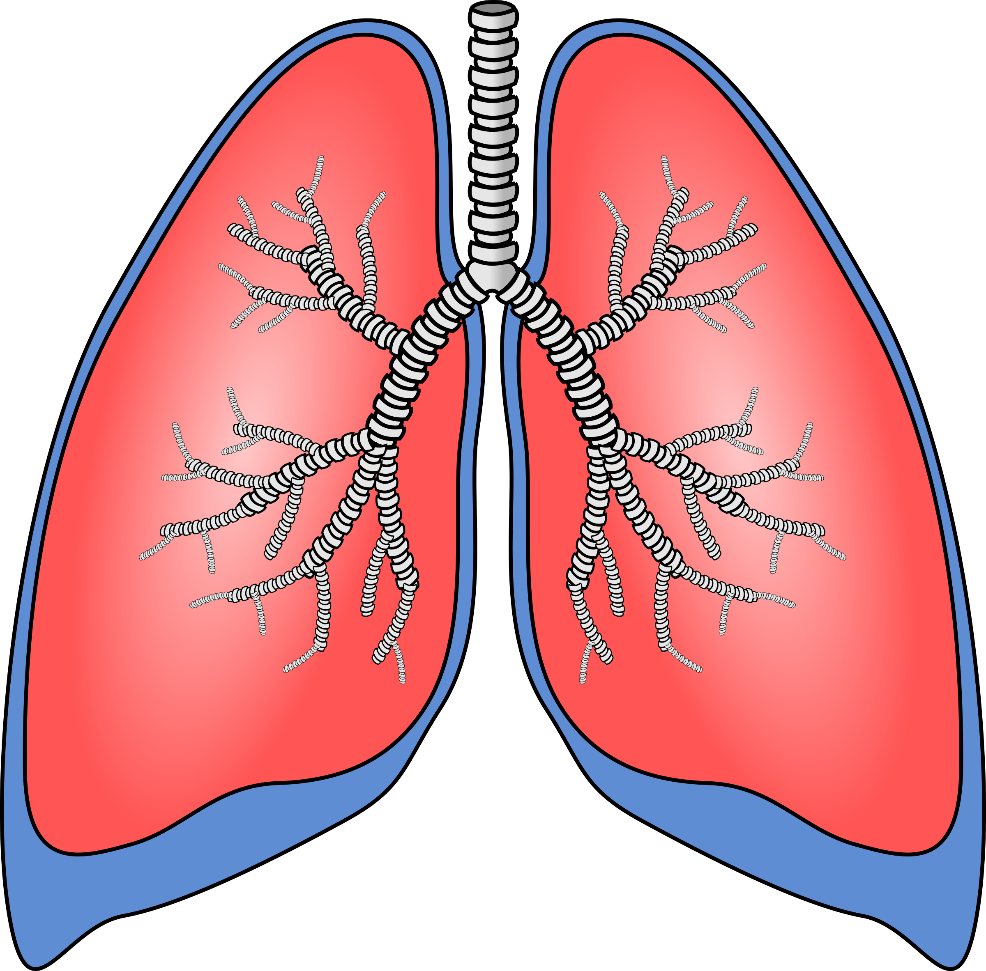

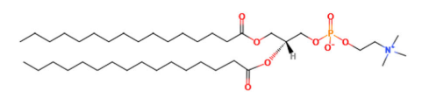
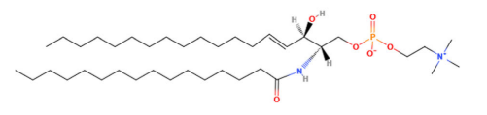
Neonatal Respiratory Distress Syndrome (nRDS)
Between 1.3 – 13.2 Million premature babies affected each year
Highest cause of preterm infant mortality
No current point of care test
Lecithin/Sphingomyelin Ratio (L/S ratio) L/S < 2.2 diagnostic for nRDS
DPPC (L)
Sphingomyelin (S)
Notes:
Our interest stems from our work to develop a point of care test for nRDS, which is the largest cause of infant mortality today.
Lung surfactant is essential to reduce the surface tension in the lungs and allow us to breath, but premature babies often have immature lungs that produce surfactant with less lecithin than is required and so they have a low lecithin to sph ratio which are 2 lipid biomarkers associated with lung maturity.
There is no current point of care test, and the next alternative is to use mass spectrometry which can take anything from half a day to a week to perform which is beyond the 2 hour window that is required to perform an effective therapeutic intervention.
If we can measure the L/S ratio at the point of care, we can provide clinicians to make evidence based diagnoses and rapidly treat, reducing the severity of the disease and mortality.

Slide 3
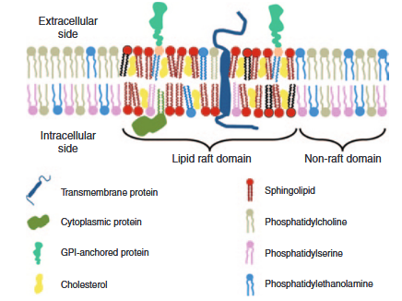
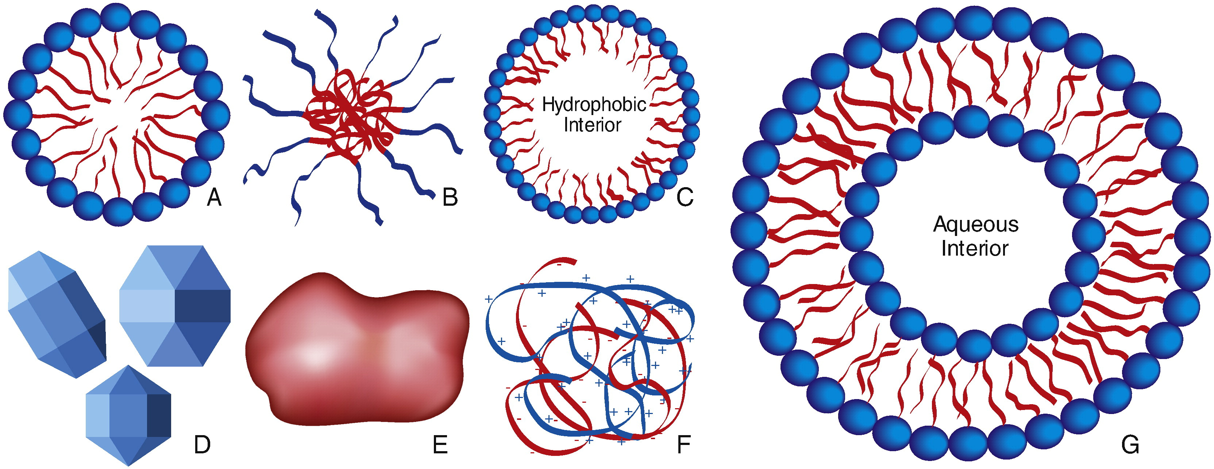
Liposomes
Hydrophobic
Non-polar
Tail
Hydrophilic Polar
Headgroup
Uses:
Drug delivery
Cosmetics
Lamellar bodies
[1] G. A. Husseini, W. G. Pitt, Advanced Drug Delivery Reviews 2008, 60, 1137.
[2] A. El-Sayed, H. Harashima, Molecular Therapy 2013, 21, 1118.
Notes:
When surfactant is produced it is in the form of lamellar bodies which are essentially liposomes. Liposomes are formed when lipids pack together such that their polar headgroups are oriented towards an aqueous medium, while their hydryphobic tails are oriented to a non polar medium. Lipids can also form a bilayer and encapsulate an aqueous core and this is useful for packaging drugs or in the cosmetics industry

Slide 4
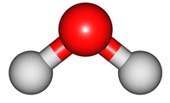
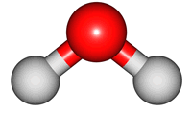
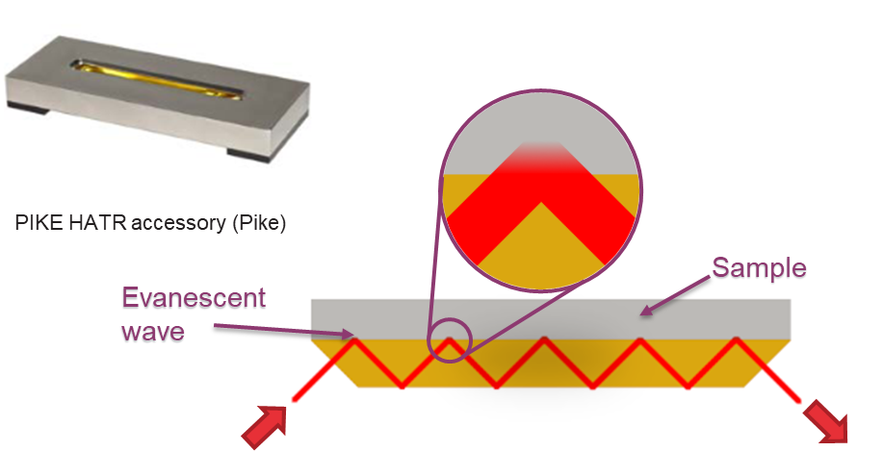


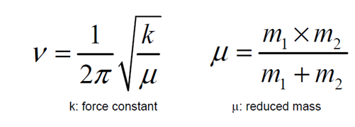



Vibrational Spectroscopy
Captures Molecular “fingerprint”
Molecular selectivity / Label free detection
Bending
(1595cm⁻¹ / 6.26µm)
IR spectroscopy
Raman spectroscopy
Molecules absorb IR radiation
Not affected by fluorescence
Water strongly absorbs IR light
Inelastic scattering of light
Fluorescence can mask Raman spectrum
Measurements can be done in water
Symmetric stretching
(3657cm⁻¹ / 2.73µm)
Asymmetric stretching
(3756cm⁻¹ / 2.66µm)
H₂O molecule
Stronger bond – higher vibrational energy
Heavier atoms – lower vibrational energy
[1] http://assign3.chem.usyd.edu.au/OrganicSpectroscopy/?type=Infrared
Notes:
Our approach was to use vibrational spectroscopy in the form of attenuated total reflectance FTIR and Raman spectroscopy and couple this to machine learning interpretation of spectra to predict the L/S ratio of liposomes
ATR-FTIR was chosen because it is well suited to probe samples in an aqueous matrix because of the limited optical path. Both these techniques capture molecular fingerprints of the molecules present which allows both their identification and quantification.
The two techniques are based on different selection rules, IR on changes in dipole moment and Raman on changes in polarizability. and so can be considered complementary. Where IR is unaffected by fluorescence but impacted by the strong IR absorption of water, Raman suffers from fluorescence masking spectral features but can be easily performed on aqueous samples.

Slide 5
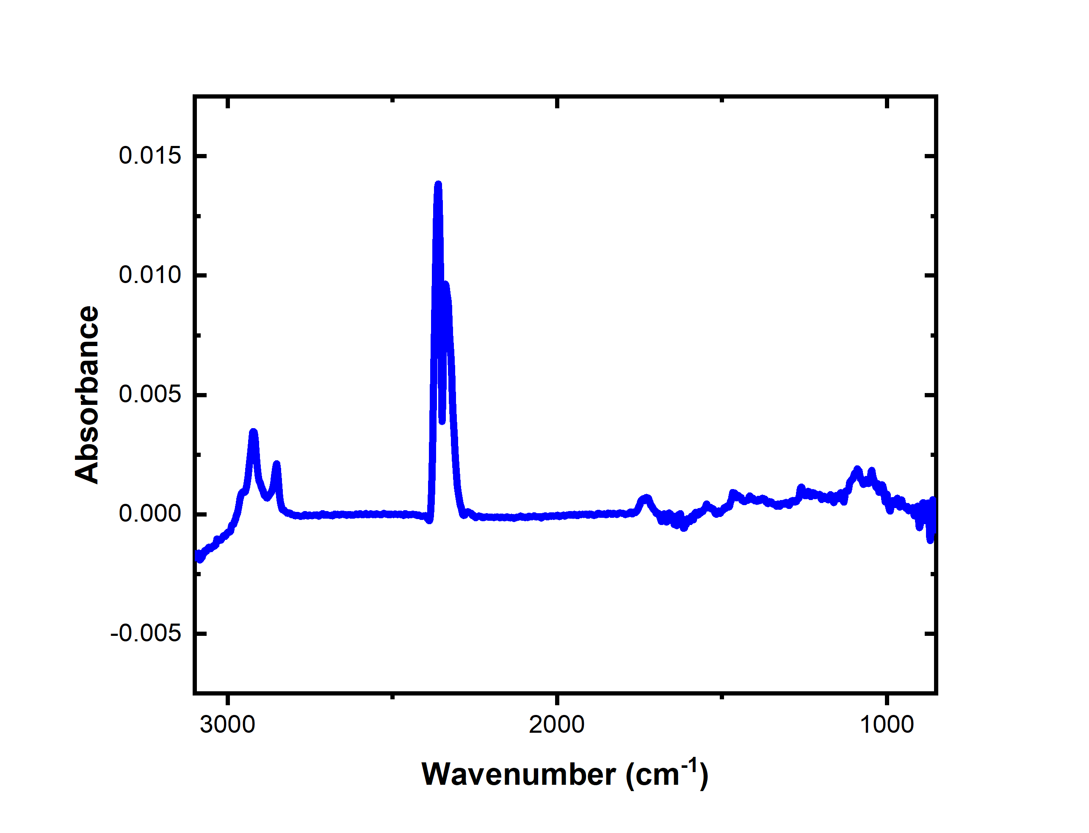
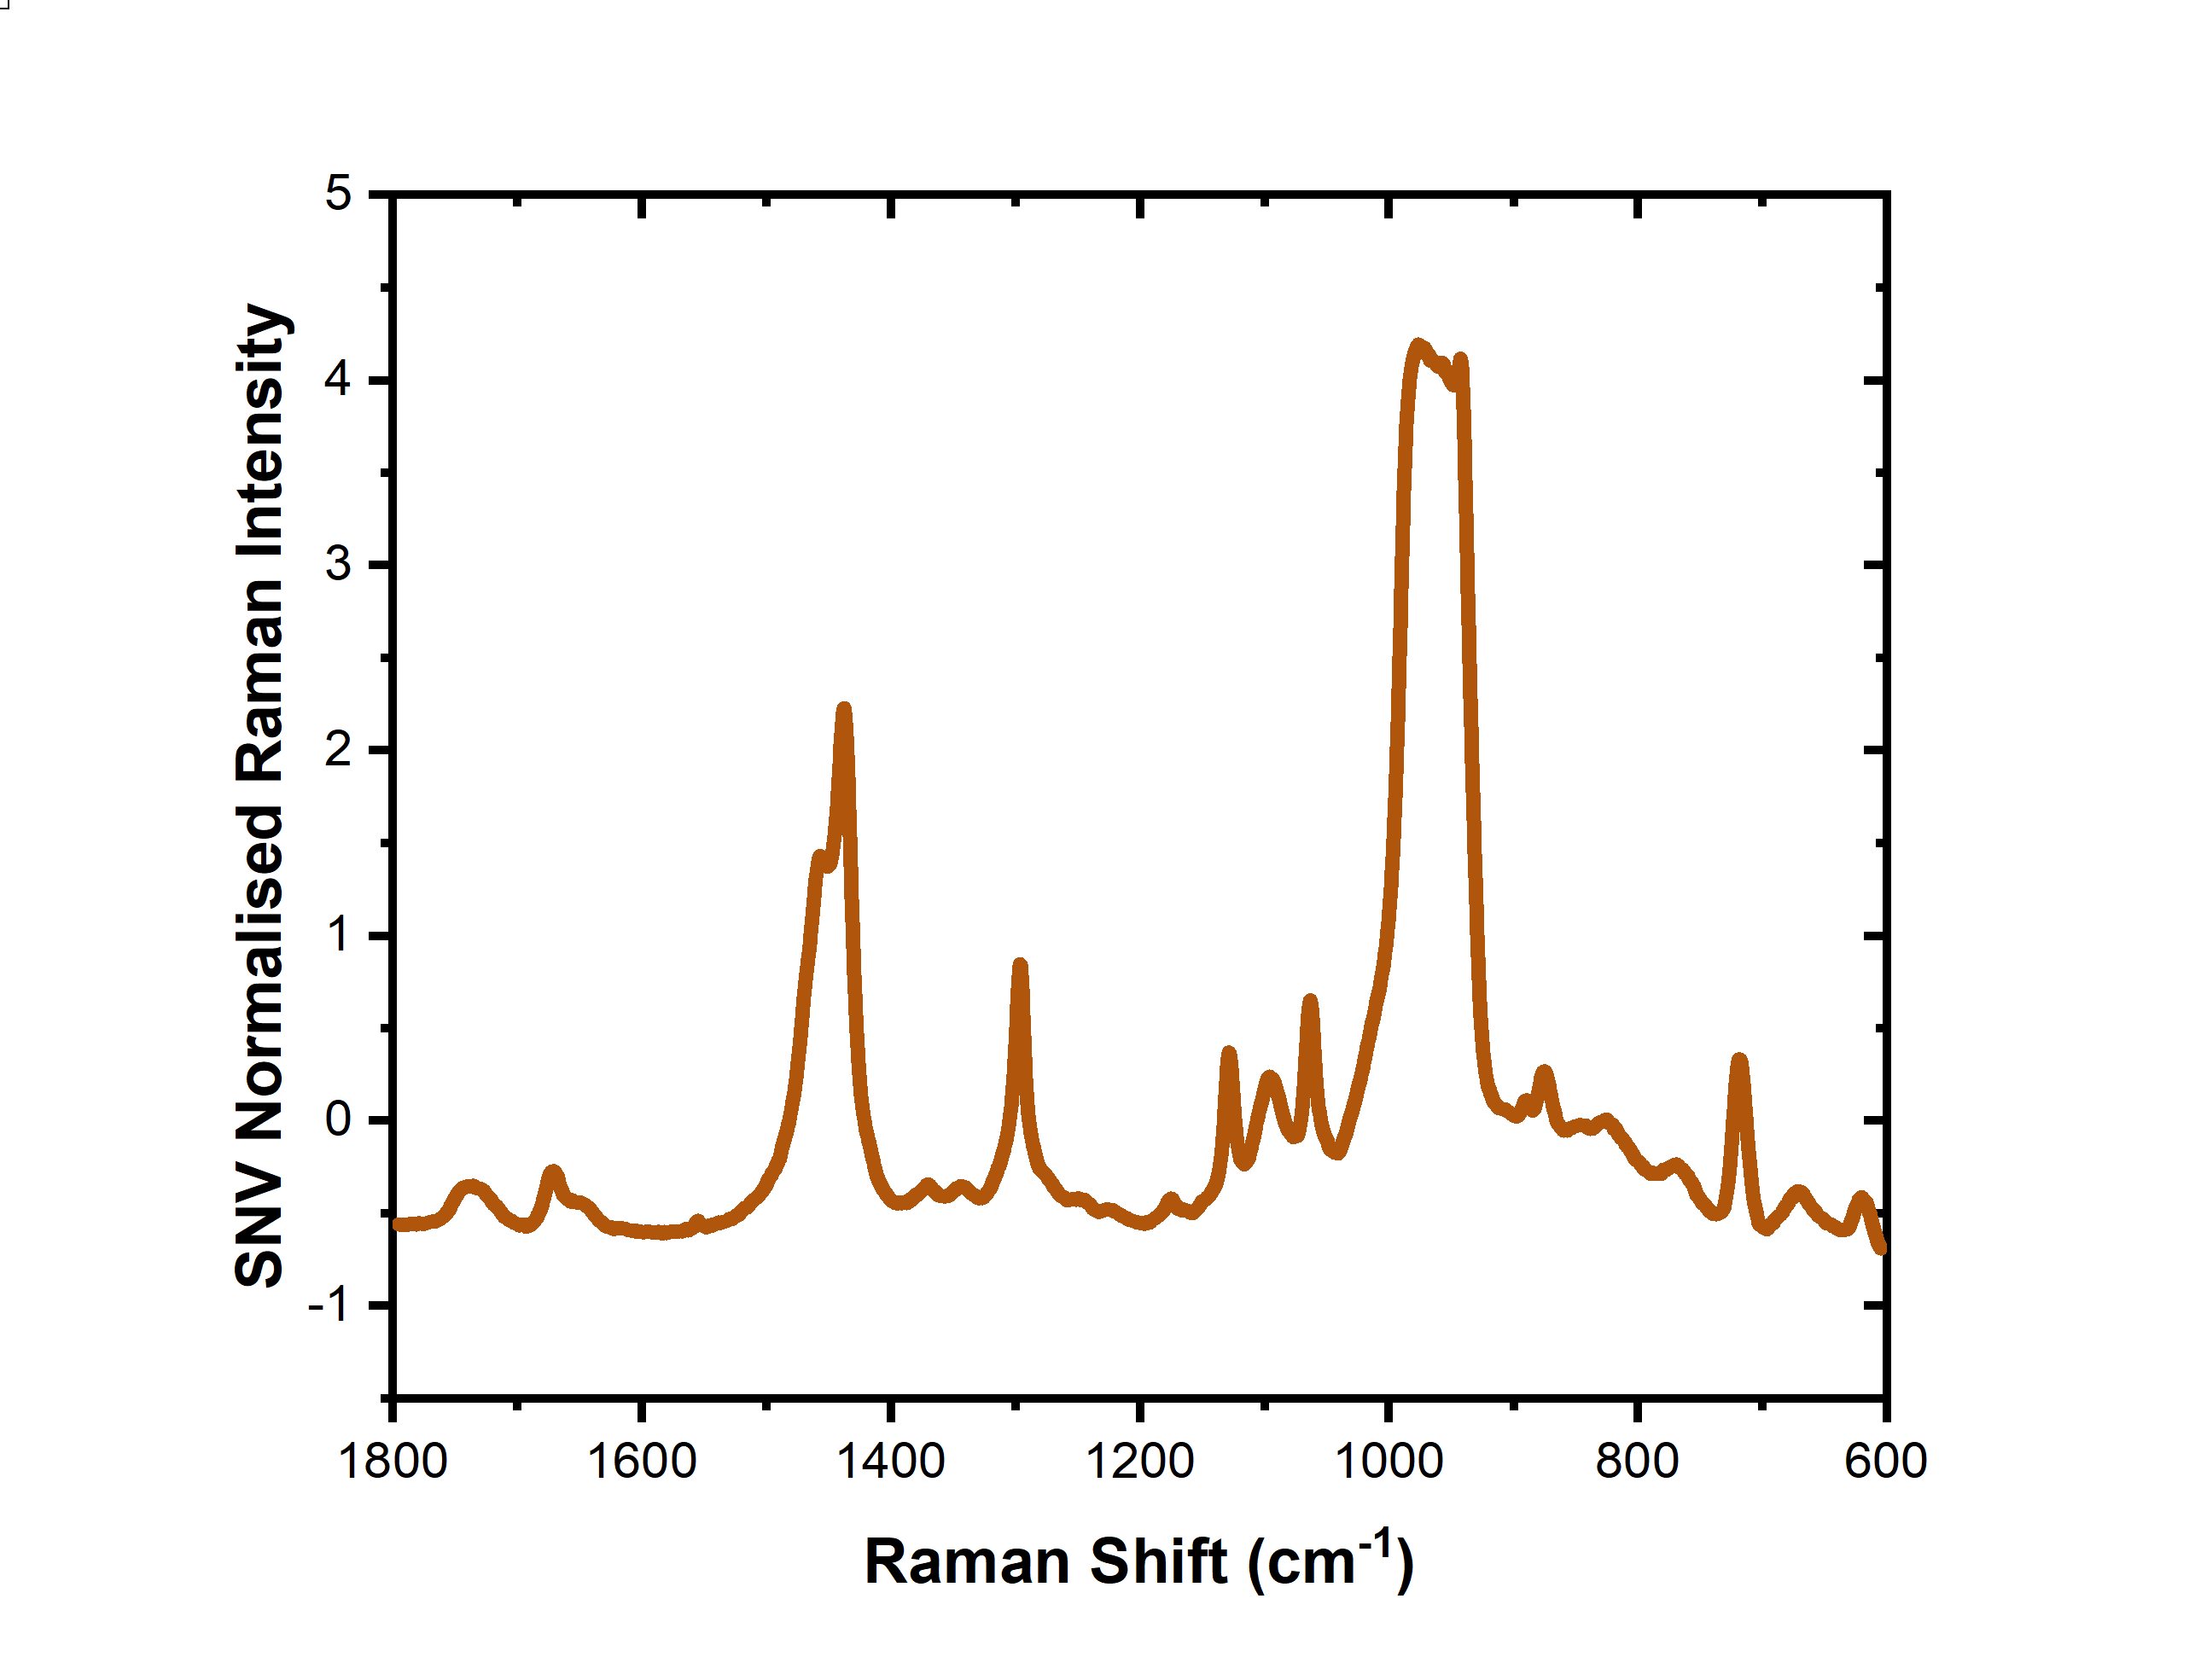
Data Fusion
High Level
Low Level
Data matrices joined
Model A
Data
Data
Average
Result
Model
Result
Model B
Notes:
To use both Raman and FTIR spectra together the data needs to be fused together in some manner
The two approaches we employed here were high and low level data fusion.
In the high fusion case the two individual modality models are passed their spectral inputs, and they both provide outputs. The outputs are combined in some way, in this case, by simple averaging, to give a single result output.
In the low level fusion case the two data matrices were concatenated and a single model trained with this joined dataset. We can then pass a concatenated dataset to the model and receive a single result output

Slide 6
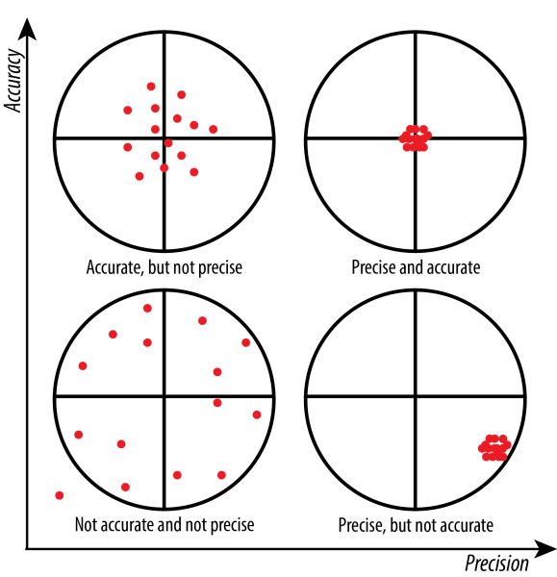
Prediction Intervals (PI)
Quantify uncertainty around future predictions: Prediction Interval
Conformal Predictors
  Non-parametric – no normality assumption
  Only requires exchangeability, not i.i.d residuals
  Coverage guarantee even when model bias present
Performance metrics
  Prediction interval width – smaller is more precise
  Mean squared error – smaller is more accurate
  Prediction interval coverage probability (PICP) – coverage reliability,
  Average coverage error (ACE) – PI reliability – 0 is best
[1] https://sixsigmadsi.com/precision-and-accuracy/
Notes:
It is not enough to simply train machine learning models and receive their output without understanding the uncertainty around that measurement. This can be addressed by using prediction intervals for a future reading that can quantify both the data related and the model related uncertainty
Traditionally prediction intervals are calculated using the standard deviation, but this requires that model output residuals conform to particular criteria, one of which is that they follow a gaussian distribution. This can not be guaranteed, particularly in ML or DL cases, and so we require an approach that relaxes this requirement. Using conformal predictors is a distribution independent way to calculate prediction intervals and so it can be used with any type of model, even when bias is present where the effect of the bias will be to widen the prediction bands
In terms of performance metrics we can consider that the accuracy and precision of the model with the uncertainties can be address by the mean squared error and the prediction interval width. We can also get an idea of how well specified the prediction intervals are by looking at the coverage probability and the average coverage error.

Slide 7
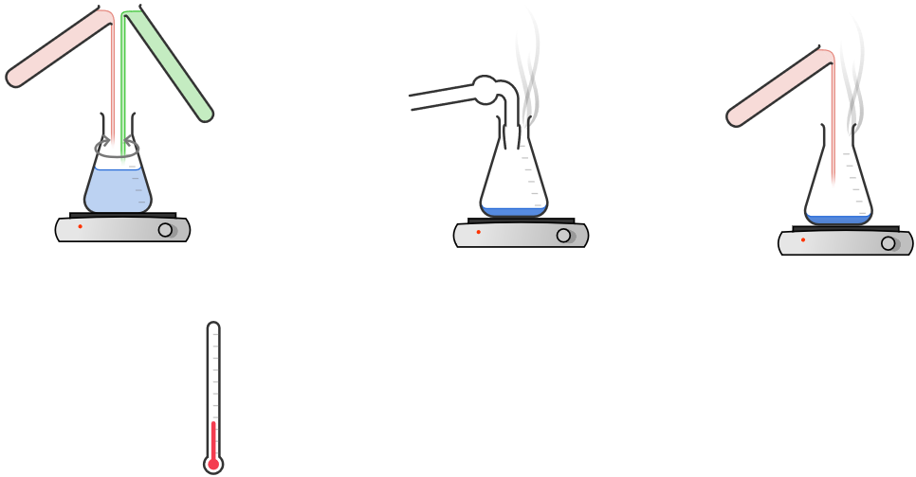
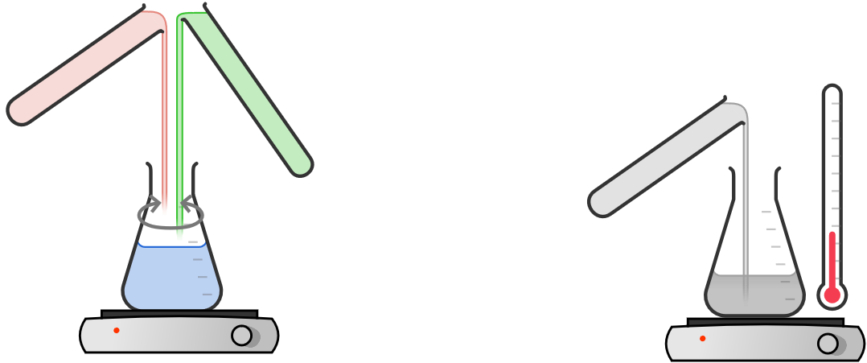

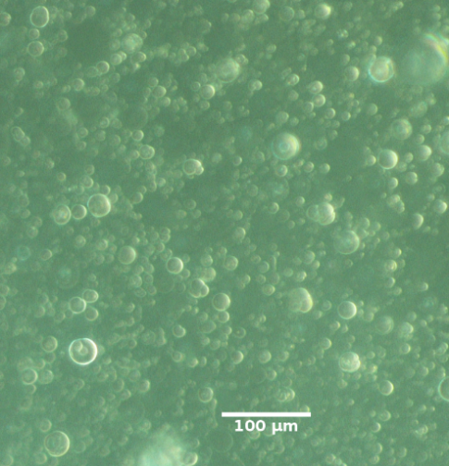



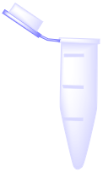
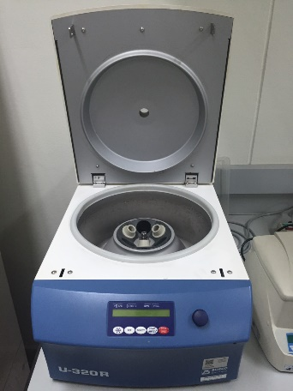
Liposome Generation
a
b
c
DPPC
SM
H₂O
N₂
f
e
d
[1] Veluthandath, A.V. et al. (2023a), J. Raman Spectrosc., 55(3)
Notes:
We generated the sample liposomes by first generating the correct molar mixtures in dichloromethane before drying them under nitrogen. We then resuspended this in water and then vortex mixed until homogenous. The larger liposomes were removed by centrifugation of the suspensions before performing measurements on them. The picture at F shows the form of the vesicles from the test mixtures.

Slide 8

Machine Learning
Initial Calibration with Cross Validation
Decide number of features
Partial Least Squares
Regression (PLSR)
$$1−α=0.95$$
Training Data
Experimental Data
Spectral
pre-processing
80%
Build Model
Uncertainty model
Test Data
20%
Test model with Test Set
Uncertainty prediction
Prediction
Notes:
Machine learning pathway to train Partial Least squared models – 3 models trained, FTIR, Raman, and a low-level fusion model
Initial common preprocessing – from other work
Split data early to prevent data leakage scenarios
Used training set to establish the number of latent variables in the partial least squares model
Retrained data on whole training set data
Used out of bag sampling to train an uncertainty model
Evaluated models on test set data, which was kept the same between all the models

Slide 9
FTIR Spectra of Vesicles
Peak | Assignment
A | CH₃/CH₂ stretch
B | CH₃/CH₂ stretch
C | C=O stretching (DPPC)
D | Amide I (C=O stretch)
E | CH₂ bend
F | PO⁻₂ stretch
G | C-O stretch
H | C-O stretch
I | PO⁻₂ stretch
J | C-O-C stretch
K | PO stretch
Notes:
FTIR spectra show characteristic features for both L and S
Concentrations not conserved between mixtures – the centrifugations step meant that ONLY the ratios are known, not the conc
Some notable features in these spectra are the features labelled C and D which correspond to the ester carbonyl bond on DPPL (L) at 1740 and 1650 wavenumber.

Slide 10
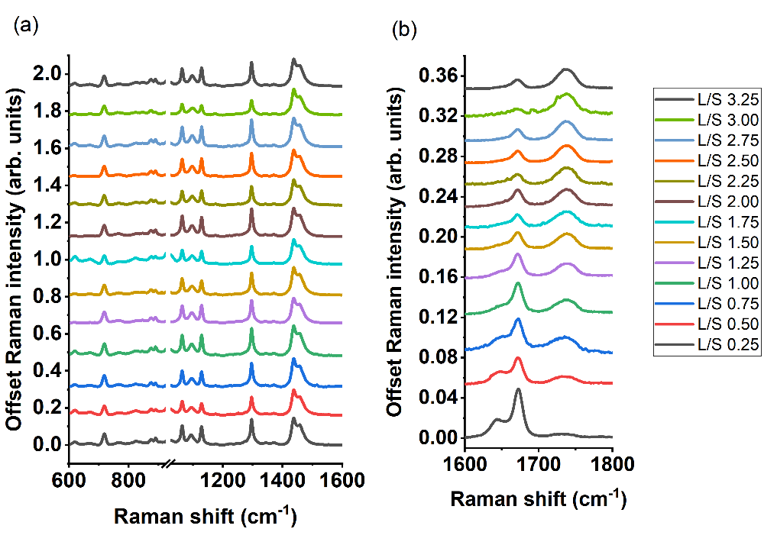
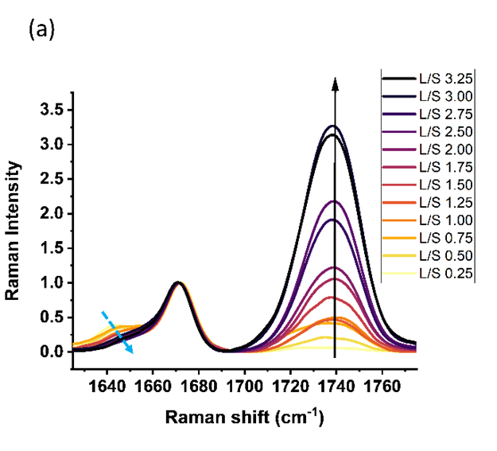
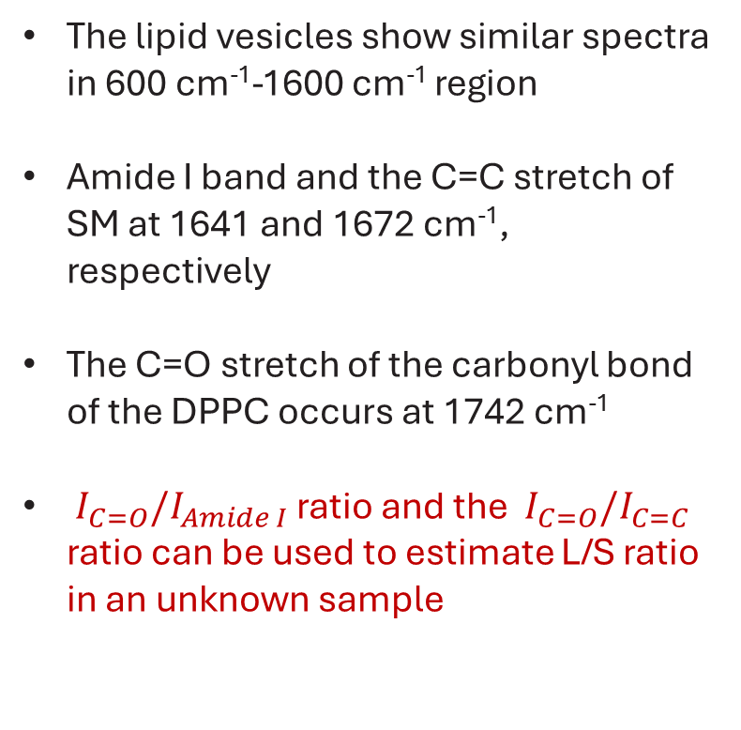
Raman Spectra of Vesicles
The lipid vesicles show similar spectra in 600 cm⁻¹-1600 cm⁻¹ region
Amide I band and the C=C stretch of SM at 1641 and 1672 cm⁻¹, respectively
The C=O stretch of the carbonyl bond of the DPPC occurs at 1742 cm⁻¹
$I_{C=O}/I_{Amide I}$ ratio and the $I_{C=O}/I_{C=C}$ ratio can be used to estimate L/S ratio in an unknown sample
[1] A V Veluthandath, W. Ahmed, G S Murugan et al., Raman Spectroscopy. (2023)
Notes:
The Raman spectra show similar features to the IR spectra, again the amide 1 bond at 1650 close to the C=C stretch and the ester carbonyl at 1740 Raman shift.
A univariate analysis showed that we can predict the L/S ratio by comparting the peak intensities of the ester carbonyl with the peak intensity either of the amide 1 bond, or

Slide 11
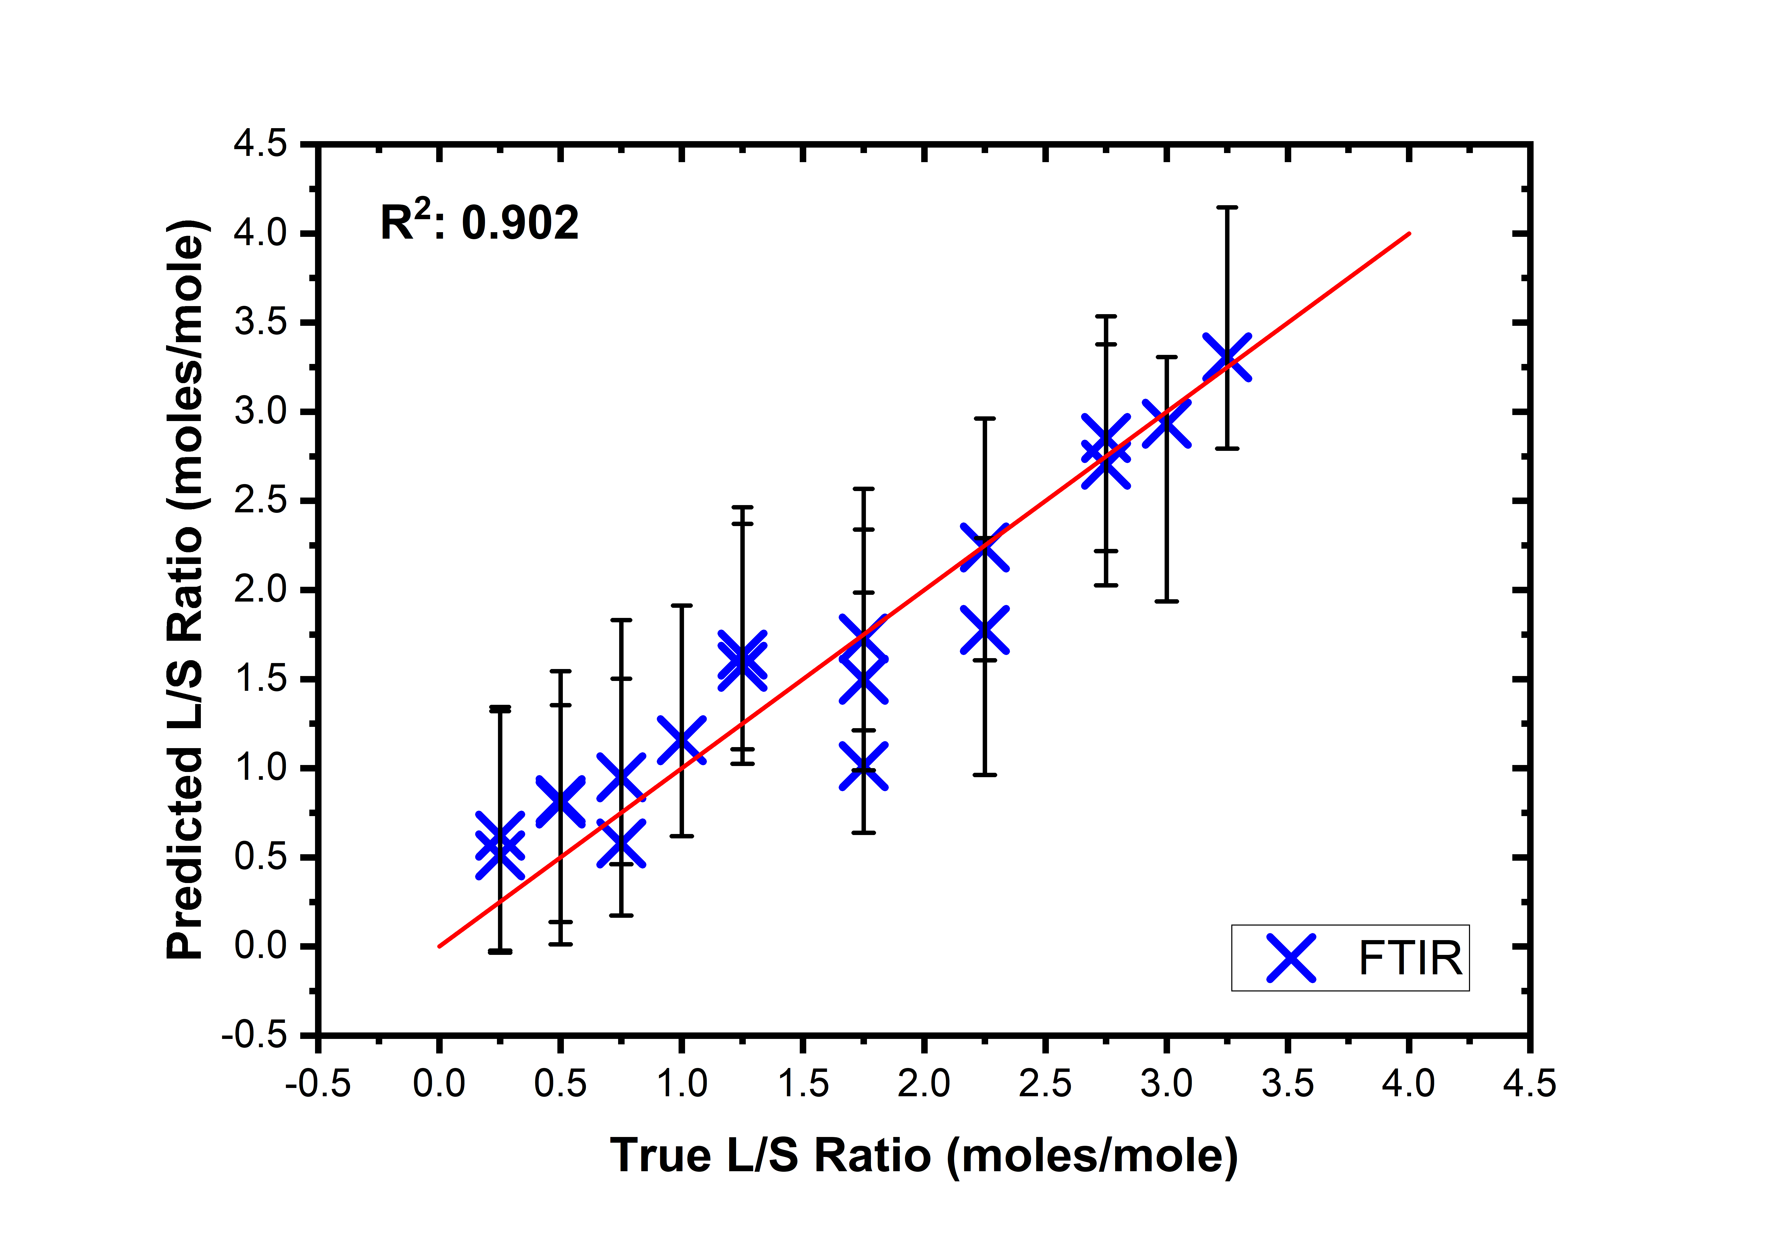
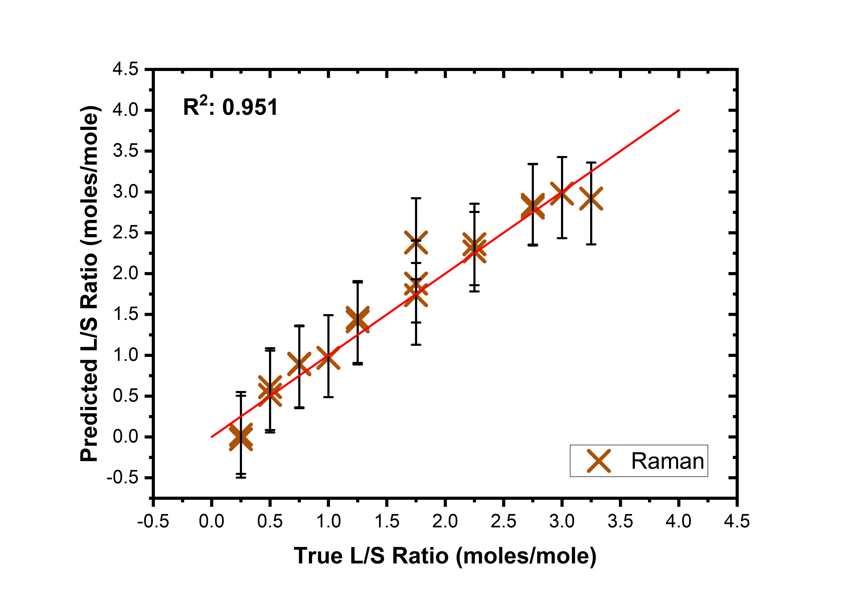
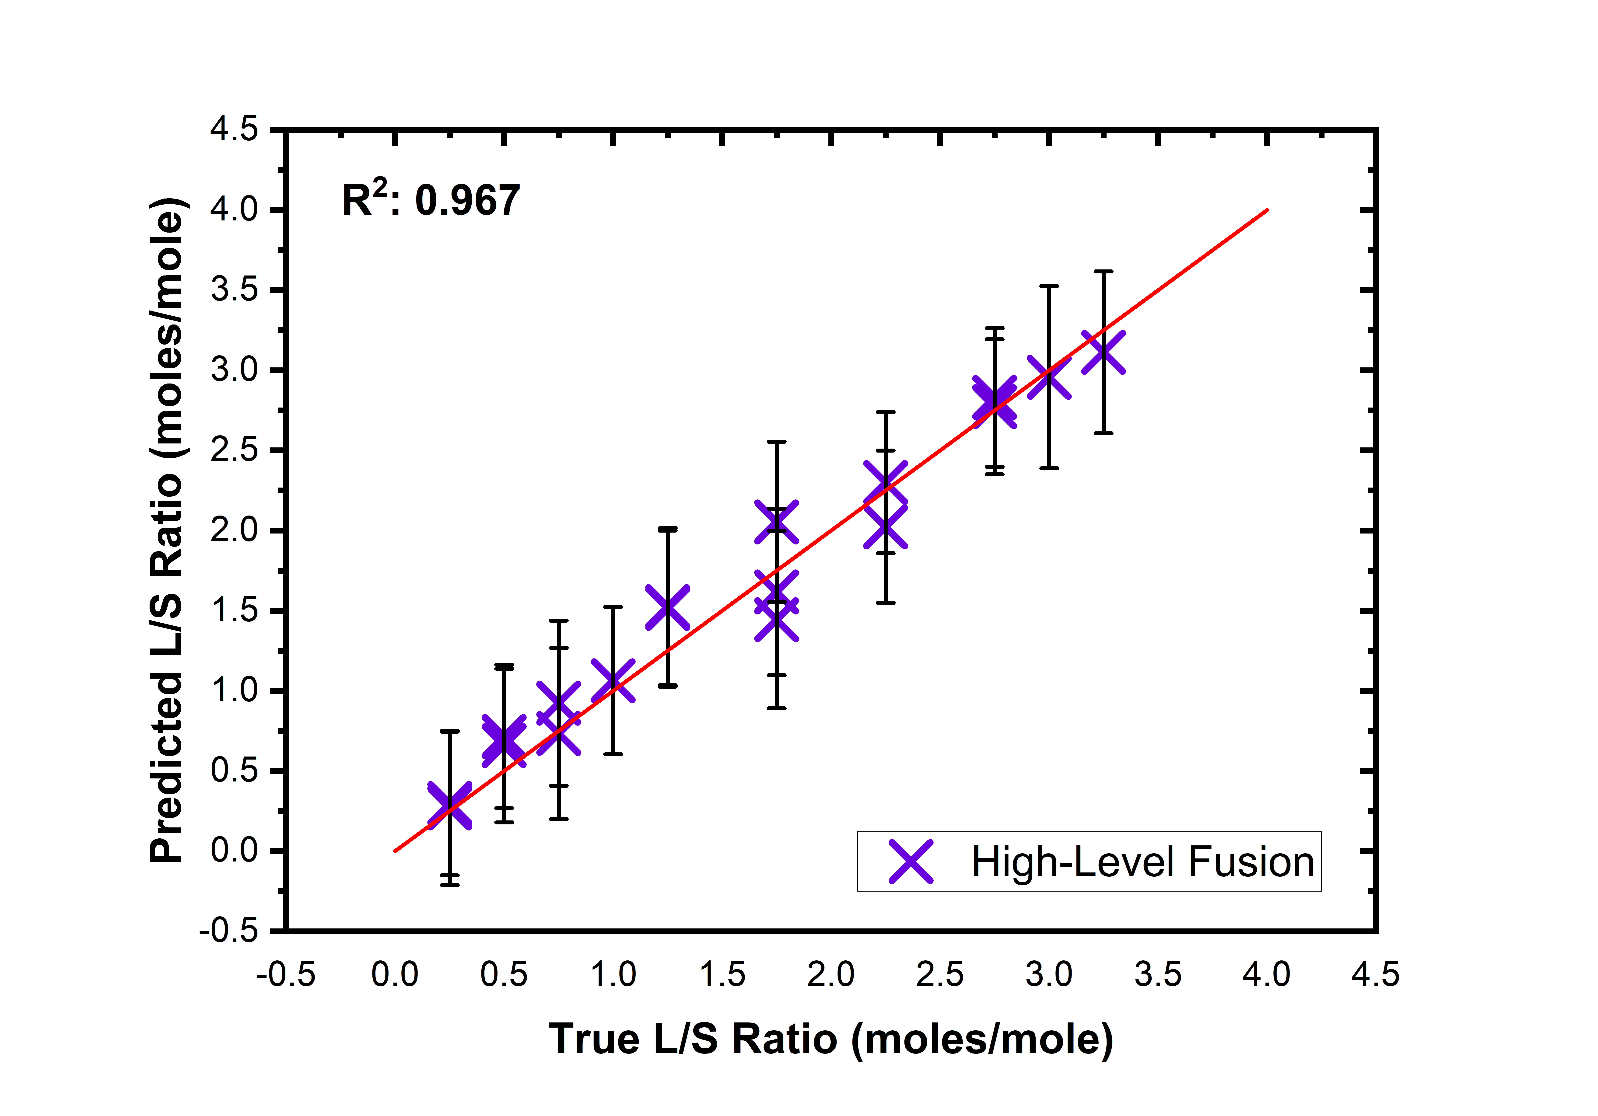
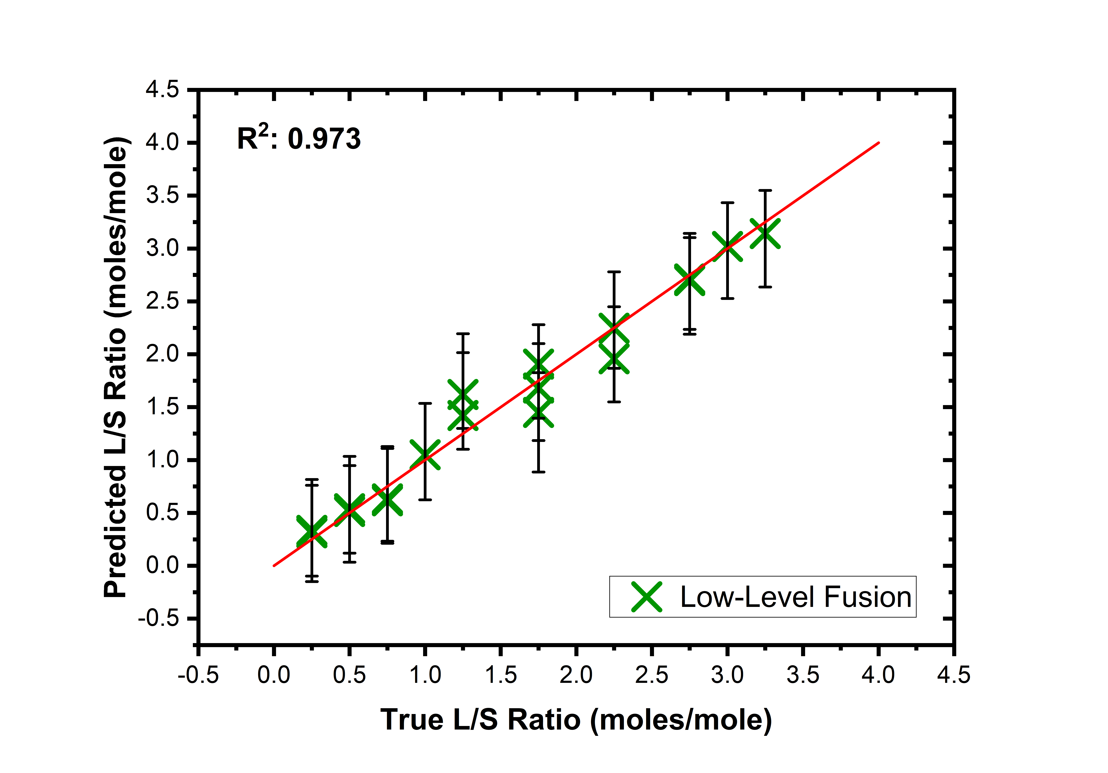
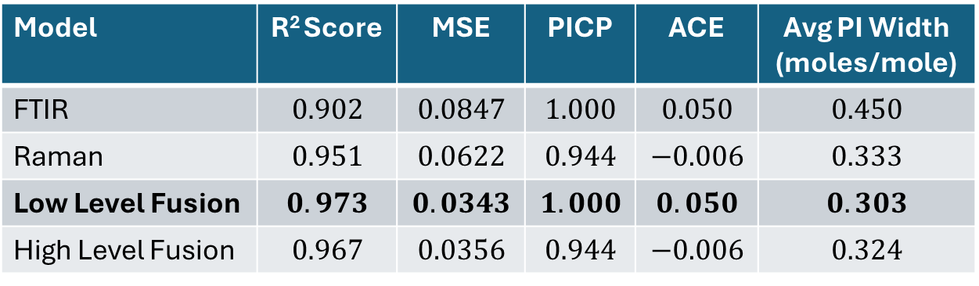
Prediction Intervals Results Summary
Model | R² Score | MSE | PICP | ACE | Avg PI Width (moles/mole)
FTIR | $$0.902$$ | $$0.0847$$ | $$1.000$$ | $$0.050$$ | $$0.450$$
Raman | $$0.951$$ | $$0.0622$$ | $$0.944$$ | $$−0.006$$ | $$0.333$$
Low Level Fusion | $$0.973$$ | $$0.0343$$ | $$1.000$$ | $$0.050$$ | $$0.303$$
High Level Fusion | $$0.967$$ | $$0.0356$$ | $$0.944$$ | $$−0.006$$ | $$0.324$$
More accurate
More precise
Notes:
The graphs on the right show the performance for each of the models mentioned in this presentation
The results show that the Raman model performed better than the FTIR model in terms of both precision and accuracy but the Fusion models both outperformed the individual models
The low level fusion model was the most accurate and precise of all the models tested with the lowest MSE and the smallest average PI width, supporting the idea that by taking a Data fusion approach it is possible improve model performance over individual models in terms of both accurary and prescion.

Slide 12
Summary
IR and Raman spectroscopies used to measure the composition ratios of binary liposomes (L and S)
Low-level fusion PLSR model more accurate (smaller MSE) and precise (smaller average PI width) than individual and high-level fusion models
Clinical measurements planned

Slide 13

Thank you
Contact: waseem.ahmed@soton.ac.uk
This research was supported by the UK Engineering and Physical Sciences Research Council (EPSRC grant EP/S03109X/1)

Slide 14
Individual Model Results

Slide 15
Fused Model Results

