Slide 1
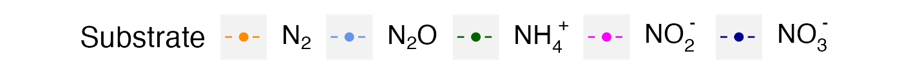
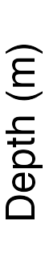
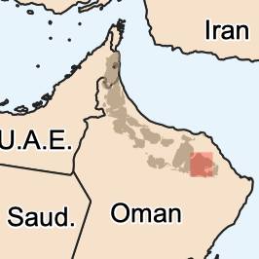
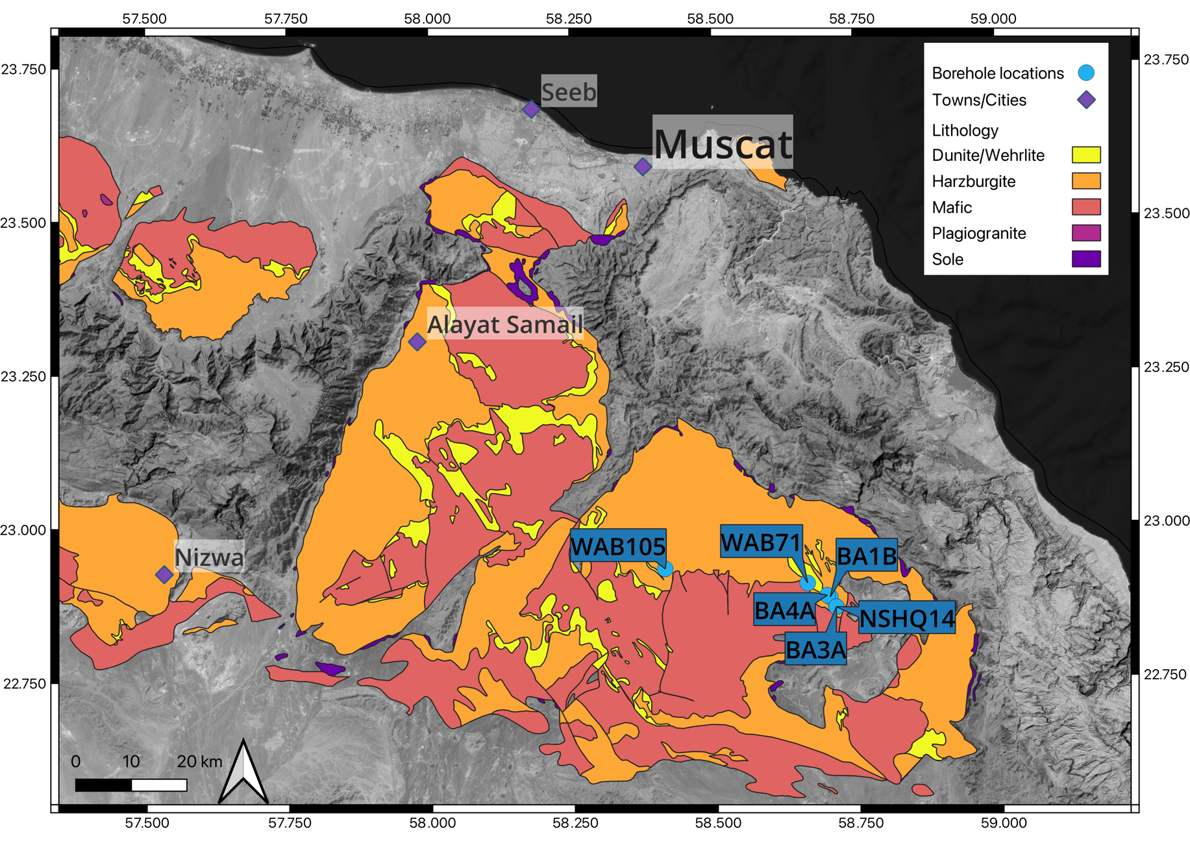
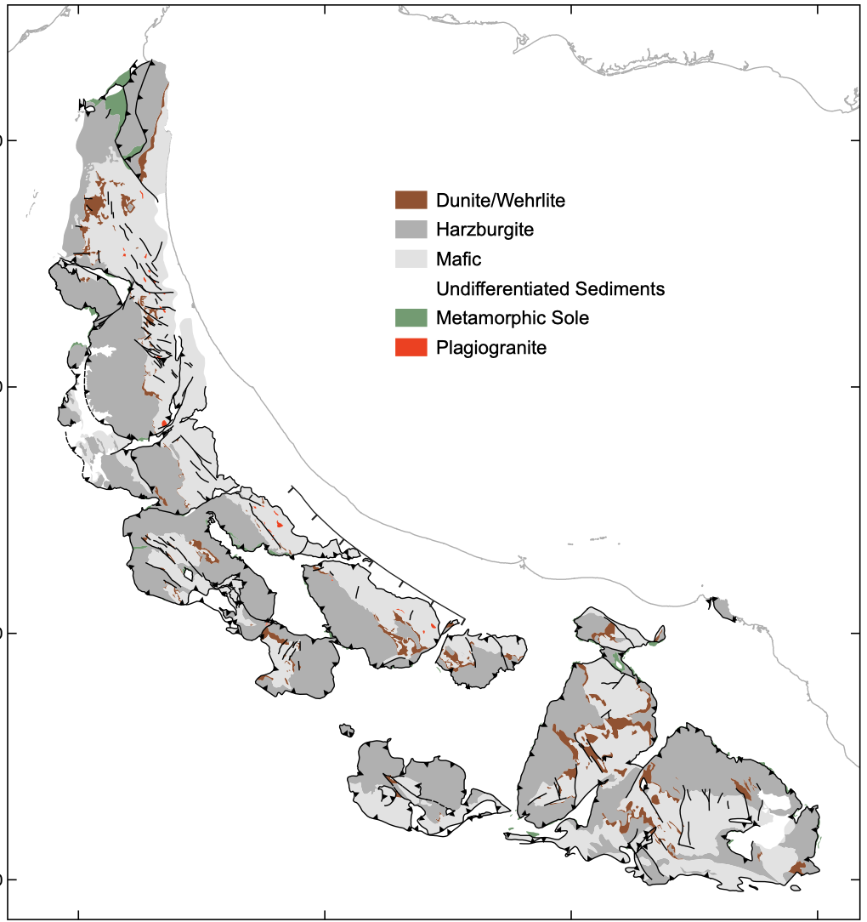
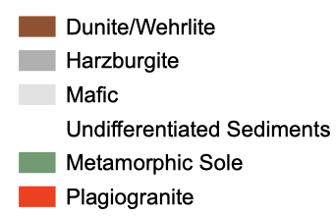
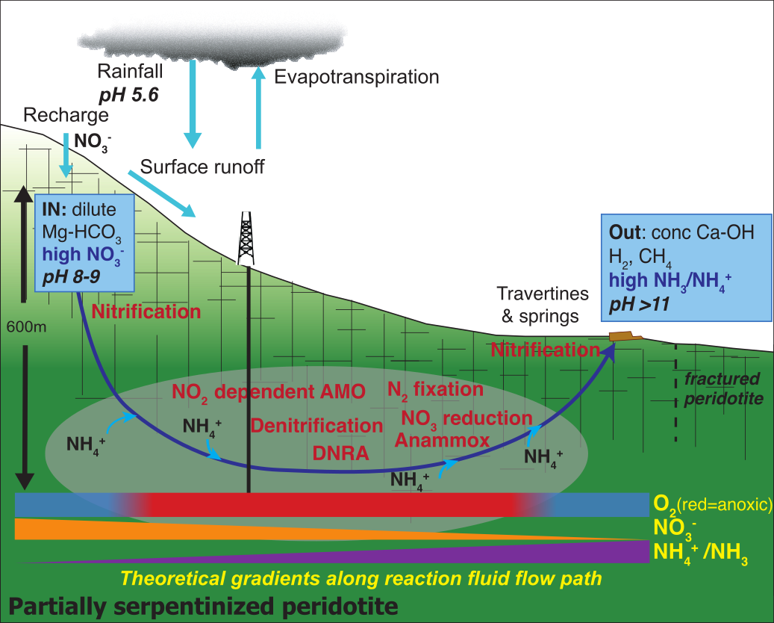
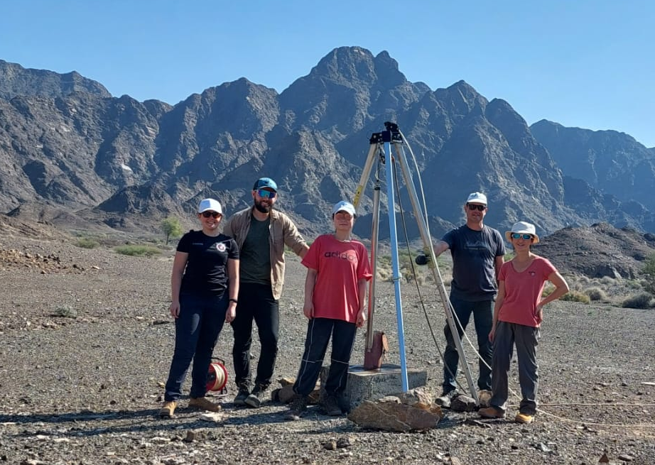



Nitrogen Cycling in a Subsurface Serpentinizing System:
Insights into Life’s Origins
Yueyue Si, Michael Stocker, Joanna Shannon, Juerg Matter, Phyllis Lam
School of Ocean and Earth Science, University of Southampton, Southampton SO14 3ZH, UK
Subsurface serpentinization generates heat, hydrogen, methane, simple organic compounds, and establishes redox and pH gradients that could support early life on Earth.
While nitrogen (N) is essential for life, how early life accessed it remains unclear.
We used ¹⁵N-isotope tracers and fluid incubations to explore microbial N-transformations within the Samail Ophiolite, one of the world’s largest and best-exposed serpentinizing systems.
Where Does the N Come From?
BA1B
BA3A
An Active Serpentinizing System
Borehole | Conditions | N₂ fixation | NH₄⁺ assimilation | Others
BA1B | Oxidised Slightly alkaline High nitrate | 74% | 23% | 3%
BA3A | Reduced Hyperalkaline High ammonium | 44% | 54% | 2%
Hypothesised Niches of N-cycling Processes
Modified from Nicolas et al., 2000 and Nothaft et al., 2021
Nutrients along Redox/pH Gradients
Ammonium predominated in hyperalkaline, reduced fluids
Nitrate dominated in oxidised, slightly alkaline fluids
Dissolved CH₄, CO₂, and N₂O in the Fluids
N-cycling Processes in the Fluids
NH₄⁺ NO₂⁻
Nitrification
NH₄⁺ NO₃⁻
NO₃⁻ reduction
DNRA
NO₂⁻ NO₃⁻
NO₃⁻ NO₂⁻
NO₃⁻ NH₄⁺
Opposite patterns of CH₄ and CO₂ with pH: CH₄ was enriched in reduced, hyperalkaline boreholes
Nitrification in oxic fluids led to net N₂O production, whereas anoxic fluids were net consumers of N₂O via denitrification.
(pH 8)
(pH 11.4)
Interaction Between N and C Cycles
Energy-yielding nitrification and nitrate reduction to nitrite were enhanced in oxidised fluids, whereas DNRA occurred only in reduced fluids.
Contact:
y.si@soton.ac.uk
Adding CH₄ stimulated N₂O production from nitrite, indicating a link between CH₄ oxidation and incomplete denitrification.

