Slide 1
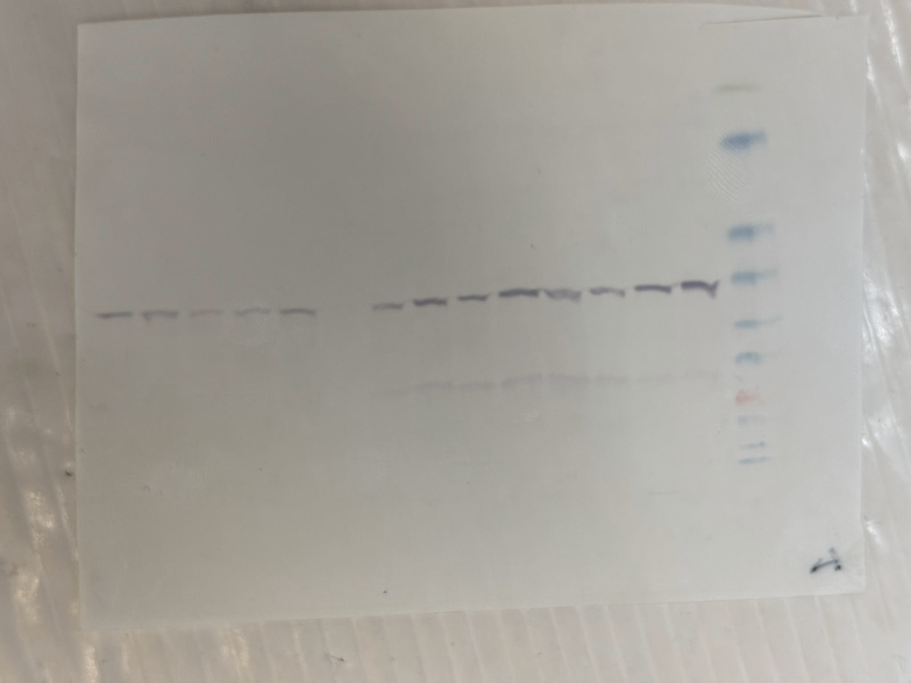
Experiment 1
KDa
170
1
2
3
4
5
6
7
8
9
10
11
12
13
14

Slide 2
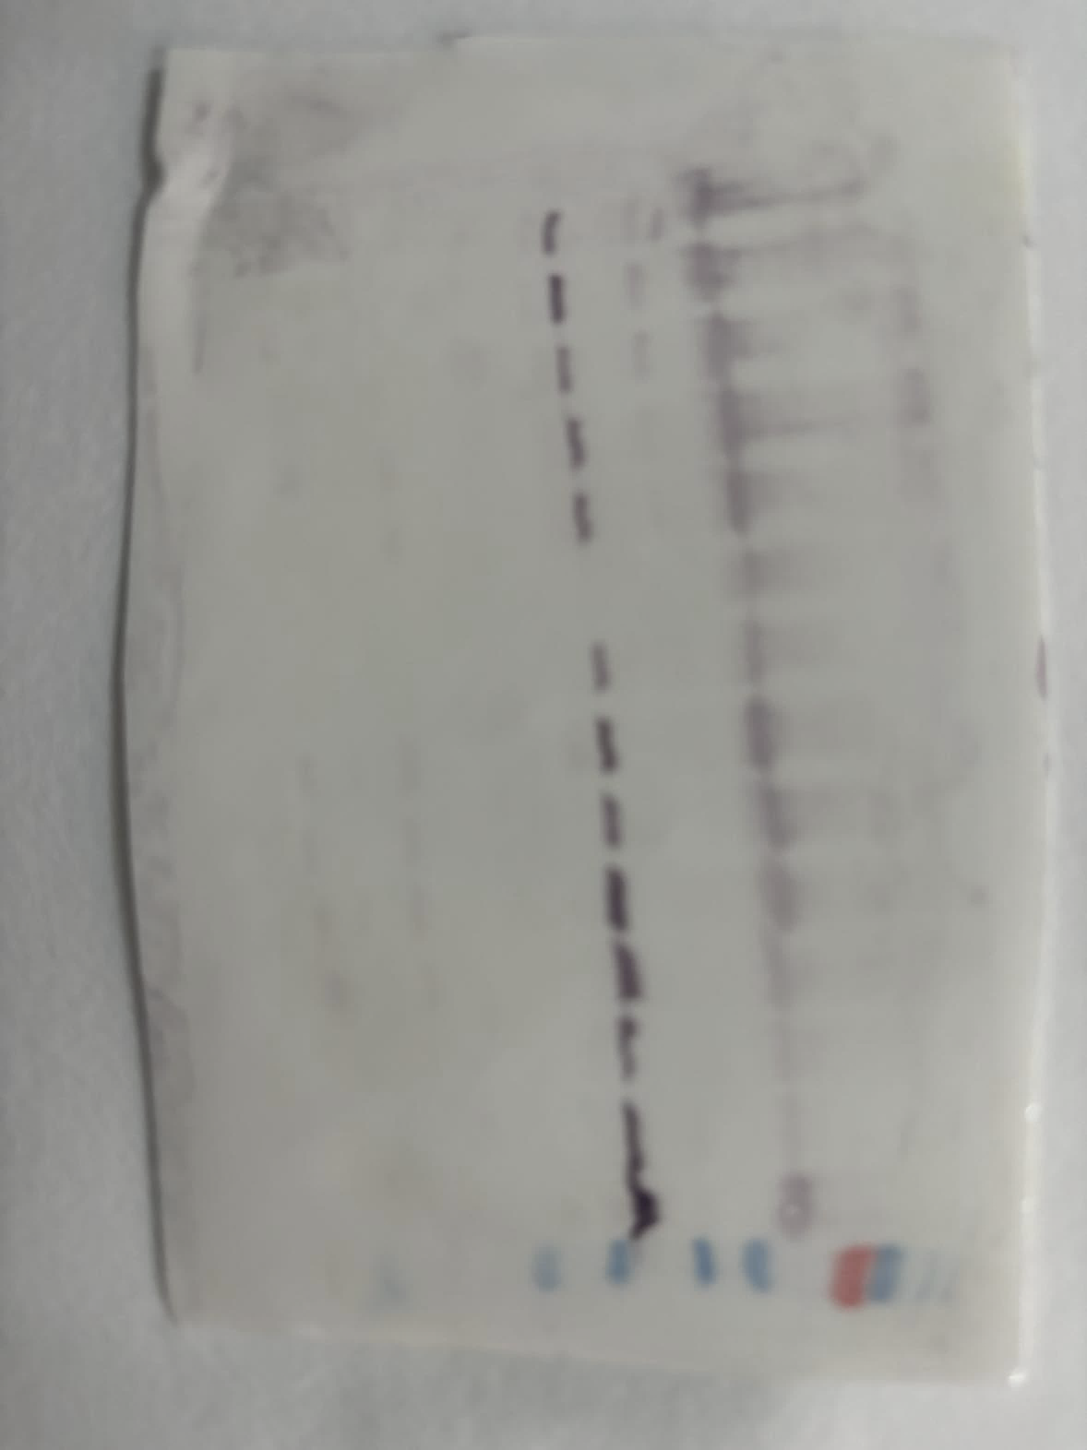
Experiment 2
KDa
1
2
3
4
5
6
7
8
9
10
11
12
13
14

Slide 3
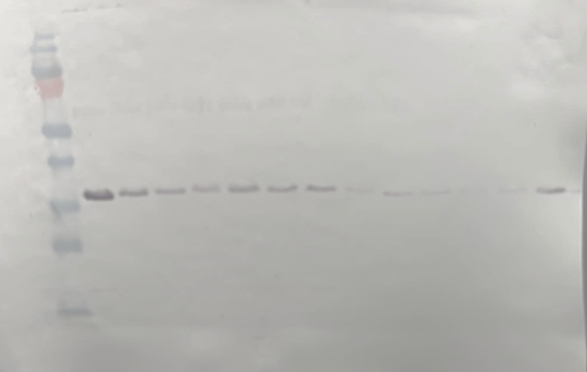
Experiment 3
KDa
1
2
3
4
5
6
7
8
9
10
11
12
13
14

Slide 4
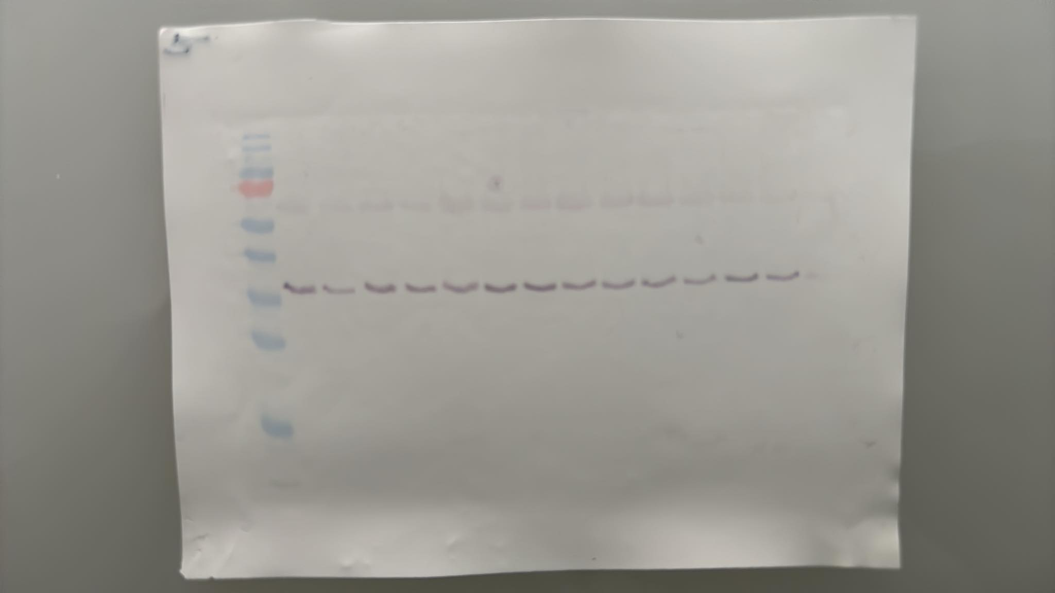

KDa
170
130
100
70
55
40
35
25
15
10
15
16
17
18
19
20
21
22
23
24
25
26
27

Slide 5
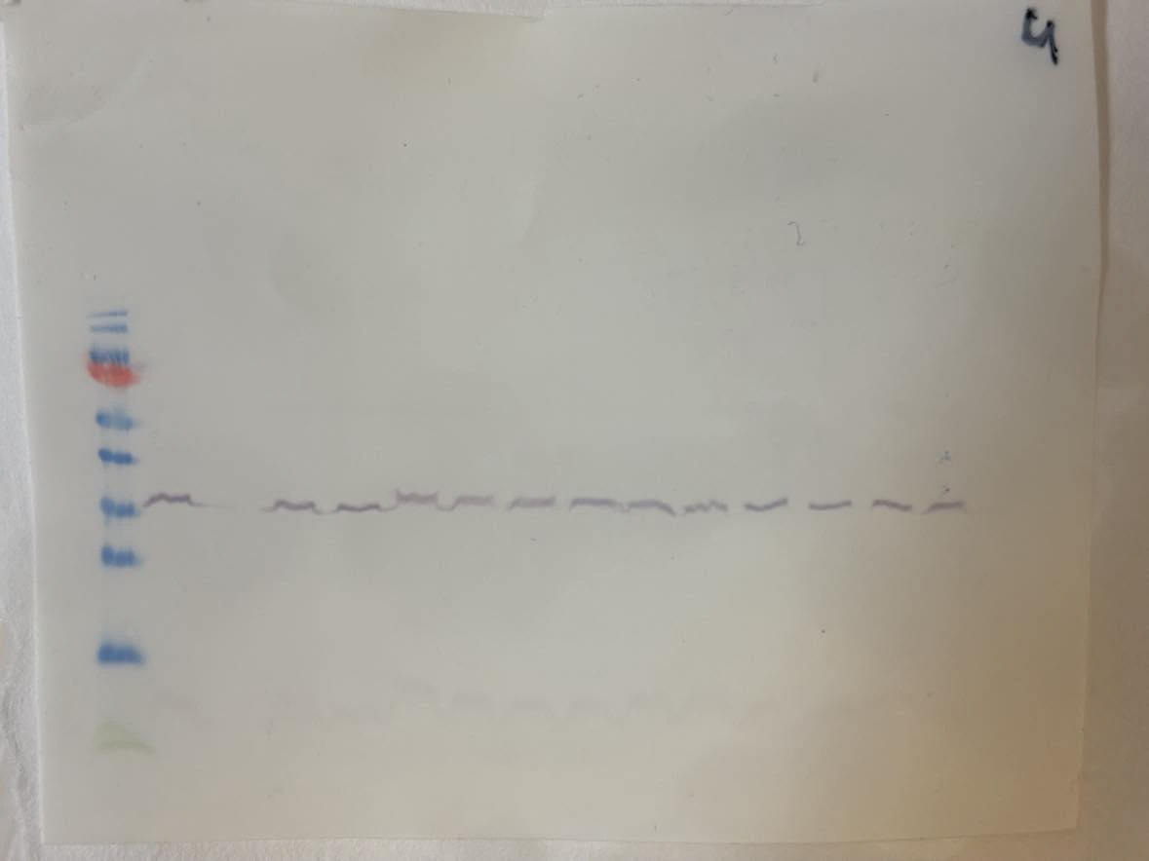
Experiment 2
KDa
170
130
100
70
55
40
35
25
15
10
15
16
17
18
19
20
21
22
23
24
25
26
27

Slide 6
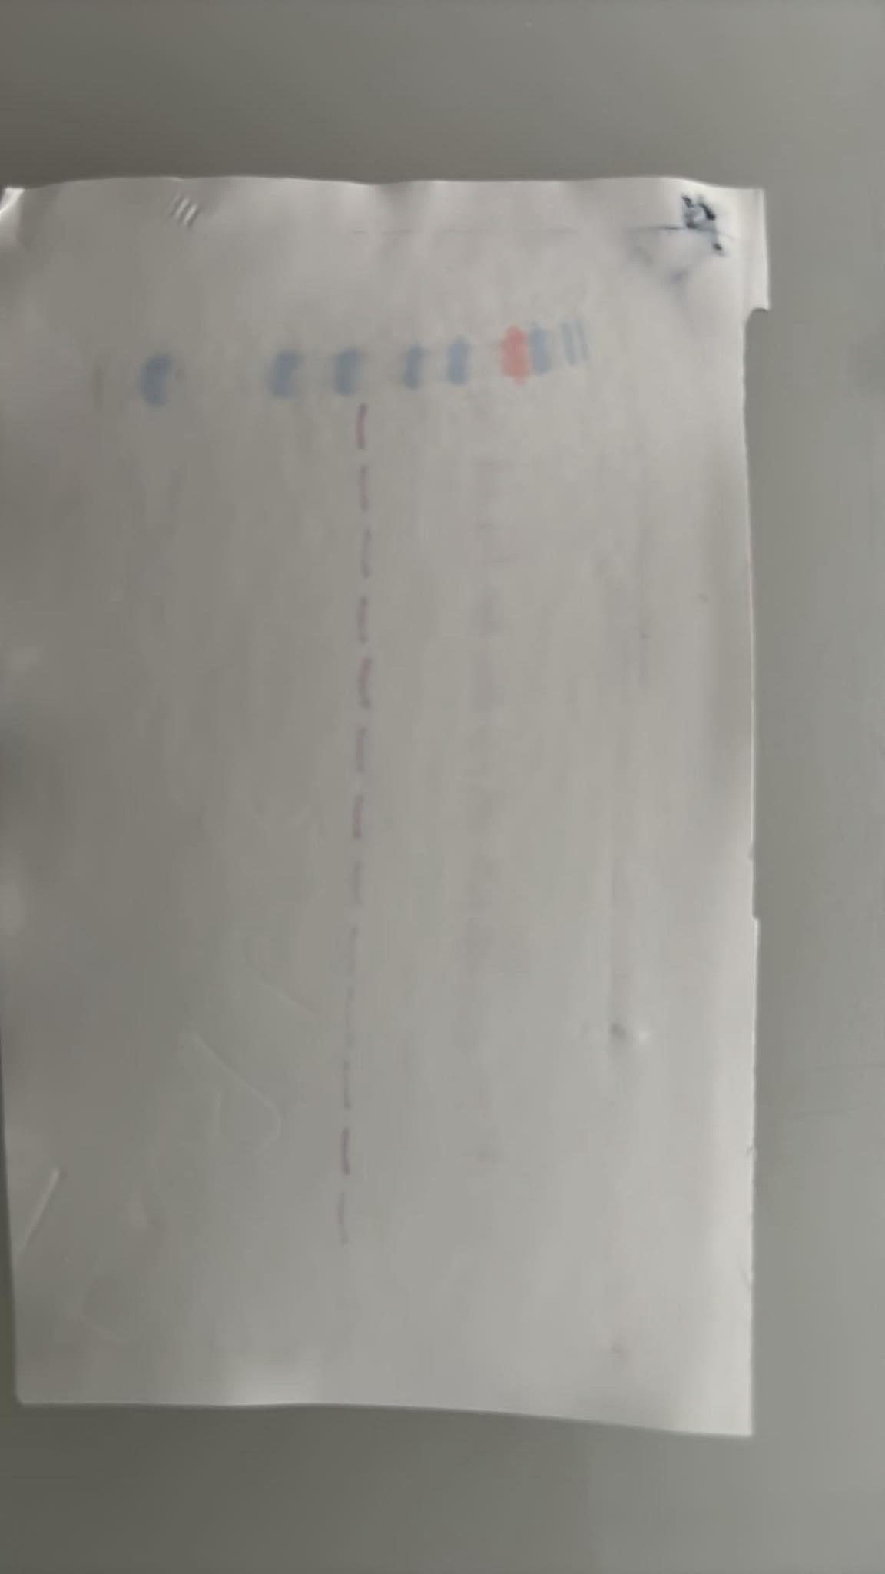
Experiment 3
KDa
170
130
100
70
55
40
35
25
15
10
15
16
17
18
19
20
21
22
23
24
25
26
27

Slide 7
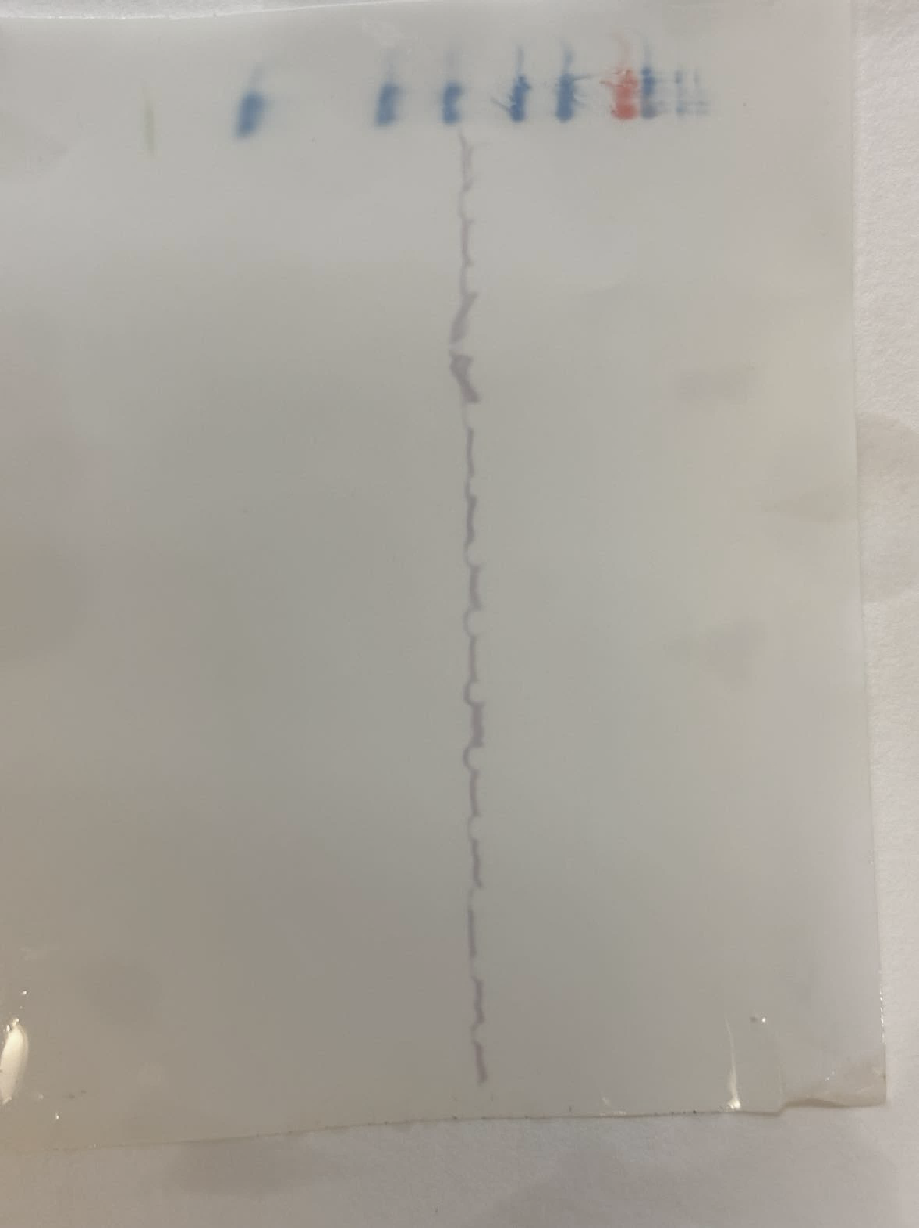
Experiment 1
KDa
170
130
100
70
55
40
35
28
29
30
31
32
33
34
35
36
37
38
39
40
41

Slide 8
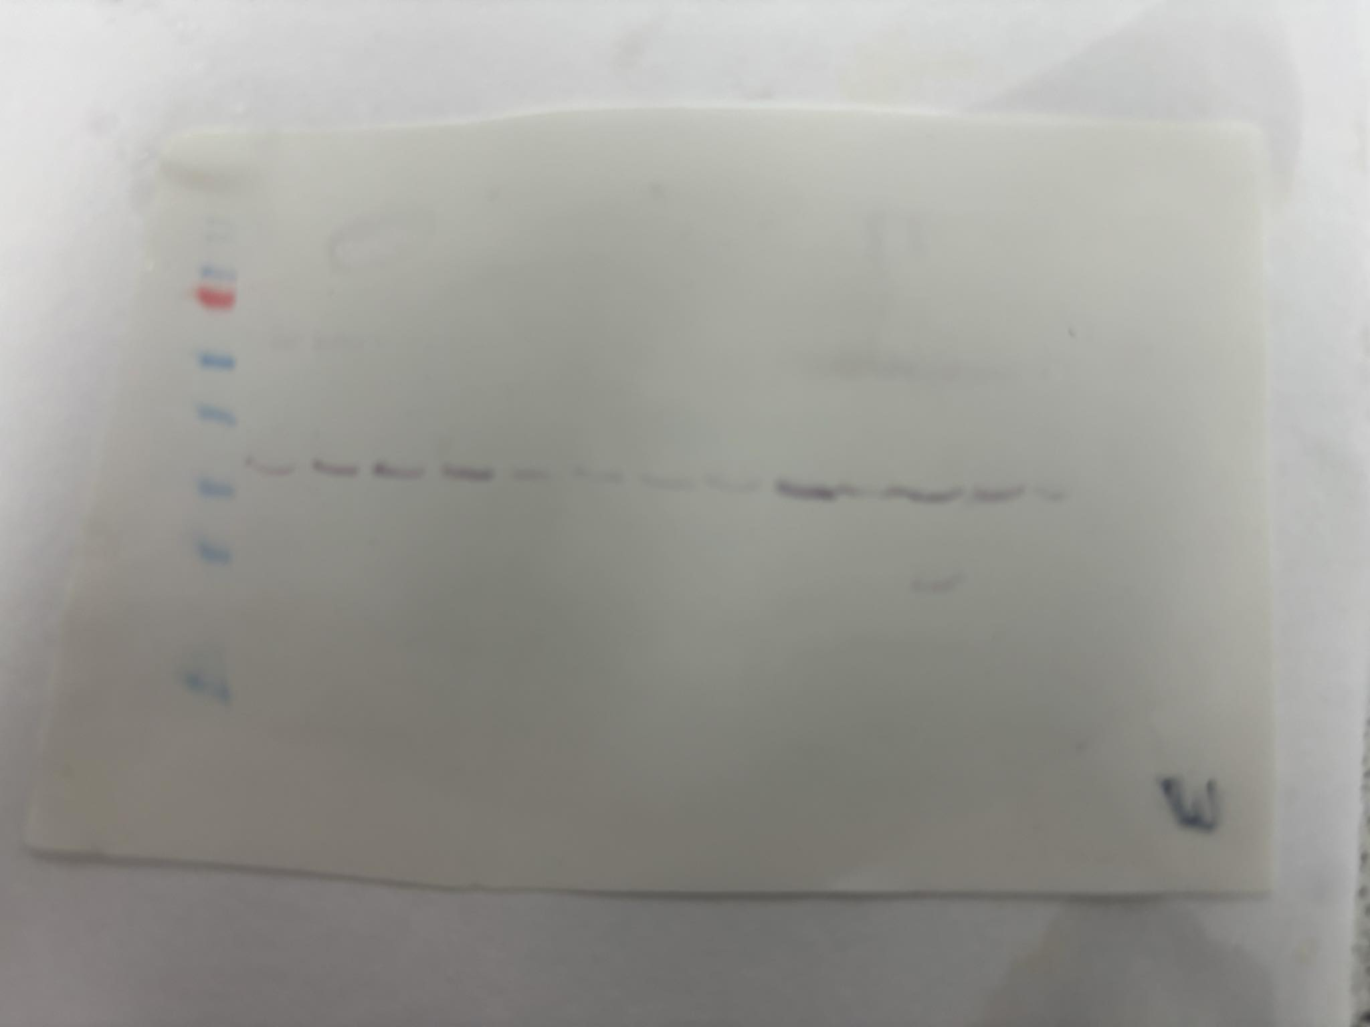
Experiment 2
KDa
170
130
100
70
55
40
35
28
29
30
31
32
33
34
35
36
37
38
39
40
41

Slide 9
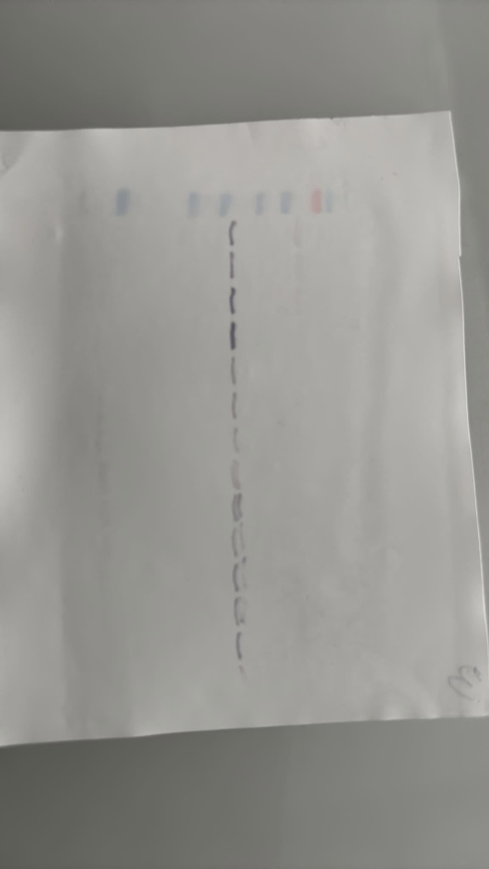
Experiment 3
KDa
170
130
100
70
55
40
35
28
29
30
31
32
33
34
35
36
37
38
39
40
41

Slide 10
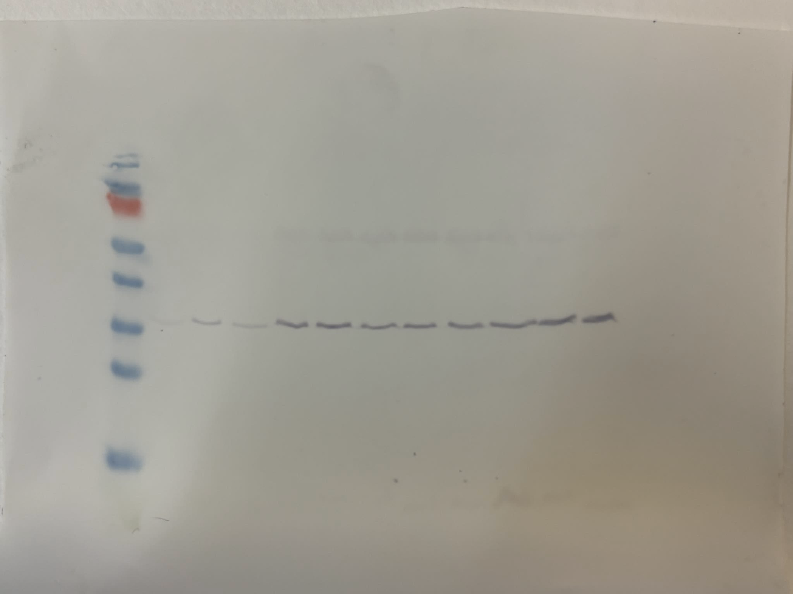
Experiment 1
KDa
170
130
100
42
43
44
45
46
47
48
49
50
51
52

Slide 11
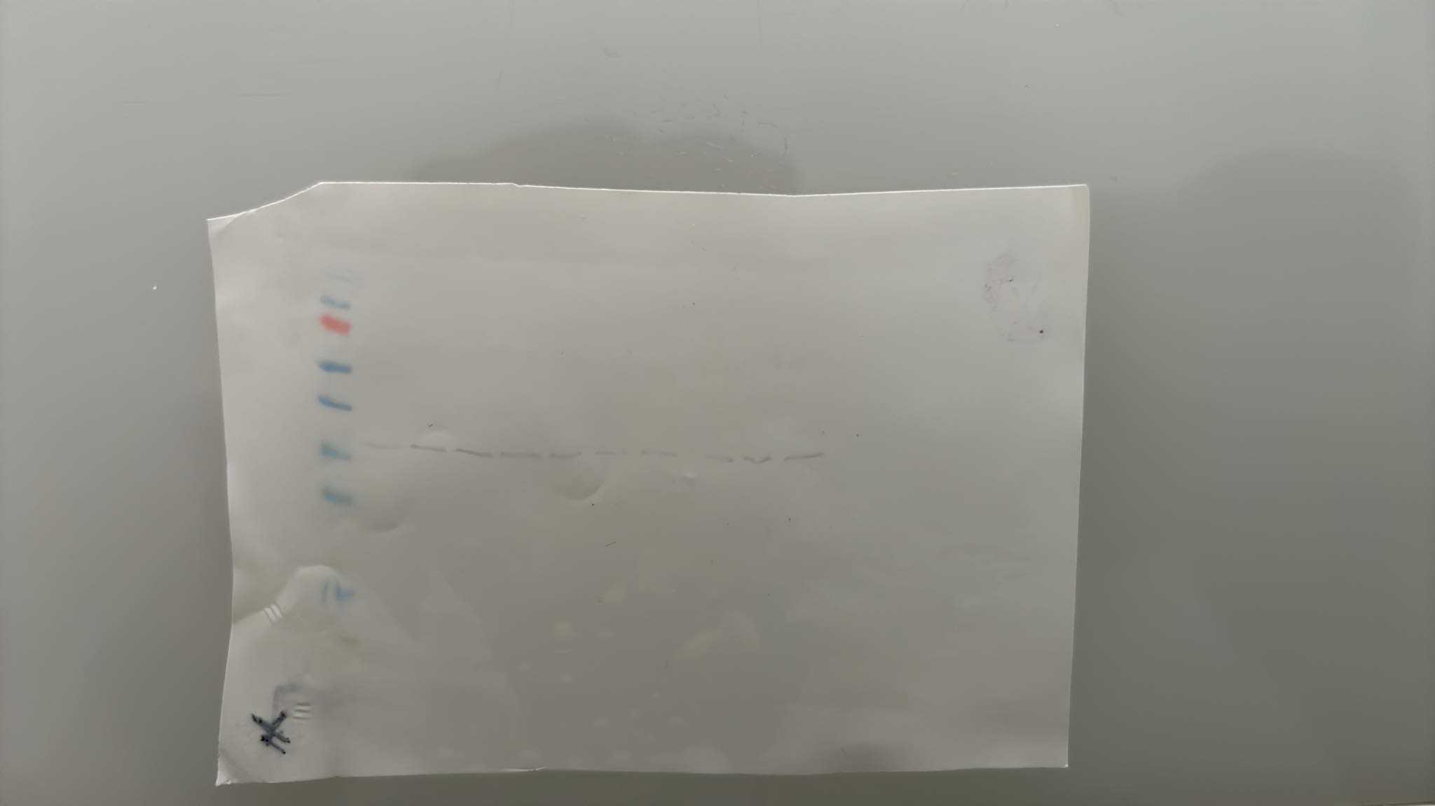
Experiment 2
KDa
170
130
100
42
43
44
45
46
47
48
49
50
51
52

Slide 12
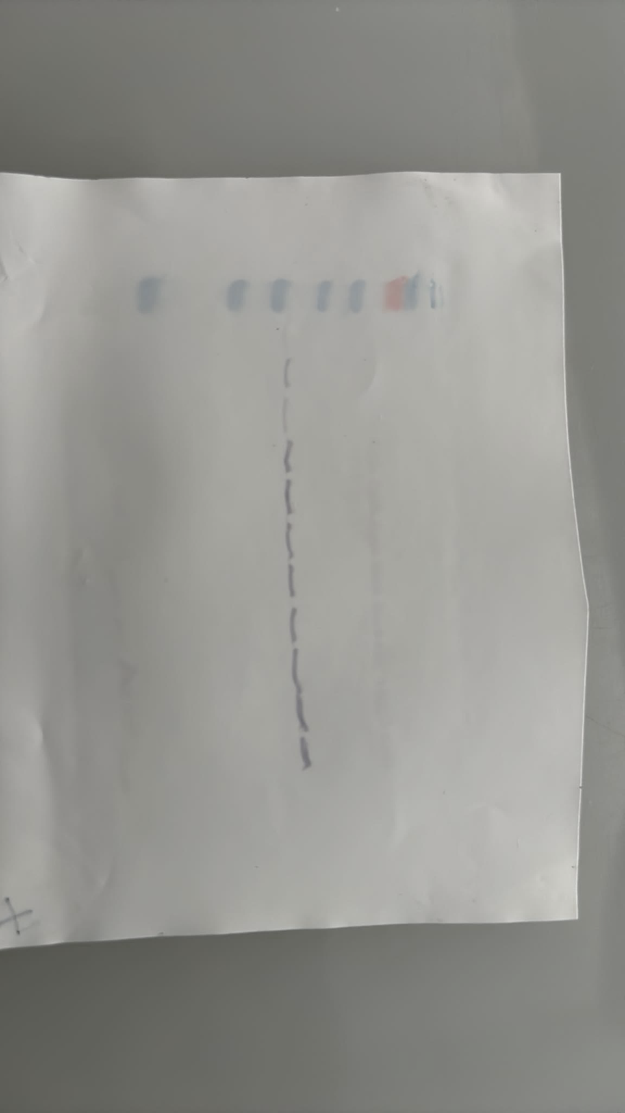
Experiment 3
KDa
170
130
100
42
43
44
45
46
47
48
49
50
51
52

