Slide 1
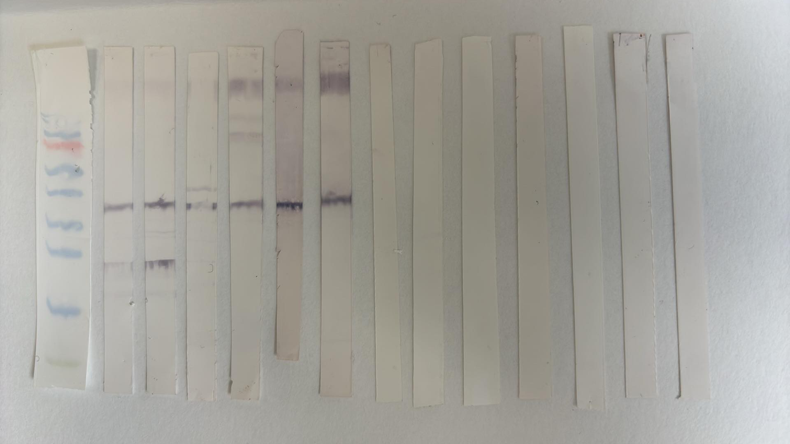
rMafA antisera against OM P9-17 strain
rMafA 2/3
Controls
Zw 3-14 micelles + MPLA
Zw 3-14 micelles + MPLA
Zw 3-14 micelles
Liposomes + MPLA
Zw 314 micelles
Liposomes + MPLA
Liposomes
Liposomes
Size (kDa)
Saline
Alum
Saline
Alum
NMS
170
130
100
70
55
45
35
25
15
10

Slide 2
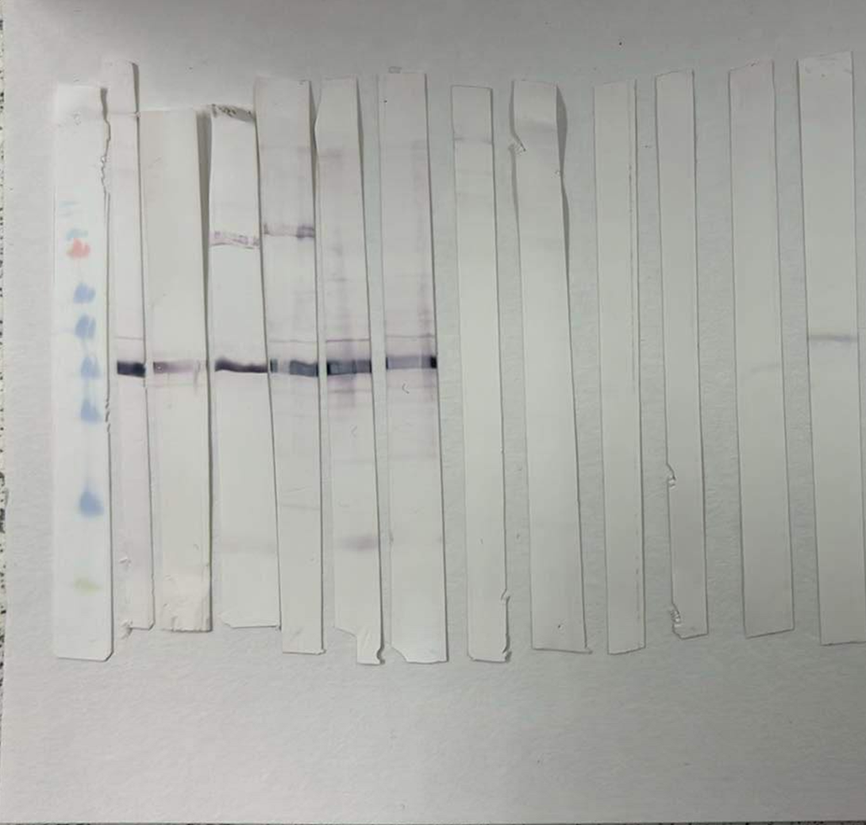
rMafA 2/3
Controls
rMafA antisera againstFA1090
Zw 3-14 micelles + MPLA
Zw 3-14 micelles + MPLA
Liposomes + MPLA
Zw 3-14 micelles
Liposomes + MPLA
Zw 314 micelles
Liposomes
Liposomes
Size (kDa)
Saline
Alum
Saline
Alum
170
130
100
70
55
45
35
25
15
10

Slide 3
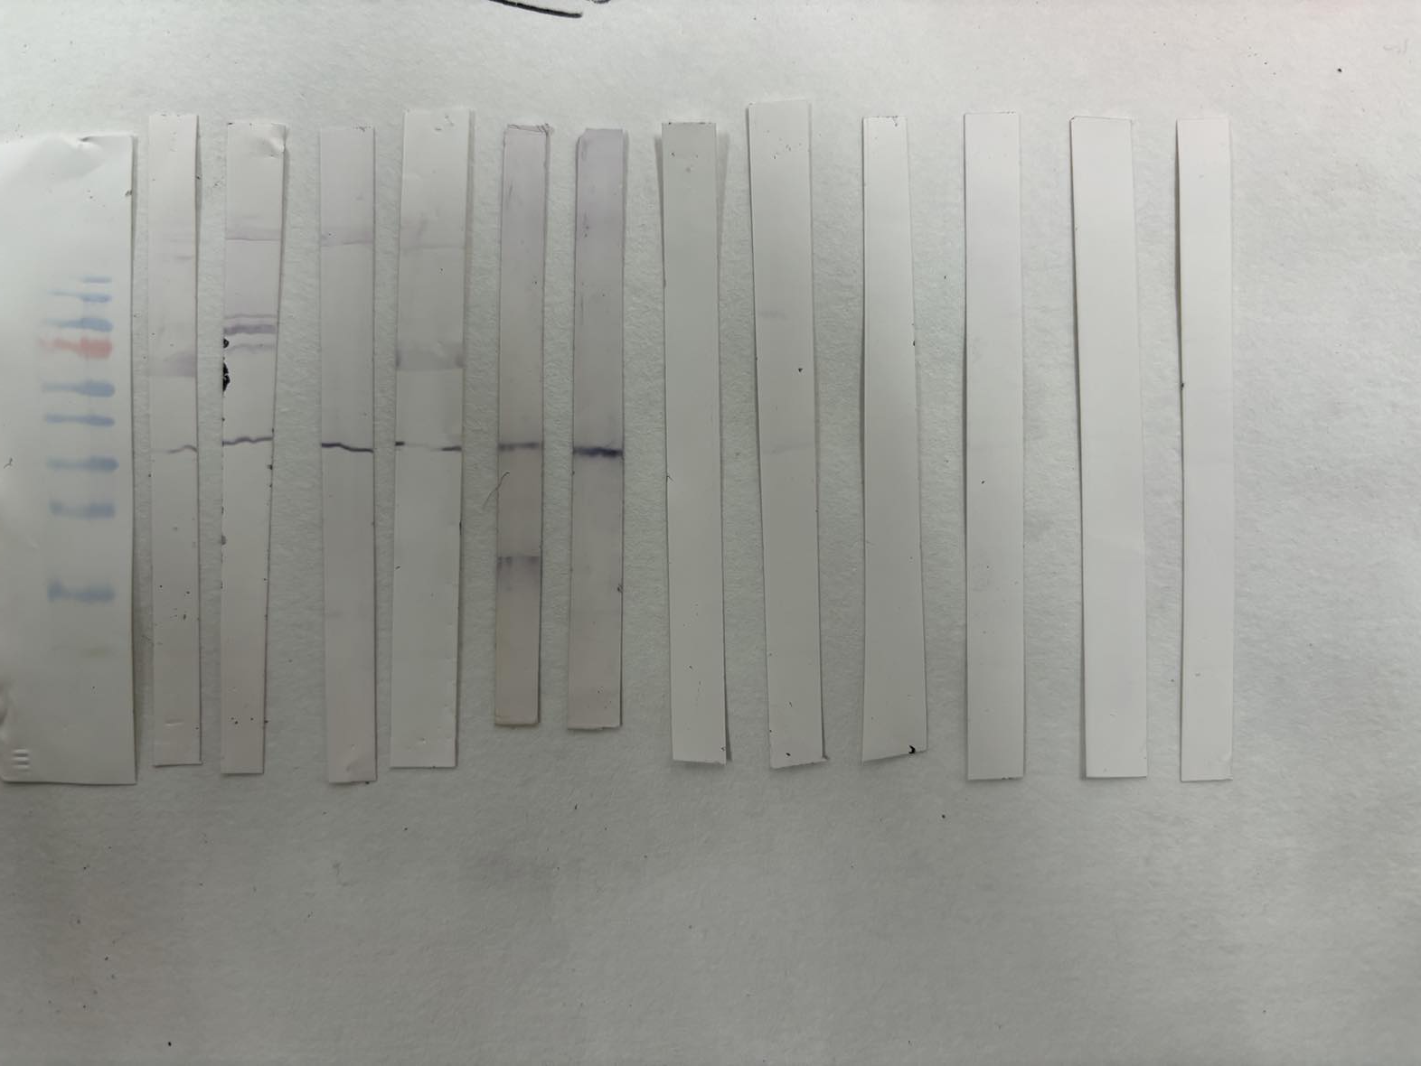
rMafA antisera against A205
rMafA 2/3
Controls
Zw 3-14 micelles + MPLA
Zw 3-14 micelles + MPLA
Zw 3-14 micelles
Liposomes + MPLA
Zw 314 micelles
Liposomes + MPLA
Alum
Liposomes
Liposomes
Saline
Saline
Alum
Size (kDa)
170
130
100
70
55
45
35
25
15
10

