Slide 1


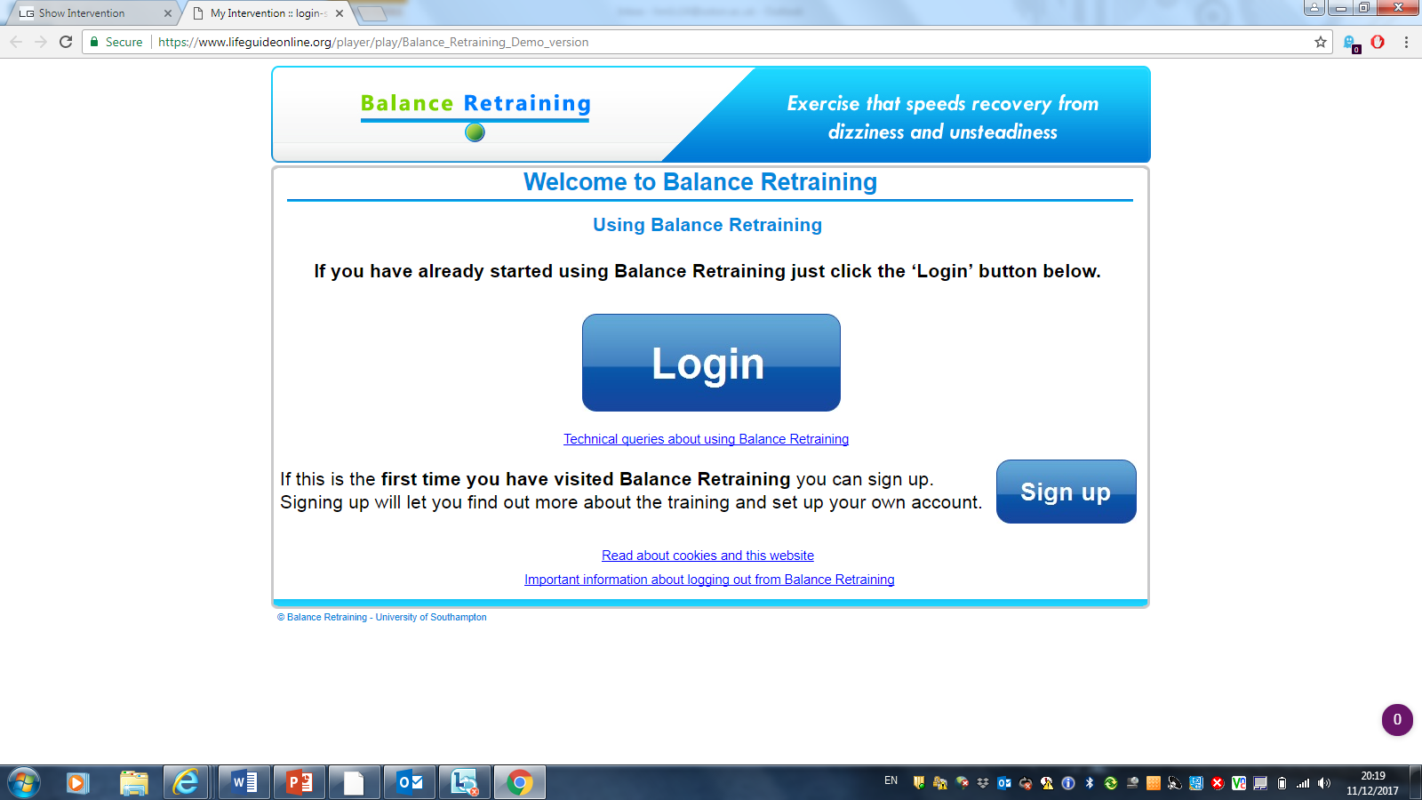

Designing a web-based intervention to retrain balance following traumatic brain injury
Hannah Marshall^{1,2} Dr Ann-Marie Hughes¹, Dr Juliette Truman¹, Prof Jane Burridge¹
¹ University of Southampton, Southampton, United Kingdom. ² Academic Department for Defence Rehabilitation, Epsom, United Kingdom.
Introduction
Traumatic Brain Injury (TBI) is the leading cause of death and disability in young people (¹Basso et al. 2007). Due to the demographic of military personnel and the tasks they undertake, TBI is the most common neurological injury managed at the Defence Medical Rehabilitation Centre (DMRC), accounting for approximately 80% of referrals to the Neurological Rehabilitation Team (NRT) (²Dharm-Datta et al. 2015).
Balance problems are often associated with TBI (³Jourdan et al. 2016). ‘Balance Retraining’, a web-supported programme, assists people to overcome balance problems and symptoms of dizziness (⁴Essery et al. 2015, ⁵Geraghty et al. 2017), but it has not been designed for use by people with TBI who have cognitive, behavioural and executive function difficulties. Gaining an understanding of the target population is vital to create an intervention that is accessible to people with TBI.
Add images/tables/figures
Fig 2. Example page from ‘Balance Retraining’
Aim
Using the person-based approach to create an online balance training programme for military TBI patients.
Participants
Focus groups: 6-8 Participants
Healthcare professionals working at the DMRC NRT with at least one year experience of working with TBI. These may include: physiotherapists, occupational therapists, speech and language therapists, neuro-psychologists and assistants, doctors, nurses and exercise rehabilitation instructors.
Think-aloud studies: 8 participants, including at least 3 with cognitive or executive function impairment.
Inclusion Criteria:
A patient of the DMRC NRT with diagnosis of TBI at least 4 weeks post-injury.
Balance or dizziness symptoms secondary to TBI.
Cognitive ability to understand and follow written/verbal instruction as determined.
Exclusion criteria:
Patients deemed unfit to participate on medical grounds by their rehabilitation consultant.
Patients iunable to use a computer, even with supervision of carers. Decision on ability will be made by the therapist selecting patients for the study.
Consent not given for video or audio recording.
Add images/tables/figures
Fig 1. Front page of ‘Balance Retraining’ Login
Method
Focus groups (FGs) will be conducted with healthcare professionals to identify the barriers and facilitators to improving balance for people with TBI. The FGs will be audio-recorded and transcribed. The data will be used to create new prototype web pages using ‘Balance Retraining’ as a foundation. This prototype intervention will then be presented to participants with TBI in video-recorded think-aloud studies. An iterative process will be used to create an accessible balance training intervention for people with TBI.
Data Analysis
Thematic analysis of the FG and think-aloud studies data set will be carried out and guiding principles for the new intervention will be created (⁶Yardley et al 2015). Immediate feedback from the interviews will be used to make adaptations to the intervention as part of an iterative process. Together with the data set this feedback, using the guiding principles, will be used to create the new intervention.
Further Work
A prospective study will be required to determine the safety and feasibility of the programme within a range of rehabilitation settings.
References
1. Basso et al. (2007) Neurological-disorders: Public Health Challenges. Chapter 3: Traumatic brain injuries. IN: WHO.
2. Dharm-Datta et al. (2015) Successful outcomes following neurorehabilitation in military traumatic brain injury patients in the United Kingdom. J Trauma Acute Care Surg 79(4 Suppl 2): S197-S203
3. Jourdan et al. (2016) A comprehensive picture of 4-year outcome of severe brain injuries. Results from the PariS-TBI study. Ann Phys Rehabil Med 59(2): 100-106
4. Essery et al. (2015) The Development of Balance Retraining: An Online Intervention for Dizziness in Adults Aged 50 Years and Older. Am J Audiol 24(3): 276
5. Geraghty et al. (2017) Internest-based vestibular rehabilitation for older adults with chronic dizziness: A randomised controlled trial. Ann Fam Med 15(3): 209-216
6. Yardley et al. (2015) The person-based approach to intervention development: application to digital health-related behaviour change interventions. J. Med. Internet Res. 17(1): e30

