Slide 1
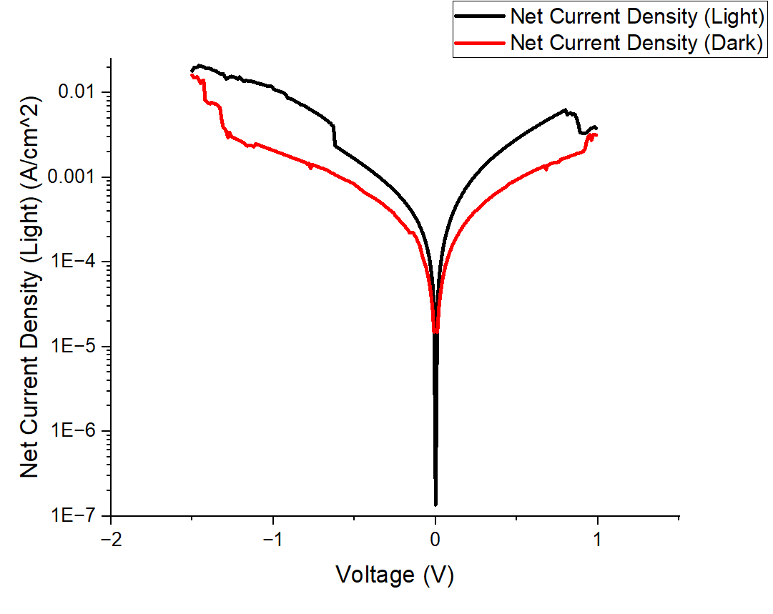
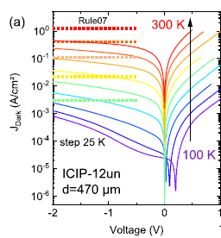
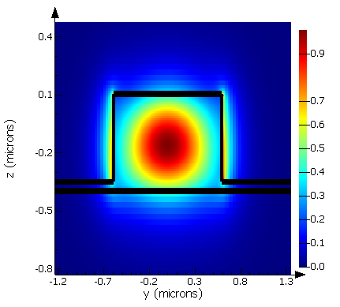
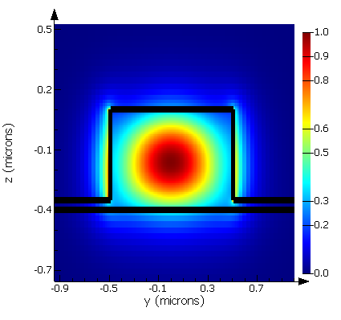
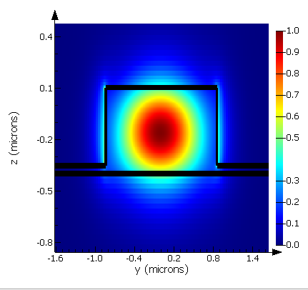
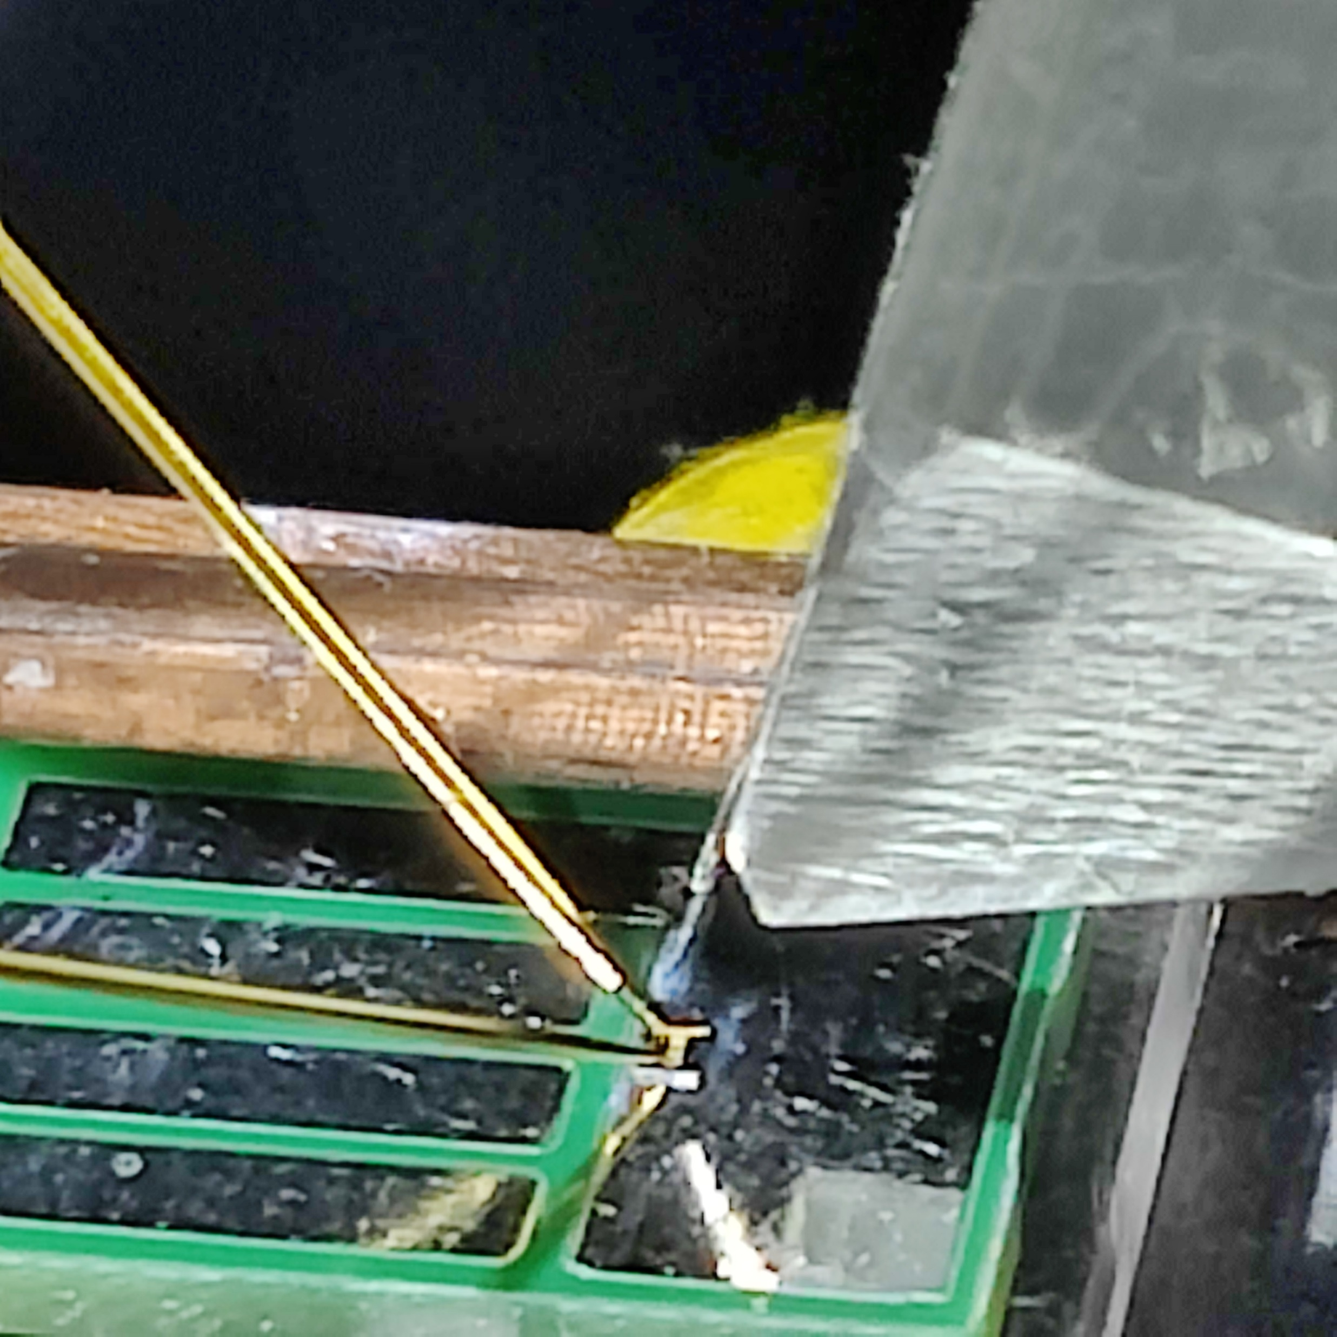
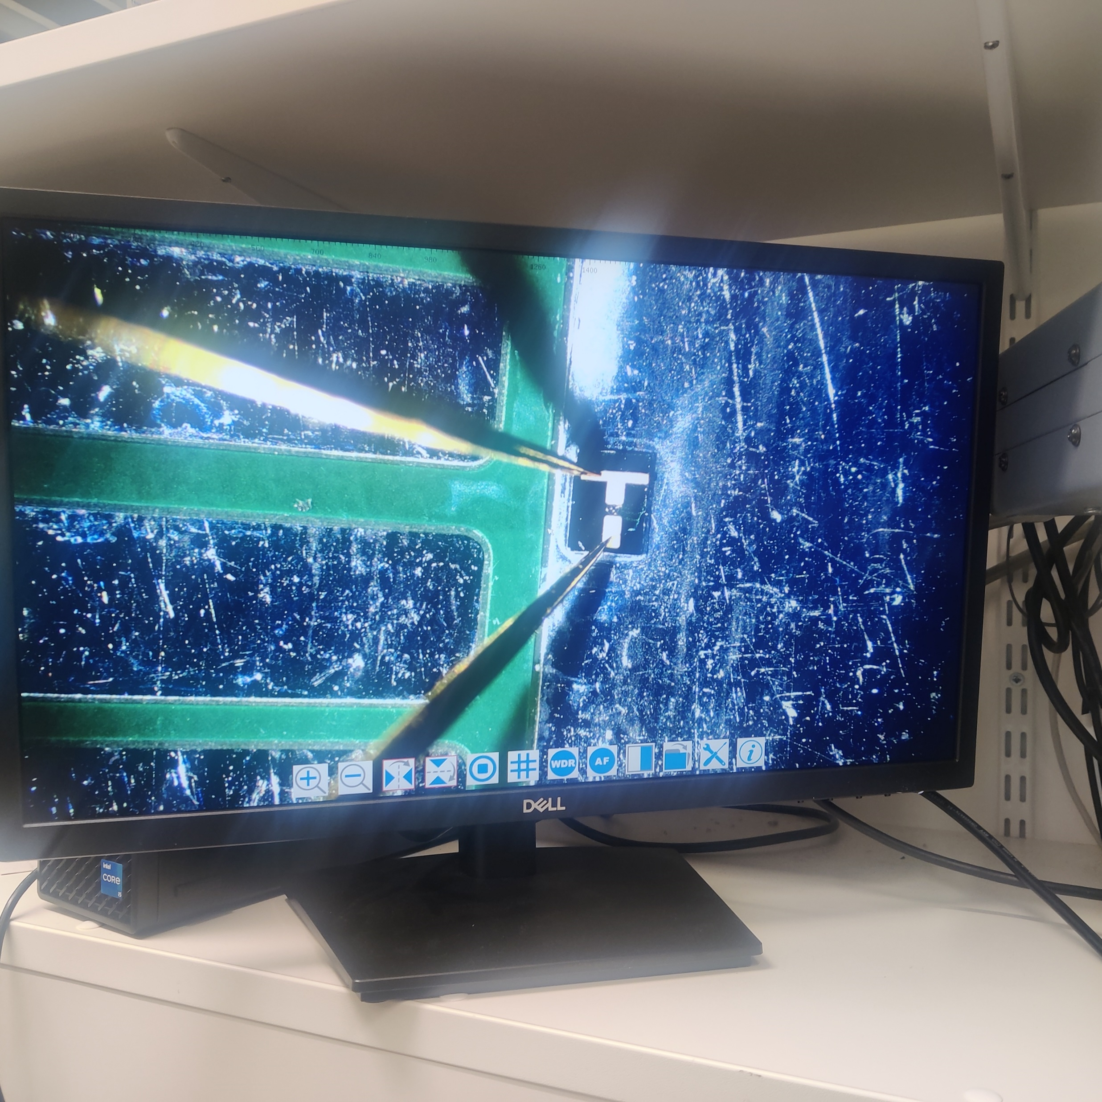
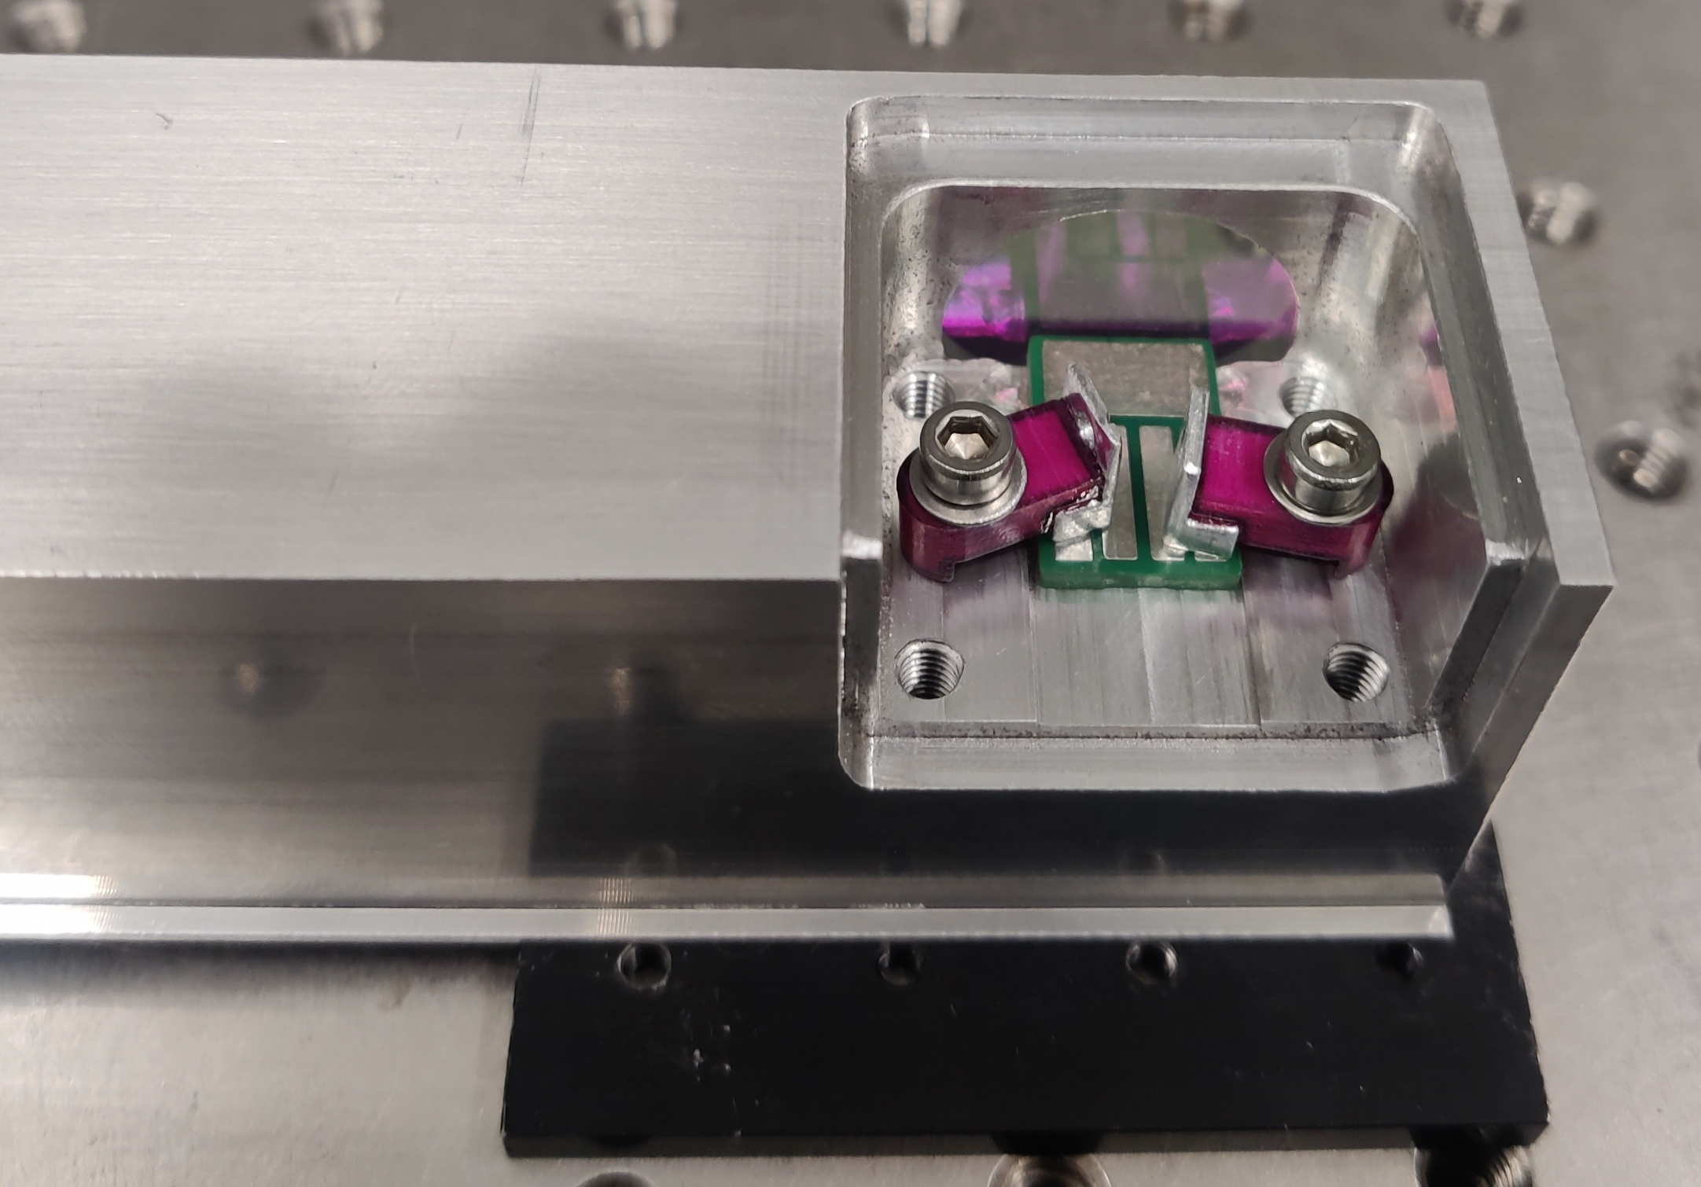
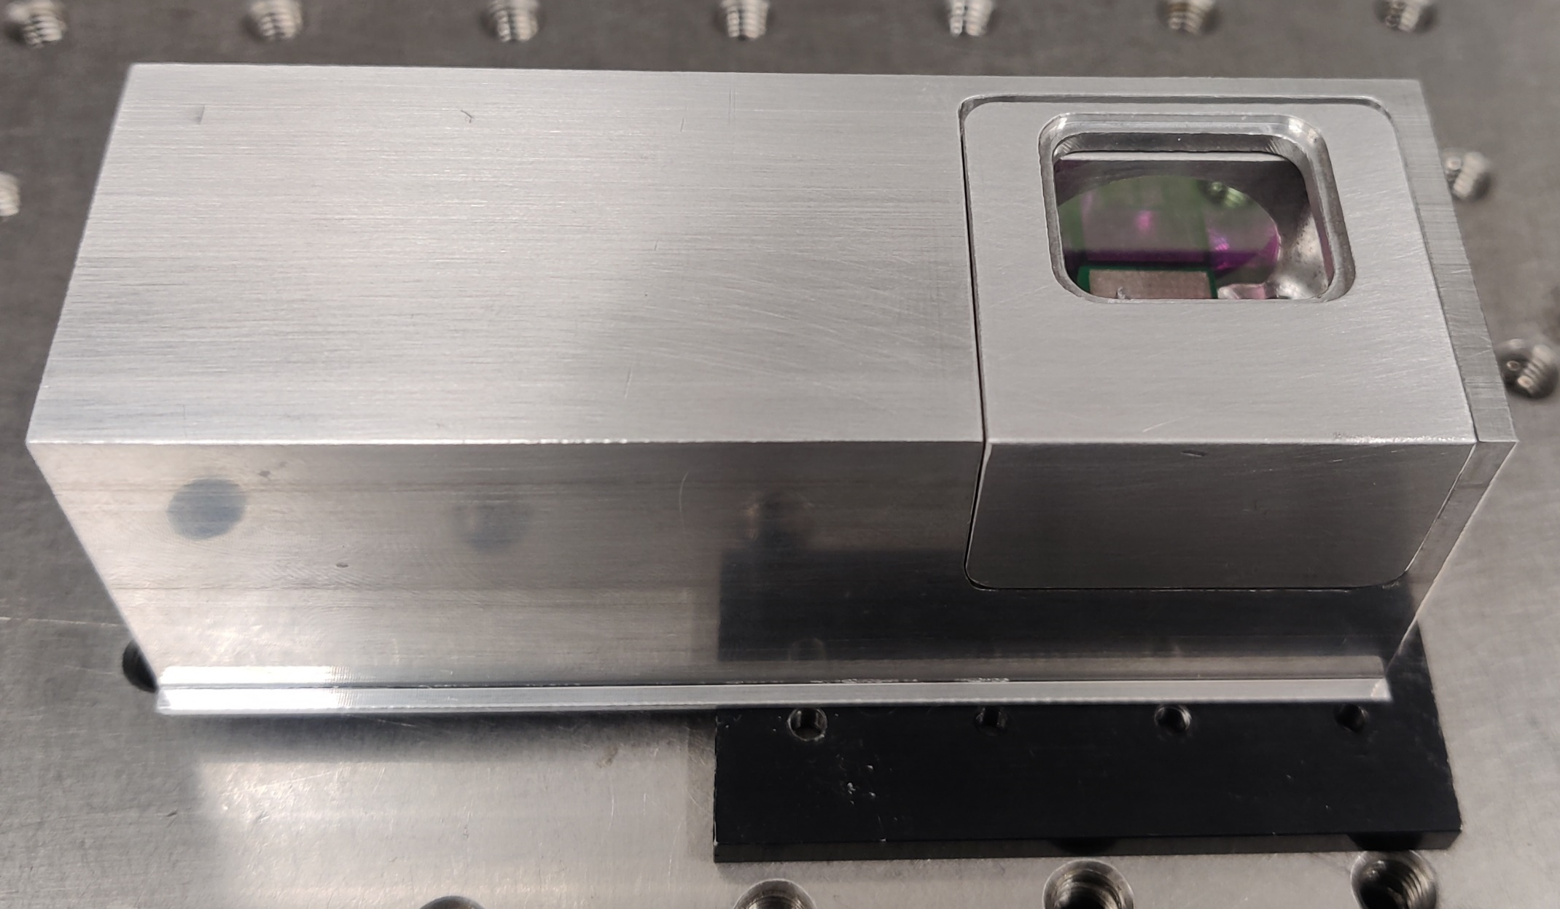






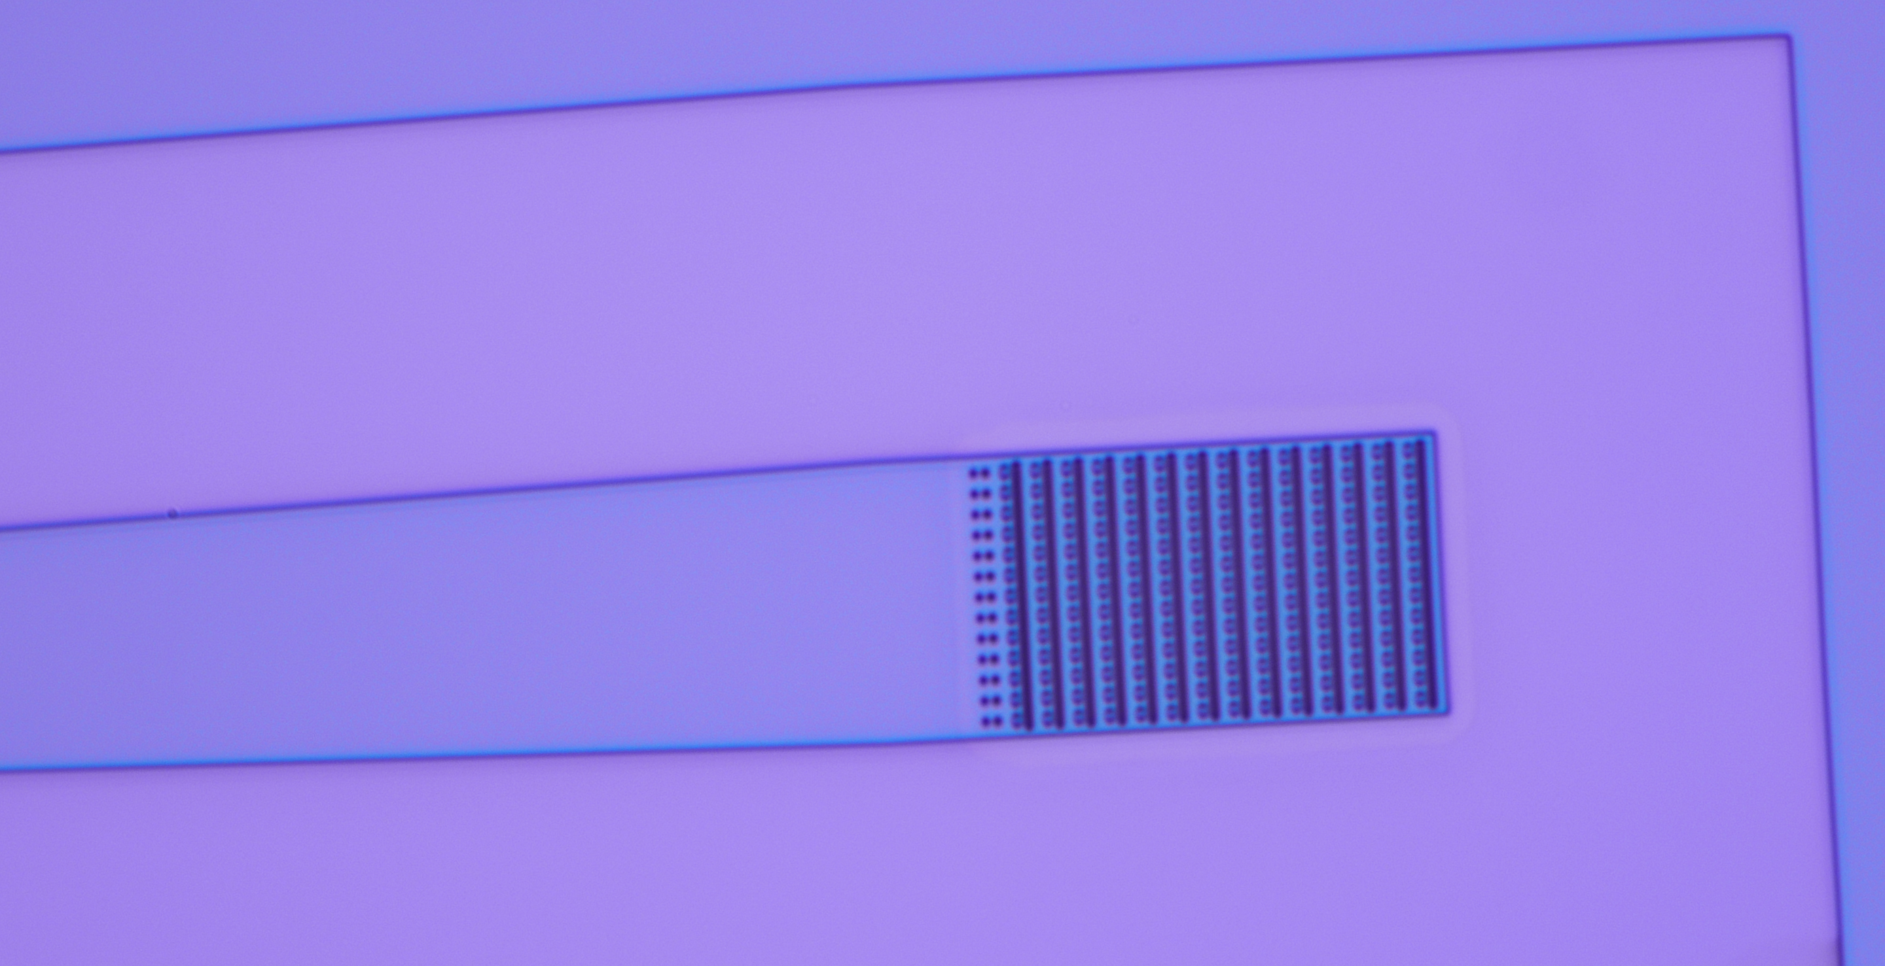


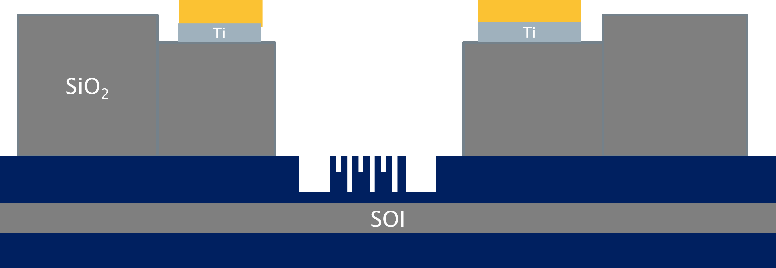
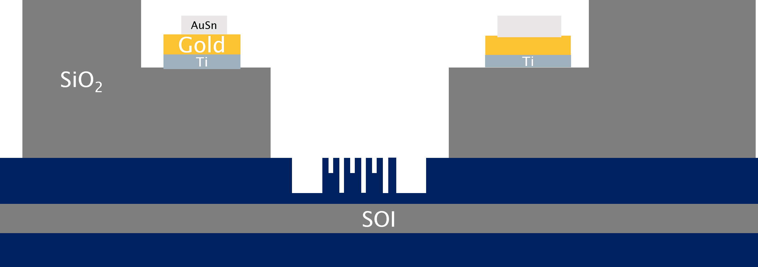
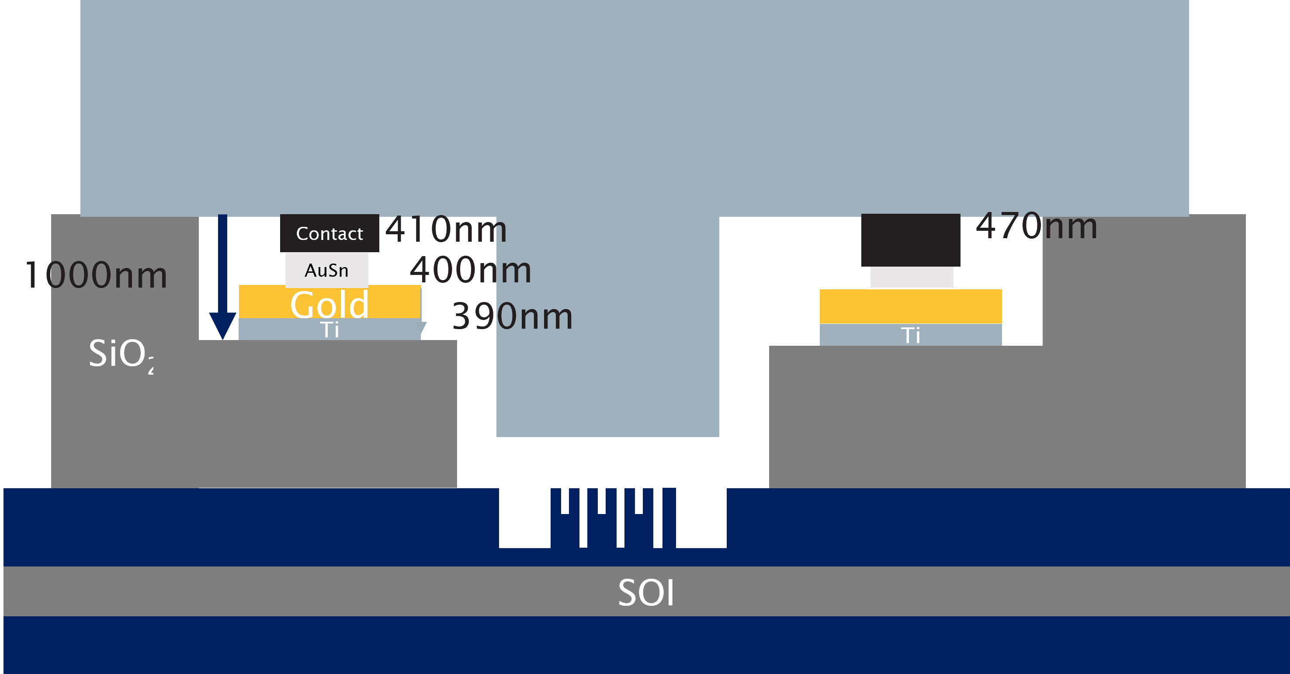


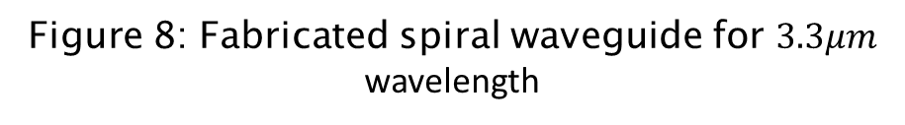
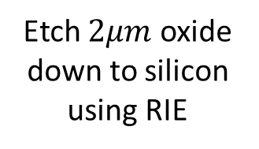

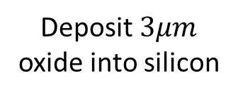

Integration of Interband Cascade Photodetector onto a SOI Platform for Gas Sensing
Daniel Adeyemi¹, Milos Nedeljkovic¹, Goran Mashanovich¹, Colin Mitchell¹
¹Optoelectronics Research Centre, University of Southampton, University Road, Southampton, Hampshire SO17 1BJ, UK
Abstract
Detector
Optical gas sensors have been useful for industries such as mining, medicine as they allow for highly sensitive measurements.
We have developed a methodology to integrate a 12-stage ICIP (interband cascade infrared photodetector) onto an SOI chip of the purpose of achieving an on-chip, laser and detector integrated sensor. We have utilised 8-inch SOI wafers for this structure.
Sensing will exploit absorption spectroscopy and measure the change in output power upon interaction with the target gas. For this design we optimised our waveguides for the minimal loss without cladding to improve interaction between the gas and the mode of the LASER.
These waveguides are designed for three wavelengths, $3.3 μm$, $3.8 μm$, $4.3μm$. The result of these simulations is shown in figures 1, 2 and 3.. The chip contains spiral waveguides of lengths 5mm, 1cm and 4cm, as well as innovative grating structures.
The 12 stage ICIP is sourced from Würzburg University. It has excellent room temperature performance making it ideal for use in sensing system. From pre integration testing we obtained the IV characteristics found in figure 7. This was compared to the IV characteristics recorded in figure 8. We compare the current at 300K.
Figure 1:Simulation of SOI waveguide at 3.3um wavelength.
Figure 2: Simulation of SOI waveguide at 3.8um wavelength.
Figure 3: Simulation Of SOI Waveguide at 4.3um wavelength.
Figure 7: Preintegration measurement of IV characteristics comparing light vs dark currents.
Figure 8: IV characteristics under dark conditions with varying temperature. [1]
Figure 4: Gas Cell without lid.
Figure 5: Gas Cell without lid.
Figure 9: ICIP under test. Two probes are used to contact pads to record current as well as supply voltage.
Figure 10: ICIP under test pictured from top via microscope
Fabrication Process
Starting From SOI Wafer
Deposit 100nm oxide hard mask
Etch 250nm into silicon
Fabrication
Etch $1μm$ oxide into silicon
Deposit $3μm$ oxide into silicon
We have fabricated the waveguides and gratings successfully and are currently fabricating the oxide supports
We expect to complete the integration in July and characterise the both the performance of the detector post-integration.
Figures 11 and 12 are images of the waveguides taken by microscope.
Etch 200nm into silicon
Etch $2μm$ oxide down to silicon using RIE
Deposit Ti then Au to form 390nm layer
Deposit AuSn alloy to form 400nm layer
Figure 7: Fabricated waveguide for $3.8μm$ wavelength
Figure 8: Fabricated spiral waveguide for $3.3μm$ wavelength
Future Work
Once integration is complete, we will create a version 2 of the system utilising detectors with thicker contacts and waveguides designed by our colleagues which will be designed for higher performance as a gas sensor.
References: [1] A. Bader, F. Rothmayr, N. Khan, J. Koeth, F. Hartmann, and S. Höfling, "Detectivity enhancement by double radiation pass in interband cascade infrared photodetectors," Applied Physics Letters, vol. 123, no. 14, 2023, doi: 10.1063/5.0165187.
Figure 6: Schematic of the photodetector integration

